Slide 1
Session VI: Reviewing the Death Certificate

Slide 2
Specific Objectives:
At the end of the session, the participants will be able to:
Properly review a certificate of Death based on the Completeness, Correctness, Consistency and Clarity of data/information as requirements for review.
Verify data by courageously calling/ writing the attending physician for correction

Slide 3
The Reviewer must check
the information regarding the IDENTITY of the deceased
all required (blanks) information are provided/ filled out. Don’t leave blanks. Put “N/A” if necessary
Cause of Death properly written out (not mode of dying, correct sequence of events)
the COD if legibly written

Slide 4
The Reviewer must check
The back page of DC for postmortem certification of death in cases of medico-legal cases.
Similarly, the certification of embalmer must always be filled out and signed by the embalmer.

Slide 5
REMEMBER
Finally, take note that you are reviewing a legal (transactional) document; therefore, you MUST AFFIX your OFFICIAL SIGNATURE (NOT INITIALS).

Slide 6
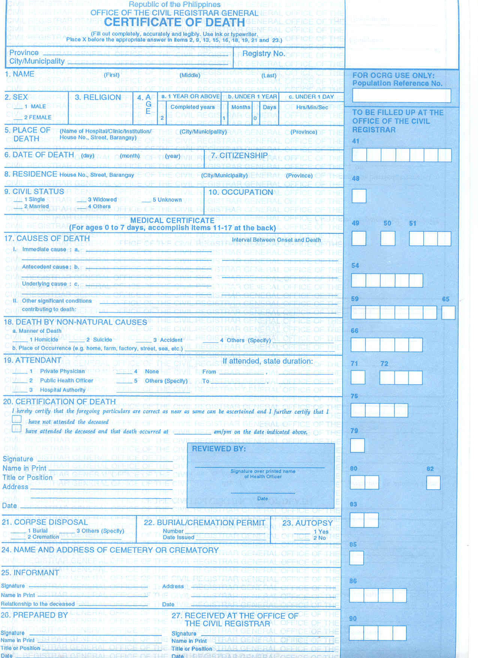
Revised 1993

Slide 7
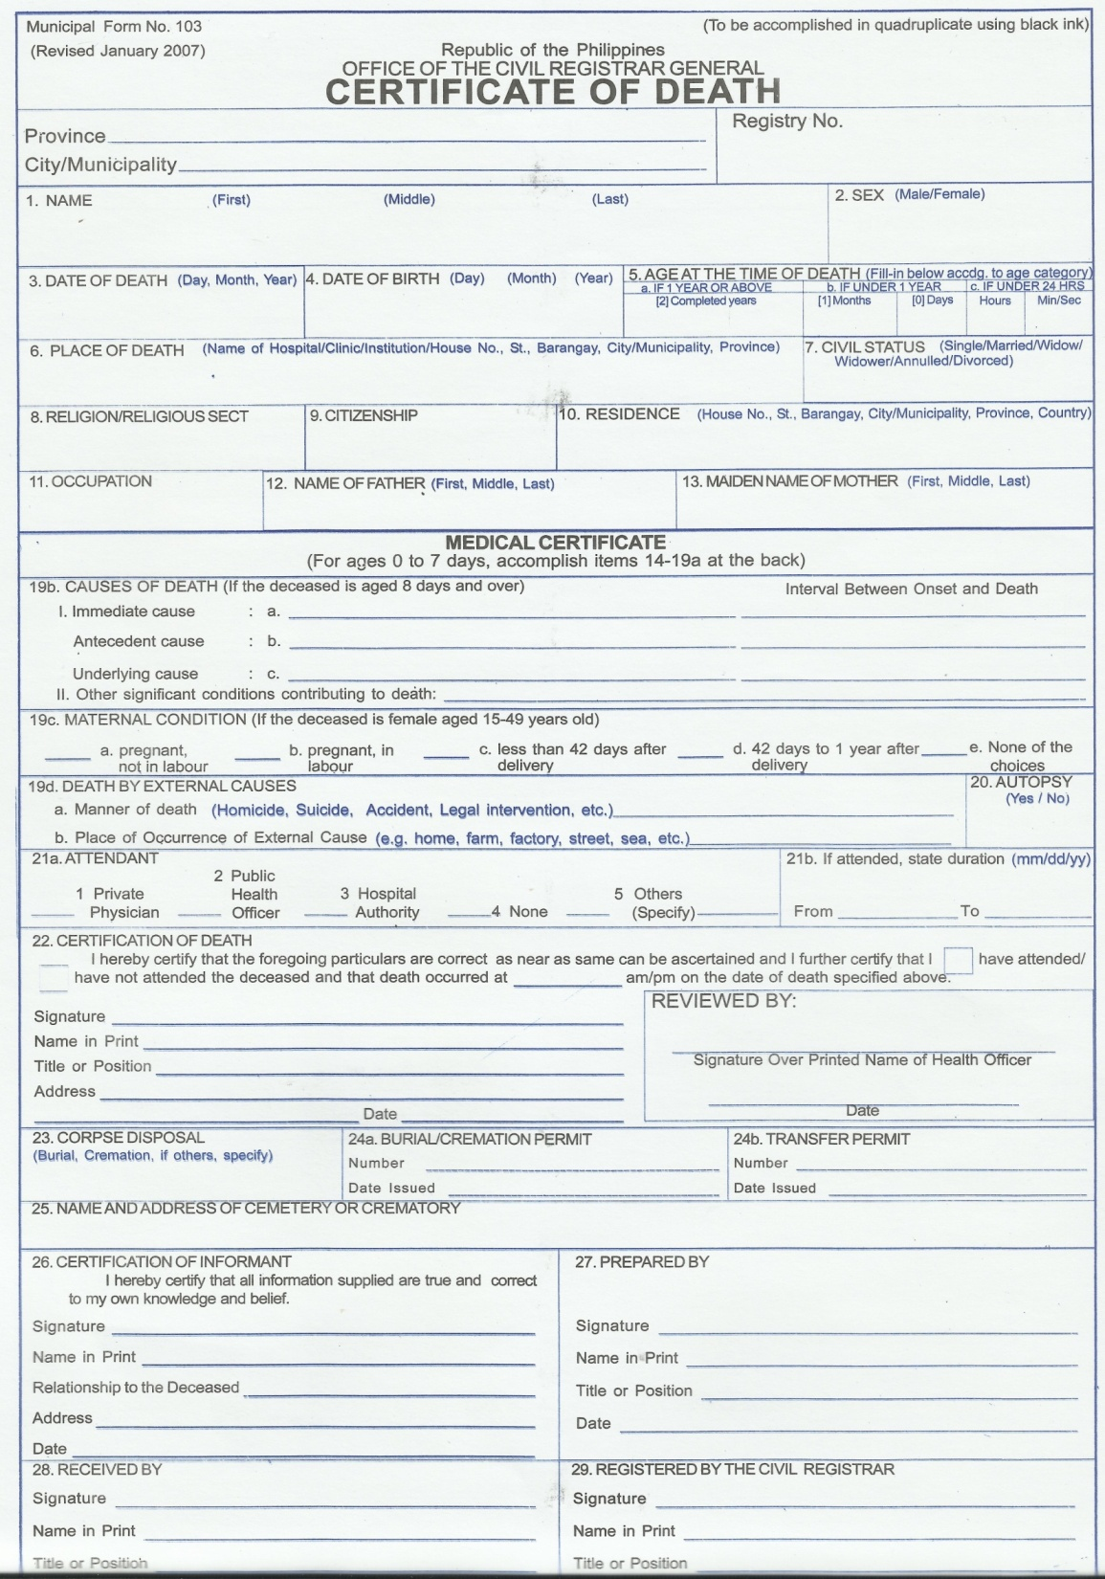
Revised 2007

Slide 8
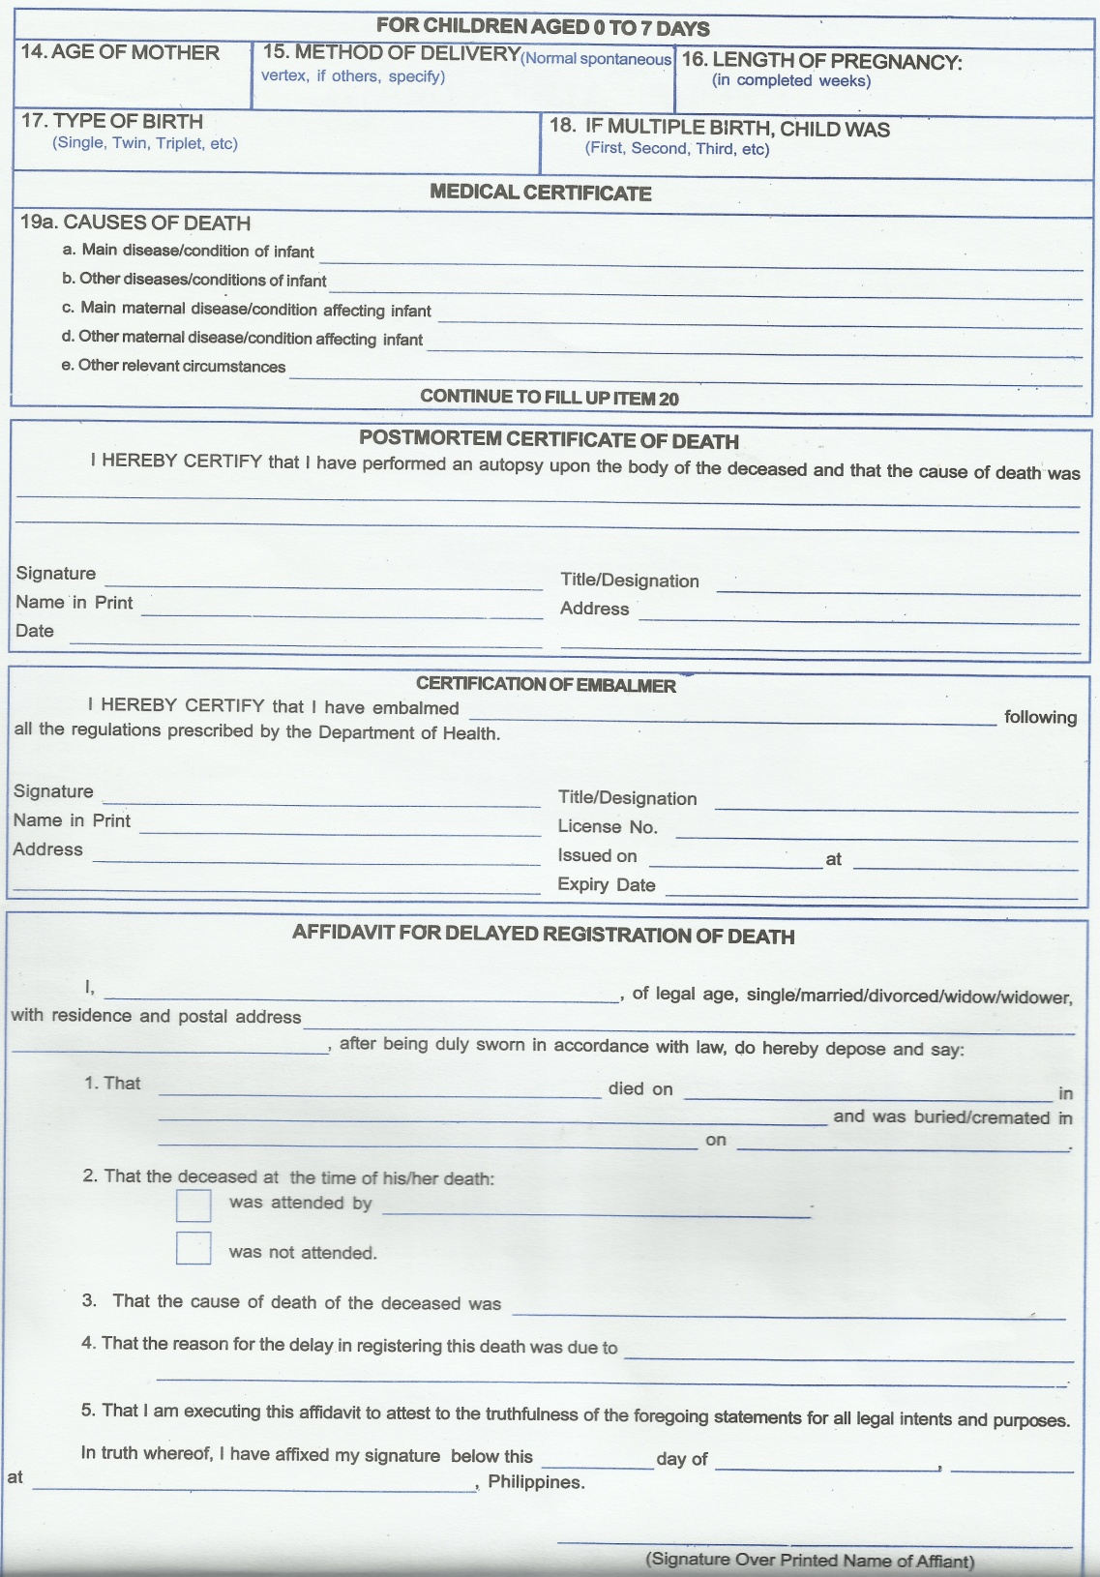
Revised 2007

Slide 9
Instructions for Workshop 2
1, Review the submitted Certificates of Death Spot what is erroneous A. In the Medical Certificate entries B In the rest of the certificate 2. If you were to rewrite A ( the medical certificate entries) how would you do it? 3. What can we do to improve the quality of mortality data of my agency? (Both for the hospital and local health office.) 4. Choose a reporter to present the group's output

Slide 10
THANK YOU
AND
GOD BLESS!

