Slide 1
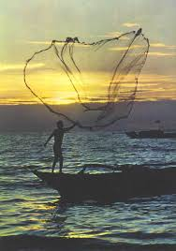
Improving the Vital Statistics of the Philippines is like fishing

Slide 2
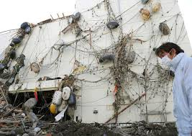
How the current status of the COD in the Philippines looks like

Slide 3
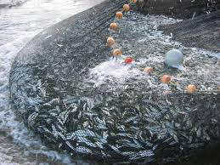
How the status of COD in the Philippines would look like after the trainings

