Slide 1
Basic Training course in the assessment and management of substance abusers for community based health care providers
RAYMUND T. BASBAS,RN,MAN
OIC-CHIEF ADMINISTRATIVE OFFICER
DANGEROUS DRUGS BOARD REPRESENTATIVE
DOH-TRC DAGUPAN

Slide 2
Why?

Slide 3
THIS IS ESSENTIAL TO ENCOURAGE CONVERGENCE OF SERVICES FROM THE PEOPLE AND THE DIFFERENT LINE AGENCIES TO SUPPORT THE REPUBLIC ACT 9165 0THERWISE KNOWN AS THE “COMPREHENSIVE DANGEROUS DRUG ACT OF 2002.” WHICH FOCUS ON THE REALIZATION OF THE NATIONAL VISION OF A DRUG FREE PHILIPPINES.

Slide 4
THIS ACTIVITY WILL ENCOURAGE A COMPREHENSIVE AND INTEGRATED DELIVERY OF SERVICES FROM THE LOCAL GOVERNMENT UNITS (LGUs) AND OTHER LINE AGENCIES FOR DRUG ABUSE PREVENTION,TREATMENT AND REHABILITATION OF A DRUG DEPENDENT FROM DIFFERENT REFERRING MUNICIPALITIES.

Slide 5
GOALS AND OBJECTIVES:
GOALS:
THIS ACTIVITY AIMS TO PROMOTE CONVERGENCE OF SERVICES WITH THE DIFFERENT LINE AGENCIES IN THE IDENTIFICATION AND PROPER CASE MANAGEMENT IN THE TREATMENT AND REHABILITATION OF DRUG DEPENDENTS.

Slide 6
SPECIFIC OBJECTIVES:
DEFINE,UNDERSTAND AND ANALYZE THE SERIOUSNESS OF DRUG ABUSE PROBLEM.
INCREASE ONE’S KNOWLEDGE OF APPROPRIATE PREVENTION AND INTERVENTION OF DRUG DEPENDENTS.
DEFINE THEIR ROLES AND RESPONSIBILITIES IN THE PREVENTION OF DRUG A BUSE ,TREATMENT AND REHABILITAION OF DRUG DEPENDENTS FROM THEIR RESPECTIVE MUNICIPALITY AND CITY.

Slide 7
ASSIST IN THE IDENTIFICATION AND BASELINE DATA GATHERING OF DRUG DEPENDENTS THEIR RESPECTIVE LOCALITY AS BASIS FOR PROGRAM PLANNING OF DRUG TREATMENT AND REHABILITATION CENTER AND THEIR RESPECTIVE MUNICIPALITY.
PROMOTE CONVERGENCE OF SERVICES OF THE DIFFERENT LINE AGENCIES FOR A “DRUG FREE COMMUNITY”….

Slide 8
WORKSHOP/ACTION PLANNING
*ROLES,RESPONSIBILITIES,COMMITMENTS OF EACH HEAD LINE AGENCIES WITH DOH-TRC DAGUPAN IN THE PREVENTION OF DRUG ABUSE, TREATMENT OF DRUG DEPENDENTS,AND THEIR PARTICIPATION ON BASELINE DATA GATHERING OF DRUG DEPENDENTS IN THEIR RESPECTIVE MUNICIPALITY AS BASIS FOR AN EFFECTIVE PROGRAM PLANNING.

Slide 9
EXPECTED OUTPUTS:
AFTER COMPLETION OF A 3 DAYS SEMINAR-WORKSHOP A “CERTIFICATE OF PARTICIPATION” WILL BE GIVEN TO EACH PARTICIPANTS AND WOULD BE EXPECTED FOR AN ACTIVE PARTICIPATION IN THE CONVERGENCE OF SERVICES….

Slide 10
DOH-trc dagupan city

Slide 11
BreIF HISTORY:
OUR TREATMENT AND REHABILITATION CENTER LOCATED IN BONUAN,BINLOC,DAGUPAN CITY PANGASINAN IS THE FIRST GOVERNMENT OWNED DRUG TREATMENT AND REHABILITATION FACILITY,NORTH OF MANILA OPERATED BY THE DEPARTMENT OF HEALTH.THE CENTER OPENED ON DECEMBER 3,2011 AND CATERS TO PATIENTS WITH DRUG PROBLEMS IN THE REGION 1,(PANGASINAN PROVINCES,CORDILLERAS,ILOCOS REGION AND CAGAYAN VALLEY.)

Slide 12
December 3,2011 was directed to open as outpatient service with (10) Nurses, (5) Psychologist, (2) Social Workers, (1) Psychiatrist
August 11,2014 – was Accredited as 300 bed capacity by the Bureau of Health Facilities and Services under Department of Health.
February 26,2015- Formal opening and Inauguration of DOH TRC- Dagupan with Residential ,Aftercare, and OPD Program.

Slide 13
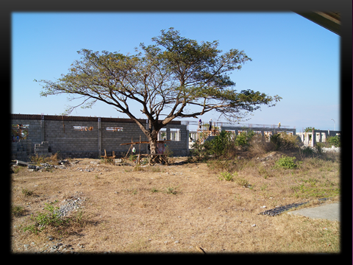

Slide 15
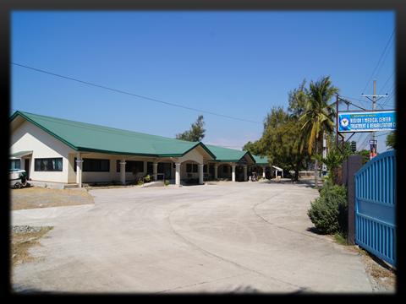

Slide 16
OUR TEAMS:
PSYCHIATRIST
PSYCHOLOGIST
MEDICAL DOCTORS
DENTIST
NURSES
SOCIAL WORKERS
ADMINISTRATIVE OFFICERS

Slide 17
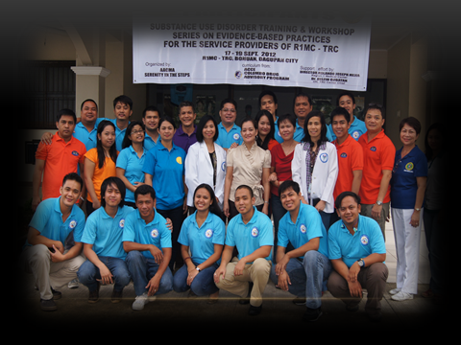

Slide 18
MISSION:
R1MC TREATMENT & REHABILITATION CENTER
OF DAGUPAN CITY,PANGASINAN SHALL PROVIDE
AFFORDABLE QUALITY & SUSTAINABLE REHABILITATIVE SERVICES OF ITS SUBSTANCE ABUSE CLIENTELE REGARDLESS OF SOCIO ECONOMIC
STATUS AND TRANSFORM THEM INTO HEALTHY & PRODUCTIVE INDIVIDUAL ACCEPTABLE TO THE SOCIETY.

Slide 19
VISION:
TO BE A WORLD CLASS FULLY EQUIPPED DOH
TREATMENT & REHABILITATION CENTER OF NORTHERN LUZON.

Slide 20
PROGRAM FOR
DRUG TREATMENT AND REHABILITATION

Slide 21
“IT IS FURTHER DECLARED THAT IT IS THE POLICY OF THE STATE TO PROVIDE EFFECTIVE MECHANISMS OR MEASURES TO RE-INTEGRATE INTO SOCIETY INDIVIDUALS WHO HAVE BEEN VICTIMS OF DRUG ABUSE THROUGH SUSTAINABLE PROGRAMS OF DRUG TREATMENT AND REHABILITATION.”

Slide 22
addiction
-IS A CHRONIC,PROGRESSIVE, RELAPSING CONDITION THAT INVOLVES COMPULSION , LOSS OF CONTROL AND CONTINUED USE DESPITE ADVERSE CONSEQUENCE.

Slide 23
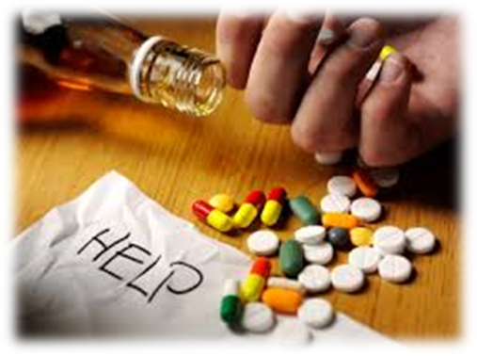
SUBSTANCE USE
-THE USE OF SUBSTANCE TO RELIEVE PAIN OR OTHER SUFFERING AND TO IMPROVE ABNORMAL CONDITION OF MIND AND BODY.
-ALSO REFERS TO INTAKE OF SUBSTANCES THAT ARE BRAIN ALTERING.

Slide 24
Substance abuse
-MALADAPTIVE PATTERN OF SUBSTANCE USE LEADING TO CLINICALLY SIGNIFICANT IMPAIRMENT OR DISTRESS,OCCURS RECURRENTLY IN 12 MONTH PERIOD.
-CONTINUED USE DESPITE PERSISTENT SOCIAL/INTERPERSONAL PROBLEMS.

Slide 25
SUBSTANCE DEPENDENCE
-MALADAPTIVE PATTERN OF USE LEADING TO CLINICALLY SIGNIFICANT IMPAIREMENT OR DISTRESS MANIFESTED BY 3 OR MORE SYMPTOMS WITHIN 12 MONTH PERIOD.
-TOLERANCE
a. need for markedly increased amount of the substance to achieve desired effect or intoxication.
b. markedly diminished effect with continued use of the same amount of substance.

Slide 26
-SUBSTANCE WITHDRAWAL
-The development of a substance-specific syndrome due to cessation or reduction in substance use that has been heavy or prolonged.
-IMPORTANT SOCIAL,OCCUPATIONAL OR RECREATIONAL ACTIVITIES ARE REDUCED OR GIVEN UP BECAUSE OF SUBSTANCE USE.
-PERSISTENT DESIRE TO OR UNSUCCESSFUL EFFORTS TO CUT DOWN OR CONTROL SUBSTANCE USE.

