Slide 1
Newborn Screening Reference Center
National Institutes of Health – Philippines
University of the Philippines Manila
and
Ilocos Training and Regional Medical Center
Department of Pediatrics
NEWBORN SCREENING
CONTINUITY CLINIC
The NBS Long-term Follow-up Program

Slide 2
NEWBORN SCREENING CONTINUITY CLINIC
Refers to an ambulatory clinic based in a Tertiary hospital identified by the Department of Health to be part of the National Comprehensive Newborn Screening System Treatment Network.
It is equipped to facilitate CONTINUITY OF CARE OF CONFIRMED patients in its area of coverage.
*DOH Administrative Order No. 2014-0035

Slide 3
R.A. 9288 Implementing Rules and Regulation
Section 13 – The DOH being the lead agency for implementing the NCNBSS shall:
“Ensure that a network of facilities for referral and management of all positive cases is established.”
“Develop referral centers and identify referral teams in strategic areas for referral and management of patients with any of the disorders.”

Slide 4
Newborn Screening Patient Follow-up
The success of a national program of Newborn Screening is measured not only by the number of babies diagnosed, but more so by the quality of life of these infants.
The National Comprehensive Newborn Screening System (NCNBSS) is a nationwide integrated system that includes the diagnosis and management of babies with positive screens and their follow-up.

Slide 5
Previous Scenario for Long Term Care
The long term care of patients with confirmed diagnosis is the responsibility of the Primary Physician (Pediatrician / Family Physician / General Physician).

Slide 6
There were 2 Major events that pushed the review
of referral flow and long term care of patients
with confirmed diagnosis:
In the 2006 Reunion, some patients had stunting.
Outcome CH Study
Subjects
86 CH patients identified through Newborn Screening between July 1996 – December 2008
Outcome Prevalence (95%)
Poor control of disease 63% (52-73%)
Stunting 24% (15-34%)
Neuro-developmental delay 17% (8-25%)

Slide 7
Establishment of
Newborn Screening Continuity Clinic
SHORT – TERM FOLLOW – UP
(Newborn Screening
Center)
LONG – TERM FOLLOW – UP
(Newborn Screening Continuity Clinic)

Slide 8
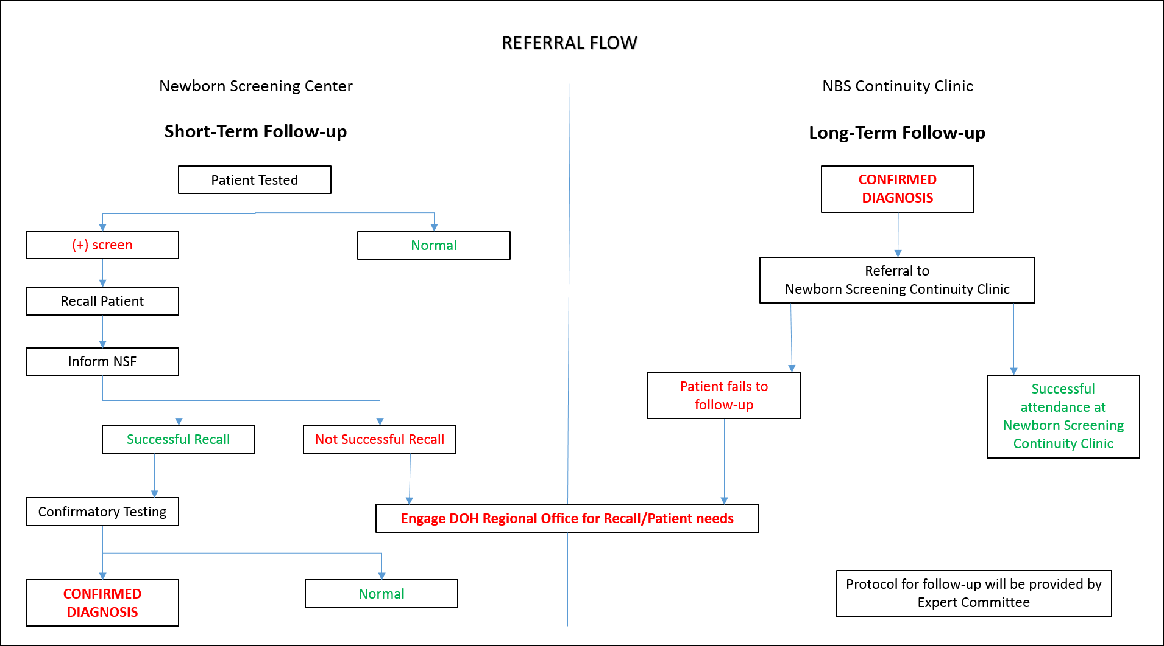

Slide 9
Who Will Man the Newborn Screening Continuity Clinic?
PEDIATRICIAN (Part-time) – Medical Specialist II
NURSE / GENETIC COUNSELOR (Full-time) – Nurse II
Mary Grace M. Padilla, MD, FPPS
Follow up Head
Newborn Screening Continuity Clinic- REGION 1
Vanessa Mabalo, RN
Follow up Nurse
Newborn Screening Continuity Clinic- REGION 1

Slide 10
Pediatrician
Dr. Mary Grace M. Padilla
Follow up Head
Nurse
Ms. Vanessa B. Mabalo
Follow-up Nurse

Slide 11
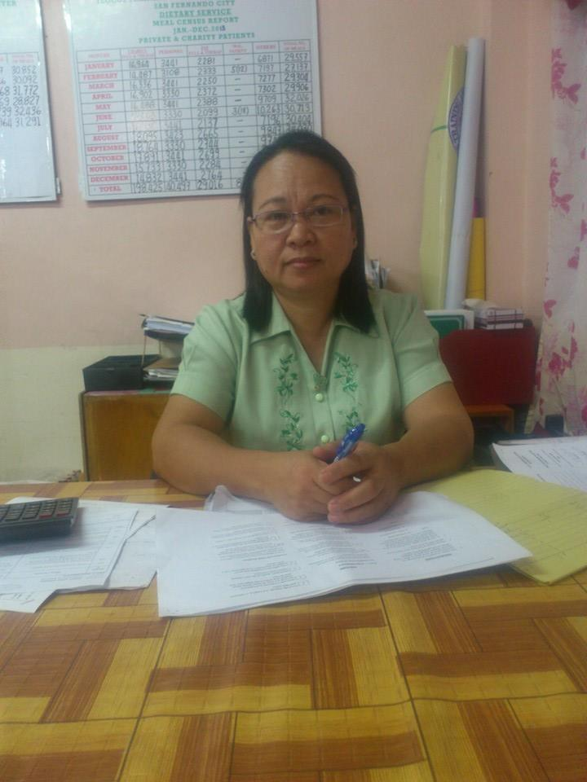
Dietician
Partners in the Program
Mrs. Anabelle N. Rebollido
Nutritionist- Dietitian
DOH NBS Coordinators
Ms. Marie Kris Lacuata
Project Development Officer II
Mr. Adrian Doctolero
Project Development Officer II

Slide 12
NBS Continuity Clinics for Implementation in 2014
1. National Capital Region
2. Cordillera Autonomous Region
3. Western Visayas (West Visayas State University Medical Center, January 13, 2014)
4. CALABARZON (GENERAL EMILIO AGUINALDO MEMORIAL HOSPITAL, JUNE 2014)
5. Davao Region (Southern Philippines Medical Center, February 7, 2014)
6. Central Luzon (Jose B. Lingad Memorial Regional Hospital, February 13, 2014)
7. Ilocos Region (Ilocos Training and Regional Medical Center, February 25, 2014)
8. Cagayan Valley (Cagayan Valley Medical Center, February 25, 2014)
9. NCR, CALABARZON, MIMAROPA (National Institute of Health, UP Manila, March 17, 2014)
10. Bicol Region (Bicol Regional Training and Teaching Hospital, March 21, 2014)
11. Northern Mindanao (Northern Mindanao Medical Center, March 25, 2014)
12. Central Visayas (Vicente Sotto Memorial General Hospital)
13. Eastern Visayas (Eastern Visayas Regional Medical Center)
14. Zamboanga Region (Zamboanga City Medical Center)

Slide 13
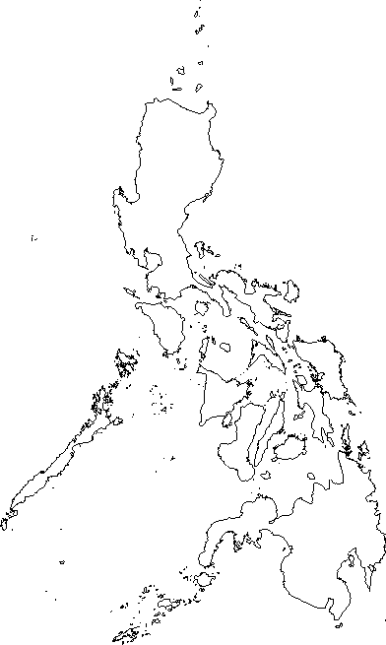
Map of NBS
Continuity Clinics
CAGAYAN
BAGUIO
LA UNION
PAMPANGA
MANILA
CAVITE
ALBAY
LEYTE
ILOILO
CEBU
CAGAYAN DE ORO
ZAMBOANGA
DAVAO
COTABATO

Slide 14
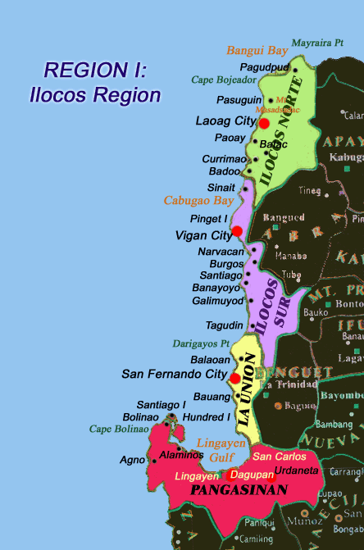

Slide 15
The Clinic covers the whole Region 1
Ilocos Norte
Ilocos Sur
La Union
Pangasinan

Slide 16
Roles and Responsibilities of NBS
Continuity Clinic Team
Patient/Family-Centered Activities (Main)
Encourages family to maintain relationship with Newborn Screening Continuity Clinic and Birth Defects Continuity Clinic to ensure continuous and effective care.
Monitors compliance with treatment (facilitate referral to appropriate sub-specialties, therapies, nutritionists).
Reinforces schedule of follow-up appointments and work-ups by the NSC.
Provides follow-up counseling and anticipatory guidance to the family.
Provides continuing education about the condition to the families and the health professionals.
Set up patient/family support in coordination with NSRC.
Coordinates with CHD in patient recall (lost to follow-up cases).

Slide 17
Newborn Screening Centers
Gives diagnosis, makes proper referral and initiate management for all confirmed NBS patients;
Provides roster of confirmed patients, including their protocols for management and the list of follow-up laboratory procedures, to the NBS Continuity Clinic.

Slide 18
Department of Health Regional Offices
Establishes a mechanism for recall of confirmed patients for referral to experts for management and follow-up care;
Provide Indigency support for confirmatory testing of patients with significantly elevated laboratory results and for the treatment of long-term management of confirmed patients in the region.

Slide 19
Anticipated Referrals
Minimum in-house specialist include:
Neonatologist
Pediatric-Hematologist
Genetic Counselor
Tele-consultation with other specialist:
Geneticist
Pediatric Endocrinologist
Pulmonologist
Etc. as needed

Slide 20
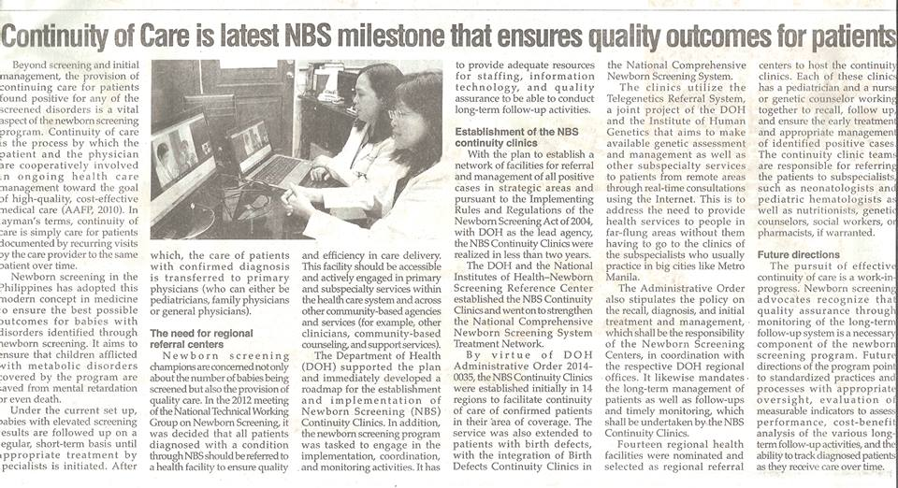
The Philippine STAR
VOL. XXIX NO. 112, SUNDAY, NOVEMBER 16, 2014, PAGE 14

Slide 21
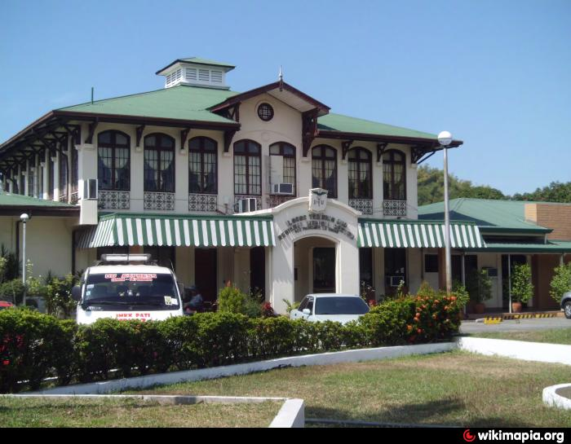
NEWBORN SCREENING CONTINUITY CLINIC
Region 1
Clinic Set-up:
Located:
Ilocos Training and Regional Medical Center
Parian San Fernando La Union

Slide 22
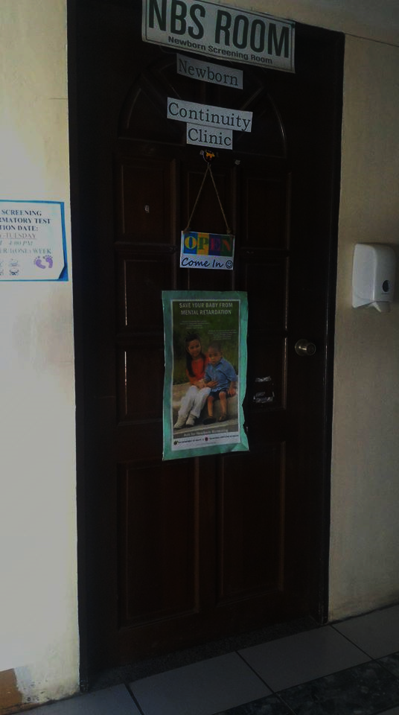
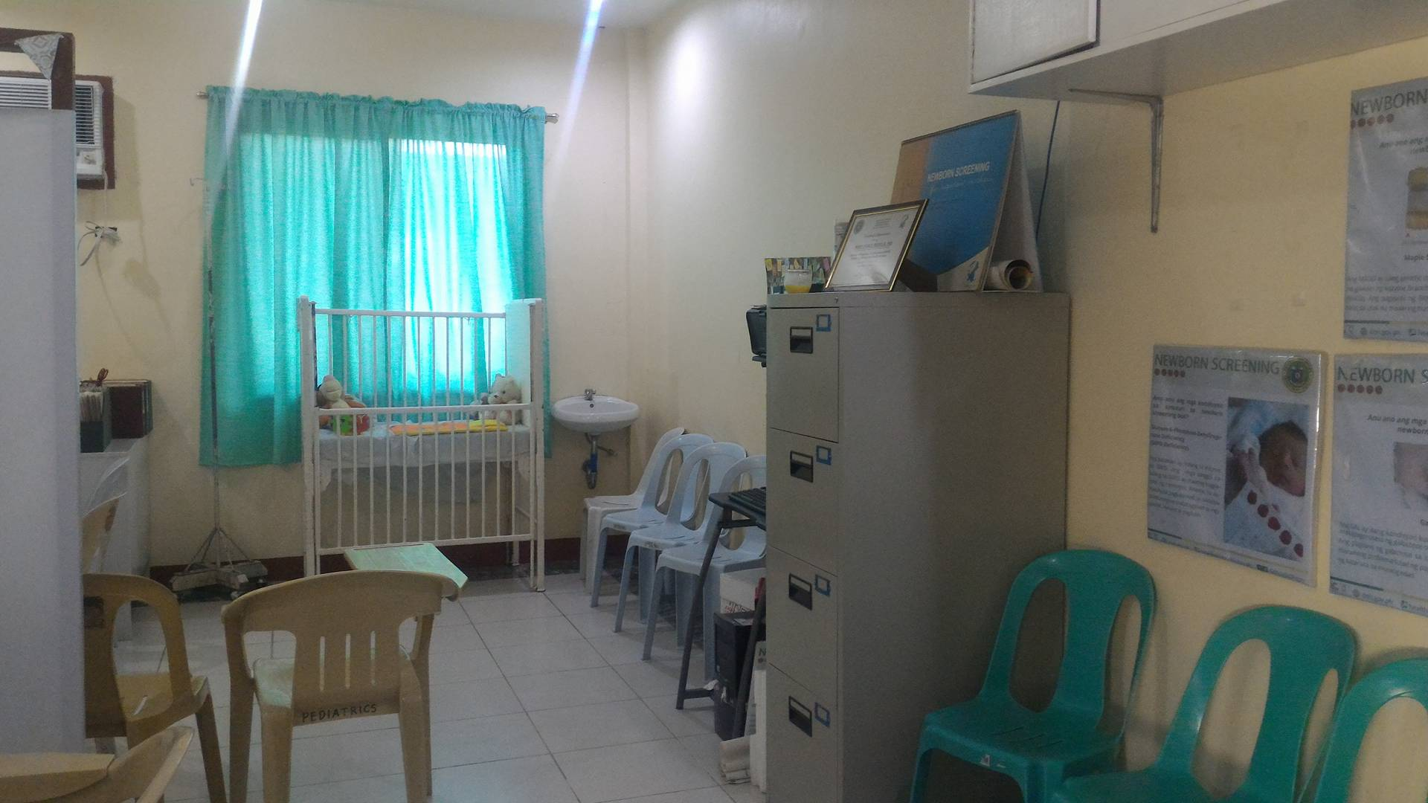
NBS Continuity Clinic
In front of Pedia Conference near NICU

Slide 23
Clinic Schedule
Monday- Friday 8:00am -5: 00 pm
SCHEDULE OF FOLLOW UP CONSULTATIONS
Wednesday 2:00 – 4:00 pm

Slide 24
Census of NBSCC as of April 2016
 | CH | CAH | Galactosemia | PKU | MSUD | ENBS
Ilocos Norte | 4 | 3 | 0 | 0 | 0 | 0
Ilocos Sur | 11 | 5 | 0 | 0 | 0 | 2
La Union | 15 | 1 | 1 | 0 | 0 | 2
Pangasinan | 45 | 4 | 0 | 1 | 0 | 5
No address noted | 2 | 2 | 1 | 1 | 0 | 0
TOTAL | 77 | 15 | 1 | 1 | 0 | 9

Slide 25
Census of NBSCC as of April 2016
Congenital Hypothyroidism
Province | Recalled | Uncompliant/ Unrecalled | Lost to Follow-up
Ilocos Norte | 3 | 1 | 0
Ilocos Sur | 5 | 4 | 2
La Union | 12 | 3 | 0
Pangasinan | 39 | 3 | 2
No address noted |  |  | 2

Slide 26
Census of NBSCC as of April 2016
Congenital Adrenal Hyperplasia
Province | Recalled | Uncompliant | Lost to Follow-up
Ilocos Norte | 0 | 2 | 1
Ilocos Sur | 3 | 0 | 2
La Union | 1 | 0 | 0
Pangasinan | 2 (1 EXPIRED) | 1 | 1
No Address noted | 2 |  | 2

Slide 27
Census of NBSCC as of April 2016
Galactosemia
Province | Recalled | Uncompliant/ Unrecalled | Lost to Follow-up
Ilocos Norte | 0 | 0 | 0
Ilocos Sur | 0 | 0 | 0
La Union | 1 | 0 | 0
Pangasinan | 0 | 0 | 0

Slide 28
Census of NBSCC as of April 2016
Phenylketonuria
Province | Recalled | Uncompliant | Lost to Follow-up
Ilocos Norte | 0 | 0 | 0
Ilocos Sur | 0 | 0 | 0
La Union | 0 | 0 | 0
Pangasinan | 1 | 0 | 0

Slide 29
Census of NBSCC as of April 2016
Expanded Newborn Screening
Province | Recalled | Uncompliant | Lost to Follow-up
Ilocos Norte | 0 | 0 | 0
Ilocos Sur | 1 | 1 | 0
La Union | 2 | 0 | 0
Pangasinan | 4 | 1 | 0

Slide 30
nsrc
THANK YOU
NBSCC Region 1 Contact no. : 09989647665
itrmc.cc@gmail.com

