Slide 1
Importance of Cause of Death Certification in Vital Statistics
Charity L. Tan
Chief, Knowledge Management Division
Department of Health

Slide 2
Session Objectives:
At the end of the session, the participants will be able to:
Describe the key features of the Philippine situation on Certification of Death;
Explain what is Civil Registration and Vital Statistics (CRVS); and
Enumerate the issues and concerns identified during the CRVS assessment done in 2011

Slide 4
Legal and Institutional Framework
As a state policy, the Civil Registration system mandates the basic and compulsory registration of all vital events and the accompanying changes in civil status of every Filipino citizen

Slide 5
Republic Act 7160 (LGC)
Civil registration is a function of the local government through the city/municipal registrar but is under the technical supervision of the Civil Registrar General

Slide 6
What is a Vital Registration System?
Continuous, consistent, complete and accurate reporting of ALL births & deaths, with medical certification of the cause of death, in a defined population
Data on each vital event recorded by functioning registration offices with integrated procedures for medical officers to certify the causes death

Slide 7
What is a Vital Registration System?
Individual data collated (and used) at municipal, provincial and national (and international) level
Establishes FACT of birth/marriage/ death and CAUSEs of death

Slide 8
Importance of Vital registration
It is the continuous and primary source of public health information on births and causes of deaths infant and maternal especially for planning and program management to achieve better population health outcomes

Slide 9
It is the
Gold Standard
of Health Information

Slide 10
Use of vital statistics in the health sector (1)
Data on prevalence and distribution of mortality by cause
Identification of health inequalities
Establishment of priorities, monitoring of trends and evaluation of the impact and effectiveness of health programmes
Notes:
10

Slide 11
Use of vital statistics in the health sector (1)
Assessment of health system performance
Tracking national strategies such as health-sector reform, poverty reduction and development efforts
Measuring baseline levels and monitoring progress towards goals, such as the Millennium Development Goals (MDGs)
Understanding emerging health challenges, e.g. noncommunicable diseases, injuries, HIV/AIDS

Slide 12
Globally, common problems with Vital Statistics
Data are not readily available
Poor communication channels or collaboration between the different authorities responsible
Low emphasis on death certification
Low quality of data (lack of standards, checking procedures, training of registrars and doctors, coders)

Slide 13
Globally, common problems with Vital Statistics
Lack of investments (weak infrastructure, lack of manpower, etc)
Little use made of the data in countries

Slide 14
Globally, common problems with death statistics
Inaccurate cause of death specified on the death certificate
High proportion of ill-defined deaths
Confusion between immediate, antecedent and underlying cause of death

Slide 15
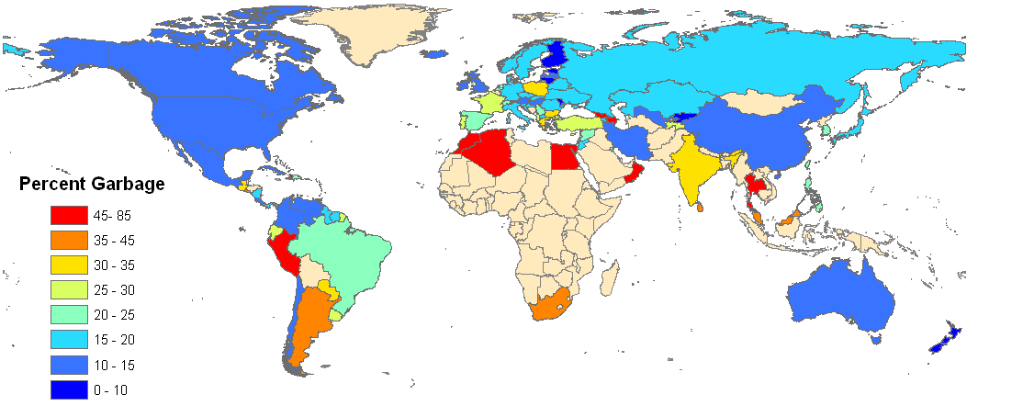
Fraction of deaths assigned to “garbage codes”, latest ICD-10 year since 2000

Slide 16
10 Leading Causes of Death, 2004
Diseases of the heart (I00-I09, I11, I13, I20-I52)
Diseases of the vascular system (I10,I12,I60-I64,I67..)
Malignant neoplasms (C00-C97)
Accidents** (V01-Y89)
Pneumonia (J12-J18)
Tuberculosis, all forms (A15-A19, B90)
Ill-defined and unknown causes of mortality (R00-R68, R70-R99)
Chronic lower respiratory diseases (J40-J47)
Diabetes mellitus (E10-E14)
Certain conditions originating in the perinatal period (P00-P99)

Slide 17
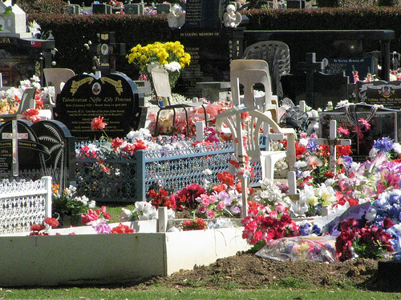
Who is not counted globally?
1 in 3 births – 40 million annually are not registered
2 in 3 deaths – 40 million annually are not registered
85 countries with 66% of the world’s population do not have reliable cause of death statistics
Notes:
MDGs are summary measures of progress but more progress needed on their measurement
Statistical modeling to fill data gaps is a poor guide to action, especially at subnational level
Need to go beyond the numbers to identify causes and solutions
Better health data and stronger health systems are mutually reinforcing

Slide 18
Philippine Setting

Slide 19
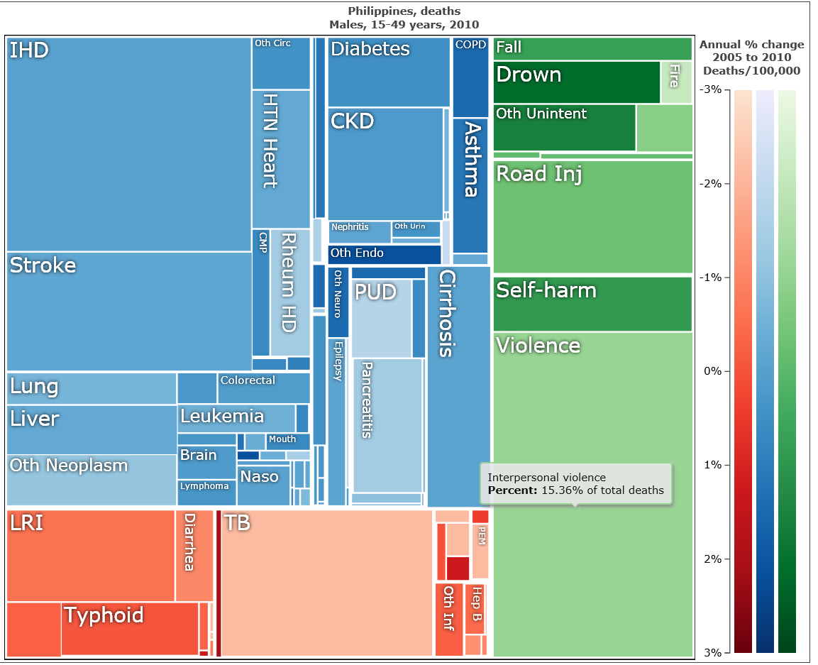
Tree map of Causes of Death for Males aged 15-49 in 2010, Philippines
Notes:
- Leading cause of death is interpersonal violence for males 15-49 in 2010.
Green is the Injury, all causes
Blue is the Non-Communicable
Red is the communicable
Figure 2 illustrates that interpersonal violence was the leading cause of death for men aged 15-49 in the Philippines in 2010, accounting for 15% of all deaths. Ischaemic Heart Disease (IHD) was the second leading cause of death, accounting for 12.5% of all deaths. However, these conclusions about the leading causes of premature death in Philippines are uncertain. One of the benefits of the GBD approach is that it guides countries in carrying out a “data audit” of the availability, reliability and utility of their existing data collections, and highlights critically important investments required to strengthen national health information systems to more reliably monitor national burden of disease patterns.

Slide 21
 | MORTALITY: TEN (10) LEADING CAUSES in the Philippines 5-Year Average (2004-2008) & 2009
 | CAUSES | 5-Year Average (2004-2008) | 2009*
 |  | Rate | Rate
1 | Diseases of the Heart | 94.5 | 109.4
2 | Diseases of the Vascular System | 64.3 | 71.0
3 | Malignant Neoplasms | 49.6 | 51.8
4 | Pneumonia | 41.1 | 46.2
5 | Accidents** | 39.9 | 39.0
6 | Tuberculosis, all forms | 29.2 | 27.6
7 | Chronic lower respiratory diseases | 24.0 | 24.7
8 | Diabetes Mellitus | 22.7 | 24.2
9 | Nephritis, nephrotic syndrome and nephrosis | 13.4 | 15.0
10 | Certain conditions originating in the perinatal period | 14.5 | 12.5
 | Note: Excludes ill-defined and unknown causes of mortality * reference year ** External causes of Mortality

Slide 22
Common Problems of Vital Statistics
Completeness: not all births and deaths are registered
Quality: cause of death coding is very weak
Timeliness: 2010 data available in 2014

Slide 23
Three most common problems with cause of death data
Inaccurate cause of death (especially for chronic diseases, maternal deaths, injuries and violence, older people) specified on the death certificate
High proportion of ill-defined deaths (of absolutely no value for health policies and programs)
Confusion between immediate and underlying cause of death

Slide 24
Problems with the mortality registration of the CRVS in the Philippines
Low emphasis on importance of death certification
Lack of quality checks in the civil registration process (lack of standards in quality assurance, training or coders, doctors and registrars)
Weak infrastructure

Slide 25
Problems with the mortality registration of the CRVS in the Philippines
Poor communication channel or collaboration between the different authorities responsible
Low utilization of vital statistics data

Slide 26
Completeness of Civil Registration
Birth registration – 93% in 2010
Death registration – 66% in 2010
And only 1/3 is medically attended

Slide 27
Issues of Under-registration in the Philippines
Under-registration is not uniform across the country
Usually higher in rural areas, among the poor and for specific events such as Ondoy
Out-of-hospital births and deaths, deaths in first week of life and deaths from certain causes are underreported such as maternal deaths
Late registration is also more common for certain events such as suicides, homicides and accidents

Slide 28
Implication
Non-registration of deaths as well as erroneous information in the registration of deaths may present problems for planning of health services especially among marginal and poverty affected sectors.

Slide 29
Issues in death registration
Determining correct identities of deceased
Determining cause of death
Determining appropriate attending physicians in unusual cases
Obtaining proper signatories for certifications among others
Process of death registration is complicated by the many circumstances of death

Slide 30
What have we done?
Developed long term strategic and investment plans for CRVS
Enhanced collaboration among different agencies involved in CRVS thru fora
Enhance the protocols and standards for CRVS. PSA with DOH is coming up with a handbook on CRVS for health workers
Develop the CRVS training program ie. CRVS Framework, ICD-10, Cause of Death and Verbal Autopsy

Slide 31
Where do we go from here?
Enhance collaboration among different agencies involved in CRVS. A lot still needs to be done.
Capacity building – infrastructure and human resource
Advocate and increase public awareness for the need to register not only birth but also death
Increase capacity of stakeholders to critically analyze and use vital statistics

