Slide 1
MEANING OF LIFE
When God created the dog, He said: "Sit all day by the door of your house and bark at anyone who comes in or walks past.
For this, I will give you a life span of twenty years."
The dog said: "That's a long time to be barking. How about only ten Years and I'll give you back the other ten?"
So God agreed.

Slide 2
Next,
God created the monkey and said: "Entertain people, do tricks, and make them laugh.
For this, I'll give you a twenty-year life span."
The monkey said: "Monkey tricks for twenty years? That's a pretty long time to perform. How about I give you back ten like the Dog did?"
And God agreed.

Slide 3
God then created the cow and said: "You must go into the field with the farmer all day long and suffer under the sun, have calves and give milk to support the farmer's family.
For this, I will give you a life span of sixty years."
The cow said: "That's kind of a tough life you want me to live for sixty years. How about twenty and I'll give back the other forty?"
And God agreed again.

Slide 4
Finally, God created man and said: "Eat, sleep, play, marry and enjoy Your life. For this, I'll give you twenty years."
But man said: "Only twenty years? Could you possibly give me my twenty, the forty the cow gave back, the ten the monkey gave back, and the ten the dog gave back; that makes eighty, okay?"
"Okay," said God, "You asked for it."

Slide 5
So that is why
the first twenty years we eat, sleep, play and enjoy ourselves.
For the next forty years we slave in the sun to support our family.
For the next ten years we do monkey tricks to entertain the grand-children.
And for the last ten years we sit on the front porch and bark at everyone.
Life has now been explained to you!
God may call at any time Make sure you are ready

Slide 6
HYPOTHALAMUS
PITUITARY
End organ
HORMONE

Slide 7
CONGENITAL HYPOTHYROIDISM
WILSON C CUA MD DPPS FPSPME

Slide 8
SIR WILLIAM OSLER 1898
“That we can today rescue children otherwise doomed to helpless idiocy – that we can restore to life the hopeless victims of myxoedema”
“The results as a rule are most astounding – unparalleled by anything in the whole range of curative measures within 6 weeks a poor feeble-minded toad like caricature of humanity may be restore to mental and bodily health”

Slide 9
Congenital Hypothyroidism
Asymptomatic at birth; transplacental transfer of maternal T4 (33%)
NBS: increased TSH and low T4
Incidence worldwide: 1:4000
Girls: Boys ratio of 2:1
Most commonly caused by some form of thyroid dysgenesis, of which ectopic thyroid is most frequent; demonstrable by thyroid scan or through ultrasound (mass at the back of the tongue or middle part of the neck at the hyoid level)

Slide 10
Manifestations of Congenital Hypothyroidism
BW and BL are NL
Prolonged jaundice is the earliest sign; due to delayed maturation of glucuronide conjugation
Feeding difficulties, somnolence, lack of interest, choking spells during nursing; large tongue
Constipation
Umbilical hernia and large abdomen
Sluggish
Cold, mottled skin

Slide 11
Diagnosis
Must be diagnosed early in life before manifestations are evident; by the latest 2 months otherwise physical and mental retardation will occur
At 3-6 months of age the clinical features are evident and permanent
Myxedema and cretinism
EKG

Slide 12
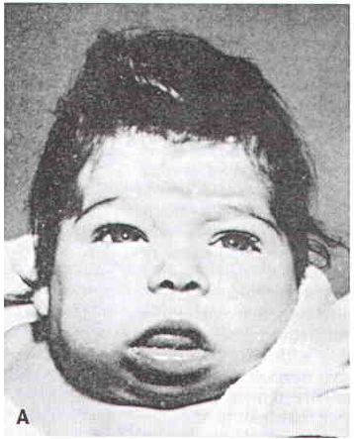
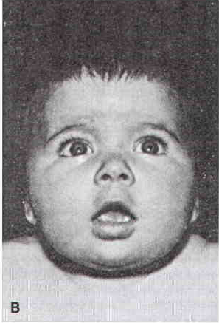

Slide 13
Lab findings
Serum level of T4 or free T4 is low; serum TSH is elevated
Serum T3 is normal and not helpful
Bone aging (absence of distal femoral epiphysis in newborns)
X-rays of the skull - show large fontanels and wide sutures with wormian bones (intersutural bones)
Scintigraphy- normally situated thyroid gland with a normal or avid uptake of radionuclide indicates a defect in thyroid hormone biosynthesis
Ultrasound of the thyroid gland

Slide 14
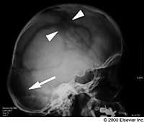

Slide 15
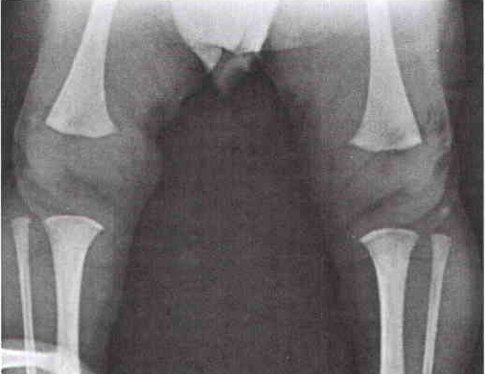

Slide 16
Treatment of Hypothyroidism
Levothyroxine is the treatment of choice
Lifelong in most cases
Newborns dose is 15 μg/kg, higher severe cases
Should not be mixed with soy protein or iron tablets that will bind T4 and inhibit absorption
Maintenance dose: 4 μg/kg/day in children, 2 μg/kg/day in adults

Slide 17
TREATMENT L-THYROXINE (T4)
Age | Daily dose (mg/kg) | Daily dose range (mg/day) | Weight range (kg)
< 6 MONTHS | 6-10 | 25-50 | 3-9
6-12 MONTHS | 5-8 | 37.5-75 | 6-12
1-5 YEARS | 4-6 | 50-100 | 9-23
5-12 YEARS | 3-5 | 50-125 | 15-55
12-18 YEARS | 2-3 | 75-175 | 30-90
ADULT | 1-2 | 100-200 | 50-100

Slide 18
Prognosis
Untreated newborns become severely mentally retarded and growth stunted; diagnosis should be made within 2 months and treatment started as early as diagnosis is made
Treatment if started within a few weeks of life provides an excellent prognosis

