Slide 1
Death Registration: Legal Mandates, Rules, and Procedures
Republic of the Philippines
Philippine Statistics Authority

Slide 2
What is Civil Registration?
Civil registration in the Philippines was made compulsory with the enactment of the Civil Registry Law (Act No. 3753) approved on November 26, 1930 and took effect on Feb. 27, 1931.
Defined as the continuous, permanent, compulsory and universal recording of the occurrence and characteristics of vital events pertaining to the population.
Carried out primarily for the purpose of establishing the legal documents.
Republic of the Philippines
Philippine Statistics Authority

Slide 3
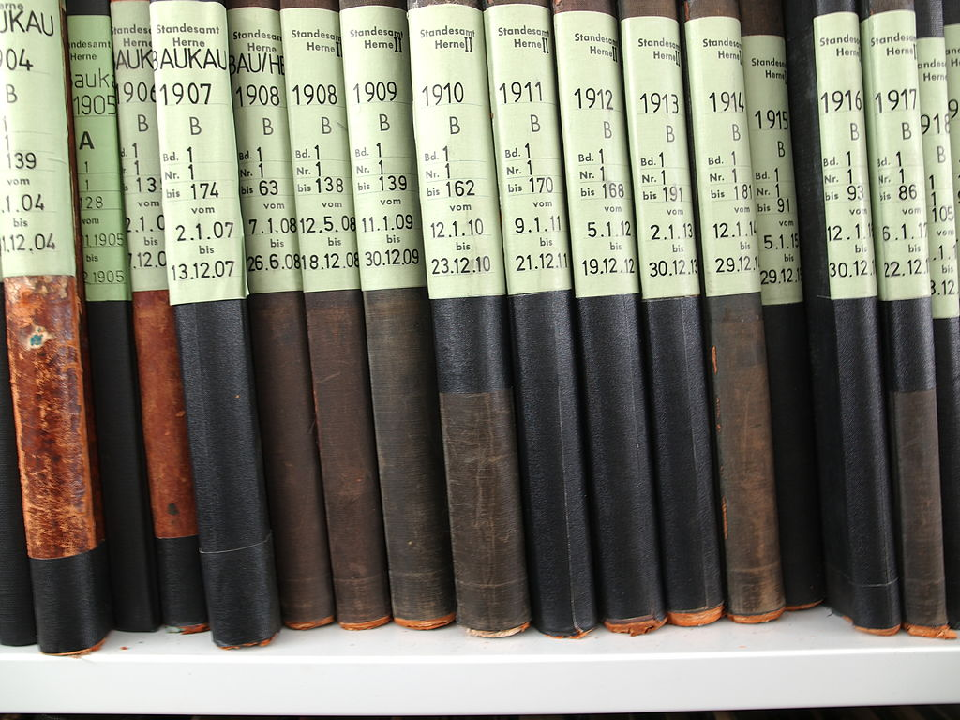
Act No. 3753
The Civil Registry Law
Registration of all facts and acts concerning the civil status of persons from birth to death including the changes in civil status taking place therein in appropriate civil registry books
Republic of the Philippines
Philippine Statistics Authority

Slide 4
PD 856
Code of Sanitation of the Philippines approved on December 23, 1975
The burial of remains is subject to the following requirements:
No remains shall be buried without a death certificate. This certificate shall be issued by the attending physicians.
If there has been no physician in attendance, it shall be issued by the mayor, the secretary of the municipality where the death occurred.
The death certificate shall be forwarded to the Local Health Officer within 48 hours after death. (Sec. 91)
Republic of the Philippines
Philippine Statistics Authority

Slide 5
RA 10625
The Philippine Statistical Act
Article 6 (e) of RA 10625
The PSA to carry out, enforce and administer civil registration functions in the country as provided for in Act No. 3753, the Law on Registry of Civil Status.
Republic of the Philippines
Philippine Statistics Authority

Slide 6
Organizational Structure of PSA
National Statistician
Deputy National Statistician for Sectoral Statistics
Deputy National Statistician for Census and Technical Coordination
Deputy National Statistician for Civil Registration and Central Support
Regional Statistical Services Office (RSSO)
Civil Registration (CRS)Service
Provincial Statistics Office (PSO)
Republic of the Philippines
Philippine Statistics Authority
Notes:
As of this time, since it was created, there are only three legitimate personnel of the PSA, these are the National Statistician and at the same time the Civil Registrar General, two deputy national statistician, and the rest of the employees are on hold-over capacity.

Slide 7
RA 10625
Rule 9 Art. 13 c(vii) of the IRR –
Civil Registration Service
civil registry document management and archiving
policy advocacy and research on civil registration matters, court decrees and legal instruments affecting civil registry documents
administrative correction of civil registry documents
outlet and customer services; and
other civil registration concerns
Republic of the Philippines
Philippine Statistics Authority

Slide 8
Republic Act 7160
Local Government Code
Civil registration is a function of the local government through the city/municipal registrar but is under the technical supervision of the Civil Registrar General
Republic of the Philippines
Philippine Statistics Authority

Slide 9
Rules and Procedures
Republic of the Philippines
Philippine Statistics Authority

Slide 10
Registrable Acts & Vital Events
Death
Refers to the permanent disappearance of all evidence of life at any time after live birth has taken place; or
The postnatal cessation of vital functions without capability of resuscitation
Republic of the Philippines
Philippine Statistics Authority

Slide 11
Registrable Acts & Vital Events
Fetal Death
Refers to the death prior to the complete expulsion or extraction from its mother of a product of conception, irrespective of the duration of pregnancy
The death is indicated by the fact that after such separation the fetus does not breathe nor show any other evidence of life, such beating of the heart, pulsation of the umbilical cord, or definite movement of voluntary muscles
Republic of the Philippines
Philippine Statistics Authority

Slide 12
Registrable Acts & Vital Events
If the fetus has an intra-uterine life of less than seven months, it is not deemed born if it dies within twenty-four hours after its complete delivery from the maternal womb.
Republic of the Philippines
Philippine Statistics Authority

Slide 13
With Intrauterine Life | Fetus lived less than 24 hours | Fetus lived more than 24 hours | Remarks
Less than seven (7) months | ̸ |  | Accomplish COLB and COD, two (2) copies each with remarks “For statistical purposes”. One copy each for LCR and CRG
 |  | ̸̸ | Accomplish four (4) copies and register (one copy each for the registrant, CRG, C/MCR, attendant at death)
More than seven (7) months | ̸̸ | ̸̸ | Accomplish four (4) copies and register (one copy each for the registrant, CRG, C/MCR, attendant at death)
Republic of the Philippines
Philippine Statistics Authority

Slide 14
Persons Responsible to Report the Event
Death/Fetal Death
Health Officer
Registration Officer
Person Responsible
Republic of the Philippines
Philippine Statistics Authority

Slide 15
Flow of Submission of Document
in 15/30
days
Person Responsible
Registration Officer
PSA Provincial Office
PSA Central Office
10th day after ref. mo.
6th week after ref. mo.
Republic of the Philippines
Philippine Statistics Authority

Slide 16
Delayed Registration
Registration of death beyond the 30–day period shall be considered for delayed registration, and shall be accepted only if the procedures and requirements are observed and complied with.
Republic of the Philippines
Philippine Statistics Authority
Notes:
(Rule 31 (3) of the Administrative Order No.1, Series of 1993). The accomplished Certificate of Death shall not have a registry number.

Slide 17
Delayed Registration
Requirements:
Four copies of COD accomplished correctly and completely
Affidavit for delayed registration which shall be executed by the hospital/clinic administrator, if the person died in the hospital, clinic or similar institution, or if the person died elsewhere, by the attendant at death.
Republic of the Philippines
Philippine Statistics Authority
Notes:
(Rule 31 (3) of the Administrative Order No.1, Series of 1993). The accomplished Certificate of Death shall not have a registry number.

Slide 18
Delayed Registration
Requirements:
Otherwise, the affidavit shall be executed by any of the nearest relative of the deceased, or by any person having legal charge of the deceased when he was still alive.
Republic of the Philippines
Philippine Statistics Authority

Slide 19
Delayed Registration
The affidavit referred to above shall state among other things the following:
name of the deceased
facts of his death
date and place of burial or cremation
circumstances why the death was not reported for registration
Submission: within 30 days after death

Slide 20
Delayed Registration
Requirements:
Authenticated copy of the certificate of burial, cremation or other means of corpse disposal
Approval for registration by the health officer in the box provided in the COD
Republic of the Philippines
Philippine Statistics Authority
Notes:
(Rule 31 (3) of the Administrative Order No.1, Series of 1993). The accomplished Certificate of Death shall not have a registry number.

Slide 21
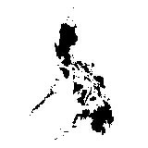
Place of Registration
As a general rule, the place of registration is the city or municipality where the event occurs.
Republic of the Philippines
Philippine Statistics Authority

Slide 22
Reporting of Vital Events Occurring Abroad
All vital events occurring to Filipinos residing abroad (permanently or temporarily)
shall be reported to the Philippine Foreign Service Establishment of the country of residence; or
where the vital event took place; or
where none is located thereat, in the Philippine Foreign Service Establishments of the country nearest the place of residence of the party concerned; or
where the vital event occurred
Republic of the Philippines
Philippine Statistics Authority

Slide 23
Reminder
Sec.6 of the Civil Registry Law
Death Certificate and Register - No human body shall be buried unless the proper death certificate has been presented and recorded in the office of the local civil
registrar.
Body parts surgically removed, e.g. amputated foot due to diabetes mellitus or accidental chopping off the hand of a machinist because of a technical machine problem, are not considered as death of a person.
Republic of the Philippines
Philippine Statistics Authority
Notes:
Rule 33 AO1 series of 93

Slide 24
Reminder
Sec.6 of the Civil Registry Law
Hence, document containing such body parts should not be registered since these are for burial purposes only.
Republic of the Philippines
Philippine Statistics Authority

Slide 25
Who is responsible in reporting the event and preparing the COD/FD?
For Death That Occurred in the Hospital
The physician who last attended the deceased or the administrator of the hospital or clinic where the person died is responsible to prepare the COD and certify as to the cause of death.
Republic of the Philippines
Philippine Statistics Authority

Slide 26
Who is responsible in reporting the event and preparing the COD/FD?
The certificate is forwarded within 48 hours after death to the Local Health Officer who will review the certificate and affix his signature in the “Reviewed By” portion and direct its registration at the Office of the LCR within 30 days.
Republic of the Philippines
Philippine Statistics Authority

Slide 27
Who is responsible in reporting the event and preparing the COD/FD?
Death in Hospital Emergency Room
Emergency Room deaths
– deaths of patients occurring in the ER, including patients who were revived by initial measures at the ER but eventually died there, regardless of the time of stay in the ER
NSO Admin. Order no.1 s.1993
Republic of the Philippines
Philippine Statistics Authority

Slide 28
Who is responsible in reporting the event and preparing the COD/FD?
Death in Hospital Emergency Room
In such cases, the Certificate of Death shall be accomplished by the ER Officer if he can come up with a definite diagnosis.
Otherwise, the death should be referred to the medico-legal officer of the hospital, or the local health officer who shall cause the issuance of the Certificate of Death.
Republic of the Philippines
Philippine Statistics Authority

Slide 29
Who is responsible in reporting the event and preparing the COD/FD?
For Death That Occurred in the Hospital
Special Cases:
When a death occurs in the ambulance while a patient is being transferred to another healthcare facility, the attending physician during the transport of the patient shall accomplish the death certificate.
Republic of the Philippines
Philippine Statistics Authority

Slide 30
Death Registration Process
48 hours
Death in a Hospital
30 days
Local Health Officer
Local Civil Registrar
Republic of the Philippines
Philippine Statistics Authority

Slide 31
Who is responsible in reporting the event and preparing the COD/FD?
For Death that Occurred Outside the Hospital
If the deceased died without medical attendance, the nearest relative or any person who has knowledge of the death is responsible for reporting the event to the Local Health Officer within 48 hours.
NSO Admin. Order no.1 s.1993
Republic of the Philippines
Philippine Statistics Authority

Slide 32
Who is responsible in reporting the event and preparing the COD/FD?
For Death That Occurred Outside The Hospital
The Local Health Officer is the one who will prepare the COD, certify the cause of death and direct its registration at the officer of the LCR within 30 days.
Republic of the Philippines
Philippine Statistics Authority

Slide 33
Who is responsible in reporting the event and preparing the COD/FD?
For Death Under Medico-Legal
When faced with the duty of completing the Medical Certificate portion of the Certificate of Death, the physician has to determine whether another physician is more qualified to complete the certificate especially if the deceased was attended by another physician prior to his death
Republic of the Philippines
Philippine Statistics Authority

Slide 34
Who is responsible in reporting the event and preparing the COD/FD?
For Death Under Medico-Legal
If the physician has reasons to believe or suspect that the cause of death was due to violence or crime, then he is duty-bound to immediately report to the authorities of the Philippine National Police or the National Bureau of Investigation concerned.
Republic of the Philippines
Philippine Statistics Authority

Slide 35
Who is responsible in reporting the event and preparing the COD/FD?
For Dismembered Body Parts
In cases when a dismembered body part which is non-viable for attachment is brought to the Emergency Room, such body part shall be forwarded to the surgical pathology section of the laboratory for gross and microscopic examination and documentation.
Republic of the Philippines
Philippine Statistics Authority

Slide 36
Who is responsible in reporting the event and preparing the COD/FD?
For Dismembered Body Parts
The surgical pathology report signed and issued by the pathologist shall serve as the Certificate of Dismembered Body Part which may be used for burial purposes or proper disposal.
The practice of issuing a Certificate of Death by the attending physician for the dismembered body part is not necessary
Republic of the Philippines
Philippine Statistics Authority

Slide 37
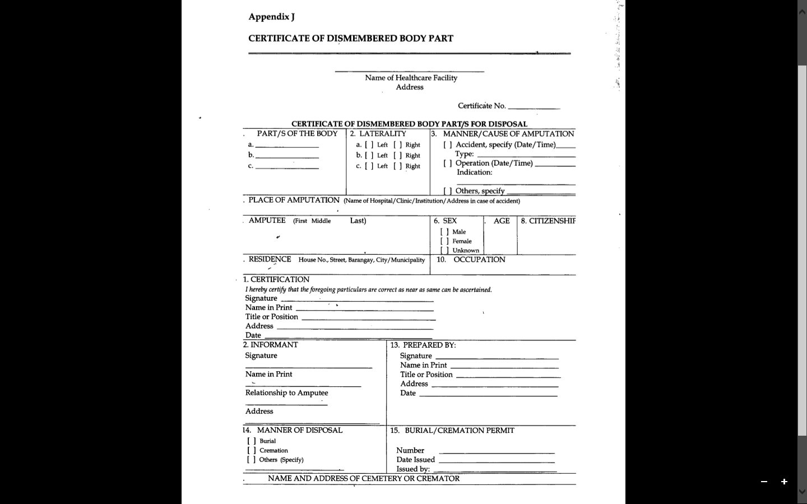
Certificate of Dismembered Body Part
Republic of the Philippines
Philippine Statistics Authority

Slide 38
In the absence of the local health officer the death should be reported to the mayor, or to any member of the Sangguniang Bayan, or to the municipal secretary who shall issue the certificate of death for burial purposes. Code On Sanitation Of The Philippines (P.D. No. 856)
Who is responsible in reporting the event and preparing the COD/FD?
Republic of the Philippines
Philippine Statistics Authority
Notes:
In the absence of the local health officer his authorized representative (a physician) will do.
When there is no authorized representative or when it is a non-working day, the others listed may issue a certificate in place of the local health officer.

Slide 39
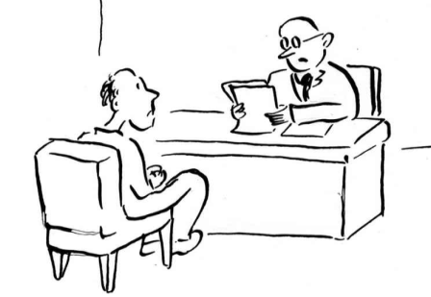
Death Registration Process
48 hours
Local Health Officer
30 days
Death Outside Hospital
Local Civil Registrar
Republic of the Philippines
Philippine Statistics Authority

Slide 40
Who is responsible in reporting the event and preparing the COD/FD?
Special Cases:
For death occurs in a vehicle/vessel/airplane, the driver/ship captain/pilot, as the case maybe, shall report such death to the concerned local health officer or his authorized representative, who shall examine the deceased, prepare the COD, certify as to the cause of death, and directs its registration to LCRO.
Republic of the Philippines
Philippine Statistics Authority
Notes:
In the absence of the local health officer his authorized representative (a physician) will do.
When there is no authorized representative or when it is a non-working day, the others listed may issue a certificate in place of the local health officer.

Slide 41
Who is responsible in reporting the event and preparing the COD/FD?
Special Cases:
In accidents where there are no survivors, it is the responsibility of the owner of the vehicle/vessel/airplane to make the report of death to the concerned local health officer or his authorized representative, who shall examine the deceased, prepare the COD, certify as to the cause of death, and directs its registration to LCRO.
Republic of the Philippines
Philippine Statistics Authority
Notes:
In the absence of the local health officer his authorized representative (a physician) will do.
When there is no authorized representative or when it is a non-working day, the others listed may issue a certificate in place of the local health officer.

Slide 42
Who is responsible in reporting the event and preparing the COD/FD?
Special Cases:
In case of mass death and the deceased cannot be identified, the local health officer upon submission of an affidavit by two disinterested persons, in the exercise of his wise discretion, may issue Certificates of Death and cause the registration of these deaths at the Office of the LCR.
NSO Admin. Order no.1 s.1993
Republic of the Philippines
Philippine Statistics Authority
Notes:
In the absence of the local health officer his authorized representative (a physician) will do.
When there is no authorized representative or when it is a non-working day, the others listed may issue a certificate in place of the local health officer.

Slide 43
Who certifies the death certificate?
If there is a medical attendant at death, the certifying officer is the attendant at death
If there is no medical attendant at death the certifying officer is the Local Health Officer
In medico-legal cases, the certifying officer is the medico-legal officer
In ALL cases, the cause of death shall be reviewed and signed by the Local Health Officer
Republic of the Philippines
Philippine Statistics Authority

Slide 44
Registration of Death for Filipino Muslim and Indigenous Cultural Communities/Indigenous Peoples
For Muslim Filipinos, the dead body may be buried even without a Certificate of Death provided that the death shall be reported to the local health officer within 48 hours after the date of burial.
Republic of the Philippines
Philippine Statistics Authority
Notes:
The death shall be reported by the person who performed the burial rites (or by the nearest kin).

Slide 45
Registration of Death for Filipino Muslim and Indigenous Cultural Communities/Indigenous Peoples
The local health officer shall prepare the COD, certify the cause of death and submit the COD to the LCR for registration. This is also true for the Indigenous Cultural Communities/Indigenous Peoples (ICCs/IPs).
Republic of the Philippines
Philippine Statistics Authority

Slide 46
Registration of Death for Filipino Muslim and Indigenous Cultural Communities/
Indigenous
NOTE: Aside from the COD/COFD, it is required to have an attachment which shall constitute the facts of occurrence of the event. Mun. Form 103 - Attachment for Muslim Death IP Form 2 – Attachment for death of ICCs/IPs
Republic of the Philippines
Philippine Statistics Authority

Slide 47
When registration of death can be denied?
The local civil registrar cannot deny registration except for insufficiency of information. The entries are essential to identify the deceased and his/her cause of death.
It is important that these should be mandatorily entered in the death certificate, otherwise the document shall be considered valueless. Application for registration of death shall not be allowed if the entries in the full name of the deceased and the cause of death are not given.
Republic of the Philippines
Philippine Statistics Authority
Notes:
MC No. 2008-06 per opinion No. 68 of the DOJ(Memorandum Circular 2008-06/DOJ Opinion No. 68)

Slide 48
Reminder
Entries in the Medical Certificate must be accomplished by the attending physician/local health officer correctly and completely before registration since there is prohibition against change or correction of entries without judicial order. Art. 412, Civil Code of the Philippines
Republic of the Philippines
Philippine Statistics Authority

Slide 49
Uses of Certificate of Death
Prima facie evidence of death
Claim of benefits, pensions, insurance, or tax exemption
Evidence for settlement of estate
Remarriage purpose of surviving spouse
To designate a guardian or foster parent for minor
Republic of the Philippines
Philippine Statistics Authority

Slide 50
Uses of Certificate of Death
The information recorded in the death certificate is used to determine health priorities for prevention of deaths due to similar causes in the future
The information is also important for family members so that they know what caused the death and are aware of conditions that may occur or could be prevented in other family members
Republic of the Philippines
Philippine Statistics Authority

Slide 51
Uses of Certificate of Death
Provide the indicators of existing infectious diseases and epidemics that need immediate control measures
Serve as the basis for designing programs that promote public safety and strategies that help the prevention and eradication of certain types of diseases
Republic of the Philippines
Philippine Statistics Authority

Slide 52
Uses of Certificate of Death
Serve administrative purposes, specifically, in the clearing of files like disease-case registers, social security, military services files, electoral rolls and tax registers
For the control of infectious diseases
Programs in public safety, accident prevention and crime eradication
Republic of the Philippines
Philippine Statistics Authority

Slide 53
Uses of Certificate of Death
Mortality surveillance, health and epidemiologic research, health planning
Study of mortality differentials
Health decision makers and planners all around the world make extensive use of mortality statistics
Republic of the Philippines
Philippine Statistics Authority

Slide 54
What is PhilCRIS
an information system that would address the needs of the Local Civil Registrars, Hospitals, Churches, attendants at births and deaths, solemnizing officers, and those who are involved in the preparation and recording of vital events
Republic of the Philippines
Philippine Statistics Authority
Notes:
One of the important undertakings is the development of the Philippine Civil Registry Information System 3.0. (PhilCRIS 3.0) – an information system that would address the needs of the Local Civil Registrars, Hospitals, Churches, attendants at births and deaths, solemnizing officers, and those who are involved in the preparation and recording of vital events. Moreover this will enable local program planner and policy makers to generate vital statistics at the local level.

Slide 55
What is PhilCRIS
The PhilCRIS software is the Windows version of the Civil Registry Information System (CRIS DOS version), which is available for use by the Offices of the Civil Registrars and other end-users.
It has been completely redesigned to deliver civil registry information management in a new, more user friendly and efficient way.
Republic of the Philippines
Philippine Statistics Authority

Slide 56
Features of PhilCRIS
Enables encoding of relevant information from civil registry documents
Storage of vital data
Query and retrieval of encoded records
Printing and issuance of certified copies of encoded civil registry documents
Generation of transmittal files
Data management and maintenance of the local civil registry database
Republic of the Philippines
Philippine Statistics Authority

Slide 57
Benefits of Using PhilCRIS
Uses a more stable and secure database management ensuring the integrity and security of civil registry information
Has easier data entry and coding of items
Allows print preview and printing directly to the new civil registry forms
Has better support for new printers
Republic of the Philippines
Philippine Statistics Authority

Slide 58
How to Avail in Using PhilCRIS
The LCRO/hospital/clinic or similar institution shall coordinate with the PSA Provincial Office regarding the conduct of PhilCRIS training
Once they have attended the PhilCRIS training, they have to sign a MOA between them and PSA
The MOA will be submitted to the PSA-Central Office for proper control and once received they will sent the PhilCRIS installer
NOTE: PhilCRIS is given for free
Republic of the Philippines
Philippine Statistics Authority

Slide 59
PhilCRIS
Training Fee: P1,200 (handbook, food, venue and T-shirt
Installer - Free

Slide 60
Thank you!
Republic of the Philippines
Philippine Statistics Authority

