Slide 1
DR. JOSEPH B. FAMA FPSMS Internal Medicine DOH Accredited Physician for Assessment and Management of Drug Dependent
CLINICAL DEPARTMENT HEAD
Drug Treatment and Rehabilitation Center

Slide 4
COCCAINE
Cocaine is a powerful addictive stimulant drug made from the leaves of the coca plant
Other name:
Blow, Crack, Rock, Snow
Snort cocaine powder through the nose
Rub it into their gums
Others dissolve the powder in water and inject it into the bloodstream

Slide 5
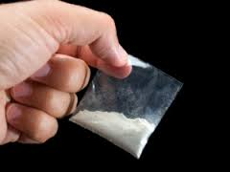
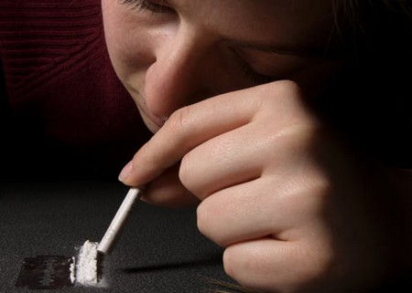

Slide 7
Short-Term Effects
Extreme happiness and energy
Mental alertness
Hypersensitivity to sight, sound, and touch
Irritability
Paranoia
Constricted blood vessels
Nausea
Faster heartbeat

Slide 8
Long-Term Effects
Nosebleeds
Severe bowel decay
Malnourishment
Restlessness
Severe paranoia with auditory hallucinations
Large amounts of cocaine can lead to bizarre, unpredictable, and violent behavior.

Slide 9
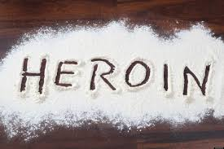
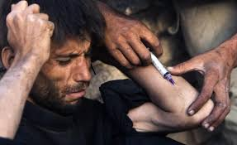

Slide 10
Heroin (like opium and morphine)
Is an opioid drug that is synthesized from morphine
Naturally occurring substance
Extracted from the seed pod
Asian opium poppy plant
Opioid pain killer
Administered intravenously by injection
Usually appears as a white or brown powder

Slide 11
Heroin (like opium and morphine)
Or as a black sticky substance, known as “black tar heroin.
Two to four times more potent than morphine
Most heroin is injected
Inhaled by snorting or sniffing, or smoked

Slide 12
Short Term Effect
Euphoria
Feelings of being warm and flushed
Heavy sensation in the extremities
Reduced sensation of pain
Drowsiness
Sedation
Lethargy
Nausea and vomiting

Slide 13
Short term effect
Confusion
Dry mouth
Constricted pupils
Light sensitivity
Lower than normal body temperature.
Slowed respiration.
Slowed heart rate.
Cyanosis

Slide 14
Long Term Effect
Decreased dental health marked by damaged teeth and gum swelling
Excoriated skin from scratching
Severe constipation
Weakness and sedation
Poor appetite and malnutrition
Sleeping problems
Decrease in sexual functioning

Slide 15
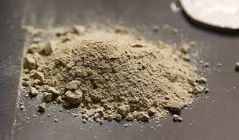
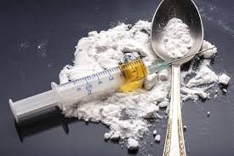
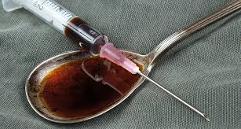

Slide 17
LSD Lysergic Acid Diethylamide
Sold on the street
Small tablets (“microdots”),
Capsules
Gelatin squares (“window panes”).
Most potent, mood-changing chemicals

Slide 18
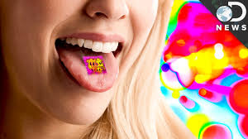
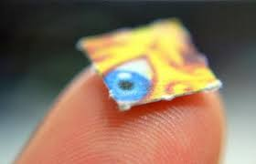
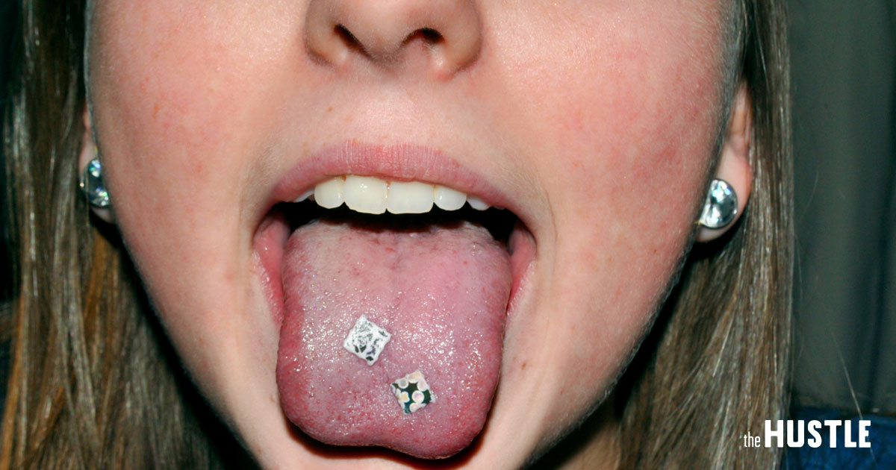
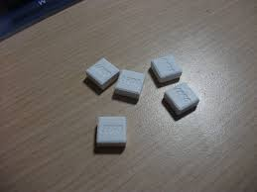

Slide 19
Physical Effects
Dilated pupils
Higher or lower body temperature
Sweating or chills (“goose bumps”)
Loss of appetite
Sleeplessness
Dry mouth
Tremors

Slide 20
Mental Effects
Delusions
Visual hallucinations
Artificial sense of euphoria or certainty
Distortion of one’s sense of time and identity
Impaired depth perception
Impaired time perception
Distorted perception of the size and shape of objects, movements, color, sounds, touch and the user’s own body image

Slide 21
Mental Effects
Severe, terrifying thoughts and feelings
Fear of losing control
Panic attacks
Flashbacks, or a recurrence of the LSD trip, often without warning long after taking LSD
Severe depression or psychosis

Slide 22
brain scans of people who were high on LSD and saw how the psychedelic substance affects brain activity and connectivity.
They found that LSD makes the brain more complete.

Slide 23
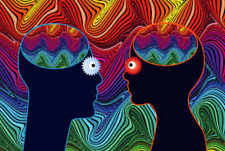
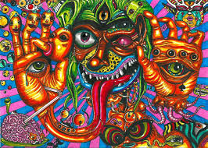
High on LSD experience several images coming from many parts of the part.

Slide 24
“INHALANT”
refers to the vapors from toxic substances which are inhaled to reach a quick high

Slide 25
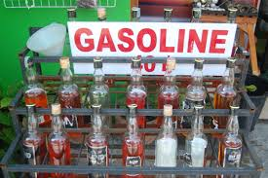
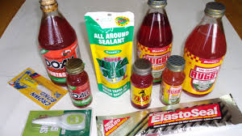

Slide 26
Side Effect
Stumbling
Vomiting
spasmodic reactions
Hallucinations
Unresponsiveness to stimuli.
Rashes around the mouth where the inhalant has blistered the skin

Slide 27
Long-Term Effects
Loss of consciousness.
Widespread cellular damage from lack of oxygen.
Cardiac arrest.
Neuromuscular toxicity.
Brain damage.
Liver and kidney damage.

Slide 28
delta-9-tetrahydrocannabinol
(THC)

Slide 29
Short Term Effect
Altered senses (for example, seeing brighter colors)
Changes in mood
Impaired body movement
Impaired memory
Severe anxiety
Paranoia
Panic
Hallucinations

Slide 30
Short Term Effect
Psychosis
Loss of sense of personal identity
Increased heart rate
Increased risk of stroke
Dizziness
Shallow breathing
Red eyes and dilated pupils
Dry mouth
Increased appetite

Slide 31
LONG-TERM EFFECTS
Decline in IQ (up to 8 points if prolonged use started in adolescent age)
Poor school performance
Impaired thinking and ability to learn and perform complex tasks
Lower life satisfaction
Hallucinations
Paranoia
Schizophrenia

Slide 32
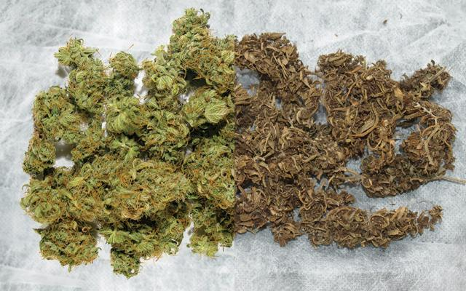
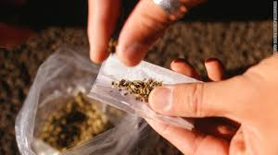

Slide 35
3,4-methylenedioxy-methamphetamine (MDMA)
Is a synthetic drug that alters mood and perception (awareness of surrounding objects and conditions)
It is chemically similar to both stimulants and hallucinogens,
Producing feelings of increased energy, pleasure, emotional warmth,
And distorted sensory and time perception

Slide 36
3,4-methylenedioxy-methamphetamine (MDMA)
Popular in the nightclub scene and at all-night dance parties ("raves"),
Now affects a broader range of users
More commonly call the drug Ecstasy or Molly.

Slide 38
How does MDMA affect the brain?
Increases the activity of three brain chemicals:
Dopamine:
Causes a surge in euphoria and increased energy/activity
Norepinephrine
Increases heart rate and blood pressure

Slide 39
How does MDMA affect the brain?
Serotonin
Affects mood, appetite, sleep, and other functions
Triggers hormones that affect sexual arousal and trust
Large amounts of serotonin likely causes the emotional closeness, elevated mood, and empathy felt by MDMA users.
Effects last about 3 to 6
Capsule or tablet

Slide 40
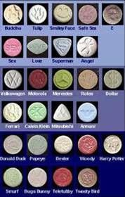
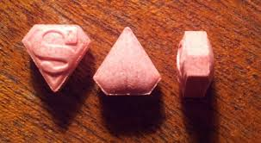
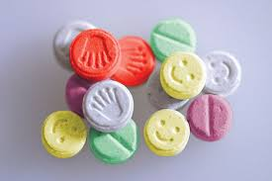
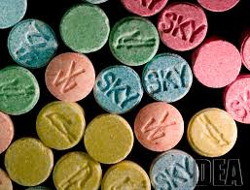
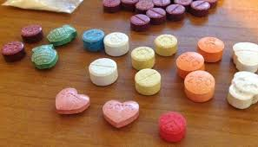
Party Drugs

Slide 42
Short Term Effect
Increase in energy levels
Euphoric state of being
Distorted perception of time
Higher pleasure from and desire for physical touch
Increased levels of sexuality and sexual arousal
Elevated alertness

Slide 43
Ecstasy Overdose
Takes more than one dose of the substance at a time
Series of pills over a period to maintain the desired effects of ecstasy “piggybacking.”
High blood pressure
Panic attacks
Seizures
Loss of consciousness

Slide 44
Ecstasy Overdose
Extreme increase in body temperature
Organ damage and complications due to increased body temperature.
May cause death by heat stroke and heart failure
increasing temperature and level of physical activity
Dehydration and exhaustion

Slide 45
SHABU

Slide 46
Methamphetamine
Usually comes in the form of a crystalline white powder that is odorless, bitter-tasting and dissolves easily in water or alcohol
Other colors of powder have been observed, including brown, yellow-gray, orange and even pink. It can also be compressed into pill form.
As covered earlier, it can be snorted, smoked or injected.

Slide 47
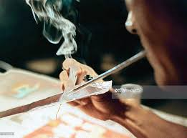
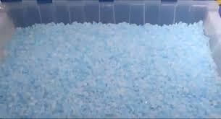
With out foil
With foil

Slide 49
THE STAGES OF THE METH “EXPERIENCE”

Slide 50
THE STAGES OF THE METH “EXPERIENCE”
Rush
High
Binge
Tweaking
Crash
Meth Hangover
Withdrawal

Slide 51
1. THE RUSH
Initial response the abuser feels
Increase heartbeat and metabolism
Blood pressure and pulse soar
Unlike the rush associated with crack cocaine, which lasts for approximately two to five minutes
Methamphetamine rush can continue for up to thirty minutes.
Notes:
A rush is the initial response the abuser feels when smoking or injecting methamphetamine. During the rush, the abuser’s heartbeat races and metabolism Unlike the rush associated with crack cocaine, which lasts for approximately two to five minutes, the methamphetamine rush can continue for up to thirty minutes.

Slide 52
2. THE HIGH
Sometimes called “the shoulder.”
Often feels aggressively smarter
Argumentative
Interrupting other people
Delusional effects
Intensely focused on an insignificant item, such as repeatedly cleaning the same window for several hours.
Last four to sixteen hours
Notes:
High—The rush is followed by a high, sometimes called “the shoulder.” During the high, the abuser often feels aggressively smarter and becomes argumentative, often interrupting other people and finishing their sentences. The delusional effects can result in a user becoming intensely focused on an insignificant item, such as repeatedly cleaning the same window for several hours. The high can last four to sixteen hours

Slide 53
3. THE BINGE
Is the uncontrolled use of a drug
Refers to the abuser’s urge to maintain the high by smoking or injecting more methamphetamine.
Can last three to fifteen days
Abuser becomes hyperactive both mentally and physically.
Notes:
A binge is the uncontrolled use of a drug or alcohol. It refers to the abuser’s urge to maintain the high by smoking or injecting more methamphetamine. The binge can last three to fifteen days. During the binge, the abuser becomes hyperactive both mentally and physically.

Slide 55
4. TWEAKING
Abuser is most dangerous
Methamphetamine no longer provides a rush or a high.
Unable to relieve the horrible feelings of emptiness and craving.
Abuser loses his sense of identity
Intense itching is common
Notes:
abuser is most dangerous when experiencing a phase of the addiction called “tweaking”—methamphetamine no longer provides a rush or a high. Unable to relieve the horrible feelings of emptiness and craving, an abuser loses his sense of identity. Unable to relieve the horrible feelings of emptiness and craving, an abuser loses his sense of identity. Intense itching is common and a user can become convinced that bugs are crawling under his skin. Unable to sleep for days at a time, the abuser is often in a completely psychotic state and he exists in his own world, seeing and hearing things that no one else can perceive. His hallucinations are so vivid that they seem real and, disconnected from reality, he can become hostile and dangerous to himself and others. The potential for self-mutilation is high.

Slide 56
4. TWEAKING
Unable to sleep for days at a time
Completely psychotic state
Hallucinations
Bugs are crawling under his skin

Slide 57
Intense itching is common Bugs are crawling under his skin

Slide 59
5. THE CRASH
Happens when the body shuts down
unable to cope with the drug effects overwhelming it
Results in a long period of sleep
Can last one to three days.
Notes:
happens when the body shuts down, unable to cope with the drug effects overwhelming it; this results in a long period of sleep for the person. The crash can last one to three days.

Slide 60
6. METH HANGOVER
After the crash
the abuser returns in a deteriorated state
Starved
Dehydrated
Exhausted physically, mentally and emotionally.
Lasts from two to fourteen days.
Leads to enforced addiction, as the “solution” to these feelings is to take more meth.

Slide 61
7. WITHDRAWAL
Thirty to ninety days - abuser realizes that he is in withdrawal.
Depressed
Loses his energy and the ability to experience pleasure.
Craving for more methamphetamine hits,
Suicidal. Since meth withdrawal is extremely painful and difficult, most abusers revert.
Notes:
Often thirty to ninety days can pass after the last drug use before the abuser realizes that he is in withdrawal. First, he becomes depressed, loses his energy and the ability to experience pleasure. Then the craving for more methamphetamine hits, and the abuser often becomes suicidal. Since meth withdrawal is extremely painful and difficult, most abusers revert; thus, 93% of those in traditional treatment return to abusing methamphetamine

Slide 62
EFFECTS OF METHAMPHETAMINE

Slide 64
SHORT-TERM EFFECTS
Create a false sense of well-being and energy
experience a severe “crash” or physical and mental breakdown
Continued use of the drug
decreases natural feelings of hunger
experience extreme weight loss
Disturbed sleep patterns, hyperactivity, nausea, delusions of power, increased aggressiveness and irritability.
Notes:
meth create a false sense of well-being and energy, and so a person will tend to push his body faster and further than it is meant to go
experience a severe “crash” or physical and mental breakdown after the effects of the drugs wear off
Because continued use of the drug decreases natural feelings of hunger, users can experience extreme weight loss

Slide 65
SHORT-TERM EFFECTS
Loss of appetite
Increased heart rate, blood pressure, body temperature
Dilation of pupils
Disturbed sleep patterns
Nausea
Hallucinations, hyperexcitability, irritability
Panic and psychosis, paranoia
Convulsions, seizures and death from high doses
Bizarre, erratic, sometimes violent behavior
Notes:
paranoia: suspicion, distrust or fear of other people

Slide 66
Rodolfo Valle Jr., a carpenter from Taytay, Rizal is facing charges of statutory rape, following his alleged rape of his 9-month-old baby
- The nine-month-old baby has been the newest addition to the growing number of rape victims in the country
- According to the baby's mother, she will pursue the charges filed against the drug-addicted Valle, "as nobody would do such a thing"
A 34-year-old carpenter has been arrested on Wednesday, August 25, following reports that he raped his nine-month-old baby in Sitio Tupay, Barangay San Juan, Taytay, Rizal
9-month-old baby raped by dad

Slide 67
LONG-TERM EFFECTS
Permanent damage to blood vessels of heart and brain
high blood pressure leading to heart
attacks, strokes and death
Liver, kidney and lung damage
Destruction of tissues in nose
Respiratory (breathing) problems
Infectious diseases and abscesses
Malnutrition, weight loss

Slide 68
Cerebral strokes

Slide 69
LONG-TERM EFFECTS
Permanent damage to blood vessels of heart and brain
high blood pressure leading to heart
attacks, strokes and death
Liver, kidney and lung damage
Destruction of tissues in nose
Respiratory (breathing) problems
Infectious diseases and abscesses
Malnutrition, weight loss

Slide 70
Malnutrition, weight loss

Slide 71
LONG-TERM EFFECTS
Disorientation, apathy,
Confused exhaustion
Strong psychological dependence
Psychosis
Depression
Damage to the brain similar to Alzheimer’s disease
Stroke and Epilepsy
Severe tooth decay

Slide 72
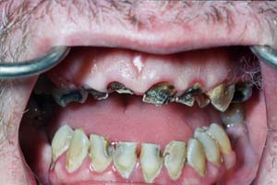
Severe tooth decay

Slide 74
Effect of drug in our body

Slide 75
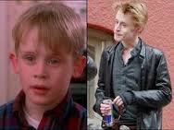
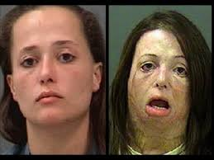
Macaulay Culkin as Kevin McCallister
HOME ALONE 1990

Slide 78
FLAKKA

Slide 79
FLAKKA
Highly Alarming Flakka Zombie Drug Hitting the Streets!

Slide 82
Warn your family, your friends about the effects of drug!

Slide 83
EITHER YOU WILL END UP IN

Slide 84
OR

Slide 85
9. Hid the call of Pres. Duterte
huminto ka na kung di PATAYIN kita

Slide 86
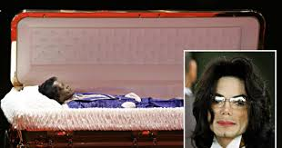
GOODBYE
IF NOT FROM PRES. DUTERTE / EFFECT OF DRUG WILL KILL YOU

Slide 87
THANK YOU FOR LISTENING
condolence

