Slide 1
FAMILY EDUCATION GROUP
Maria Teresa Vila-Calpito, RSW
DOH-Accredited Rehab Practitioner

Slide 2
Family Education Group ● Recovering clients usually isolated, or in conflict with family

Slide 3
Family Education Group ● Significant others have negative feelings, cannot understand dynamics of recovery and change
Feeling of abandonment
Anxiety
Concern
Fear
Embarrassment
Guilt

Slide 4
Family Education Group
Lack of understanding of substance use disorders and the changes that occurs in the family.
Lack of understanding of the dynamics of recovery and the changes that recovery brings.
Treatment is more likely to succeed if significant others are able to understand and predict the changes that happens in treatment.

Slide 5
Family Education Group ● Allows counselor to facilitate family involvement ● NOT Family Therapy! Does NOT enter into family dynamics

Slide 6
Family Education Group
● Provides relatively non-threatening
environment in which to present information.
● Provides an opportunity for clients and their families to feel comfortable and welcomed.

Slide 7
Clients begin treatment often can be negative, clients may be adamant that they need to “do my program alone.”
Encourage family involvement to client but don’t insist if resists firmly.

Slide 8
It is common for family members to believe that “it’s not my problem”. They may be angry and unwilling to involve themselves in the client’s treatment.
Counselor has to encourage and personally invite family.

Slide 9
“The chances of treatment
success increase immensely
if significant others become educated
about the
predictable changes that are
likely to occur within
relationships as recovery
proceeds.”
Notes:
The counselor/case loader should educates participants and encourages involvement of significant others, as well as clients.

Slide 10
Education helps families change some behaviors that are common to families coping with people who have a substance use disorder
Eg. Protecting people who are dependent on substances from the consequences of their dependence.

Slide 11
Family Education Group
Program should define “family ”
All clients attend Family Education Group sessions w/ or w/o family
Structured Education for them
information about the dynamics of family relationships
Notes:
Family define as accommodates important people in a particular client’s life. Eg. Long-term romantic partner, close friends, mentor

Slide 12
Family Education Group
Counselor should be sensitive to background & cultural issues
Counselor should remember that each client is an individual

Slide 13
Family Education Group
Family members should
be aware of local 12-
step and self-help
groups and
encouraged to attend

Slide 14
Goals of Family Education Groups

Slide 15
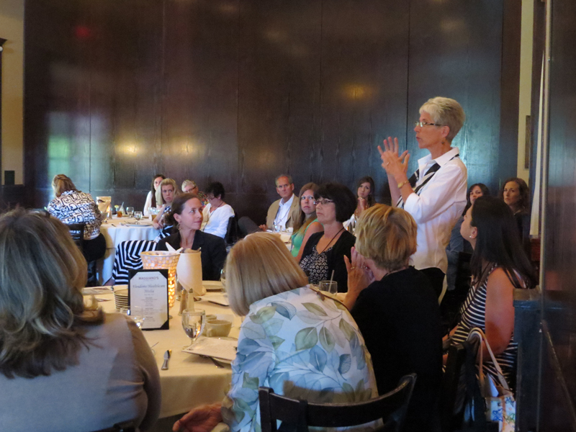
Goals of Family Education Groups
Present accurate information: drugs, effects, recovery process and treatment.
Help client & families understand effects of recovery process on relationships.
Forum for families to discuss issues of recovery.

Slide 16
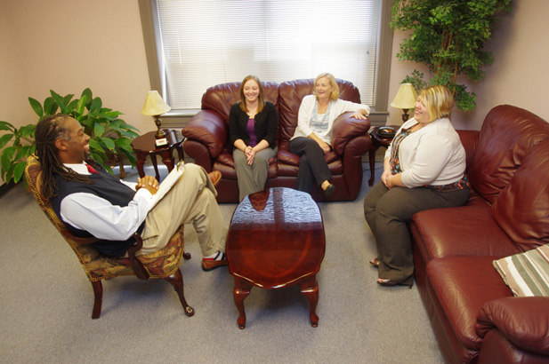
Goals of Family Education Groups
Teach, promote, and encourage client’s family members to care for themselves while supporting clients in their recovery.
Good venue for client to get to know other recovering people and their families.

Slide 17
Goals of Family Education Groups
● Provide a professional atmosphere in
which clients and their families are
treated with dignity and respect.

Slide 18
Group Format

Slide 19
Group Format
● Done in 12 sessions (3 months)
● Clients and family may enter anytime
● No limit on # of family members
● Group can be from 2 to 30 people
● Group sessions last for 90 minutes

Slide 20
Group Format
Group session techniques vary
7 sessions Powerpoint Presentations
4 sessions Multifamily Group Discussions
1 session a Panel Presentation

Slide 21
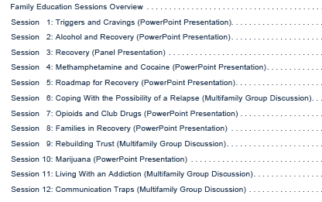

Slide 22
General Guidelines
Before Each Session
Read instructions for facilitating the session
Familiarize self with hand-outs/slides
Set up chairs based on session type
Arrange equipment
Prepare copies of handouts for session
Find out which attendees are new for intro

Slide 23
General Guideline
During each session
Welcome and Introduce
Encourage questions and comments
Provide references
Close by thanking

Slide 24
BE AWARE
Discussions may triggers cravings
- Those triggered or craving stay after until focused again
• If no companion, alert family: going home

Slide 25
THANK YOU

