Slide 1

MANGEMENT OF
GLUCOSE-6-PHOSPHATE DEHYDROGENASE DEFICIENCY
MARIA LYDIA O RAMIREZ, MD FPPS
PEDIATRIC HEMATOLOGIST-ONCOLOGIST

Slide 2
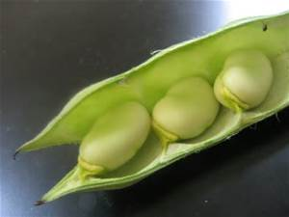
OBJECTIVES
BRIEF OVERVIEW of G6PDD
APPROACH TO TREATMENT

Slide 3
G6PD ENZYME
Enzyme in the HMP pathway responsible for the production of NADPH.
Protects the red blood cell from oxidative damage.
The G6PD gene lies on the X chromosome.

Slide 4
G6PD DEFICIENCY (G6PDD)
MOST COMMON ENZYMATIC DISORDER OF RED BLOOD CELLS
X-LINKED RECESSIVE
It affects:
  1:50 southeast Asians, 1:10 Mediterranean, 1:10 African-American males (hemizygous)
  Homozygous affected females are not uncommon

Slide 5
G6PDD: How does it present?
Usually NO SYMPTOMS
If exposed to triggers (oxidative stress), present as
H E M O L Y T I C A N E M I A

Slide 6
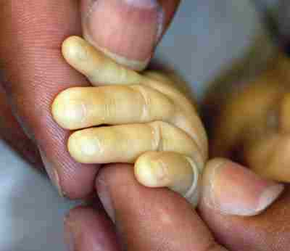
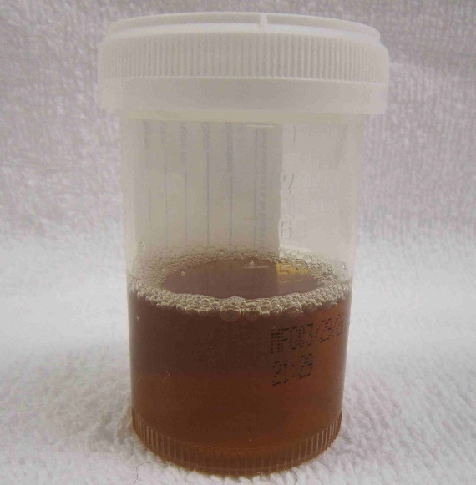

SYMPTOMS OF G6PDD
Fatigue, pallor tachycardia shortness of breath
Dark colored urine
Splenomegaly
Neonates usually present with jaundice which
can be severe and lead to kernicterus.

Slide 7
CLINICAL DISORDERS RELATED TO G6PDD
NEONATAL HYPERBILIRUBINEMIA
INDUCED (ACUTE) HEMOLYTIC ANEMIA
  triggered by exposure to oxidative agents
CHRONIC NONSPHEROCYTIC HEMOLYTIC ANEMIA (CNSHA)

Slide 8
WHO Classification of G6PD variants
Class I | Severe enzyme deficiency <1 % of normal activity or not detectable resulting in chronic hemolysis
Class II | Severe enzyme deficiency with <10 % activity presents as intermittent hemolysis; drug induced
Class III | Mild to moderate enzyme deficiency with 10-60 % activity presents as intermittent hemolysis
Class IV | Very mild enzyme deficiency with 60-90 % activity with no clinical problem
Class V | Very mild enzyme deficiency with >110 % activity with no clinical problem

Slide 9
DIAGNOSIS:
UNIVERSAL SCREENING IN POPULATIONS WITH HIGH DISEASE PREVALENCE (WHO recommendation)
CONFIRMATORY ASSAY
  Quantitative spectrophotometric analysis
  Rapid fluorescent spot test
PCR based tests for specific mutations

Slide 10
APPROACH TO THE TREATMENT OF G6PDD

Slide 11

The main treatment
for G6PD deficiency is
AVOIDANCE OF OXIDATIVE STRESSORS
AFP Vol 72 (7). 2005

Slide 12
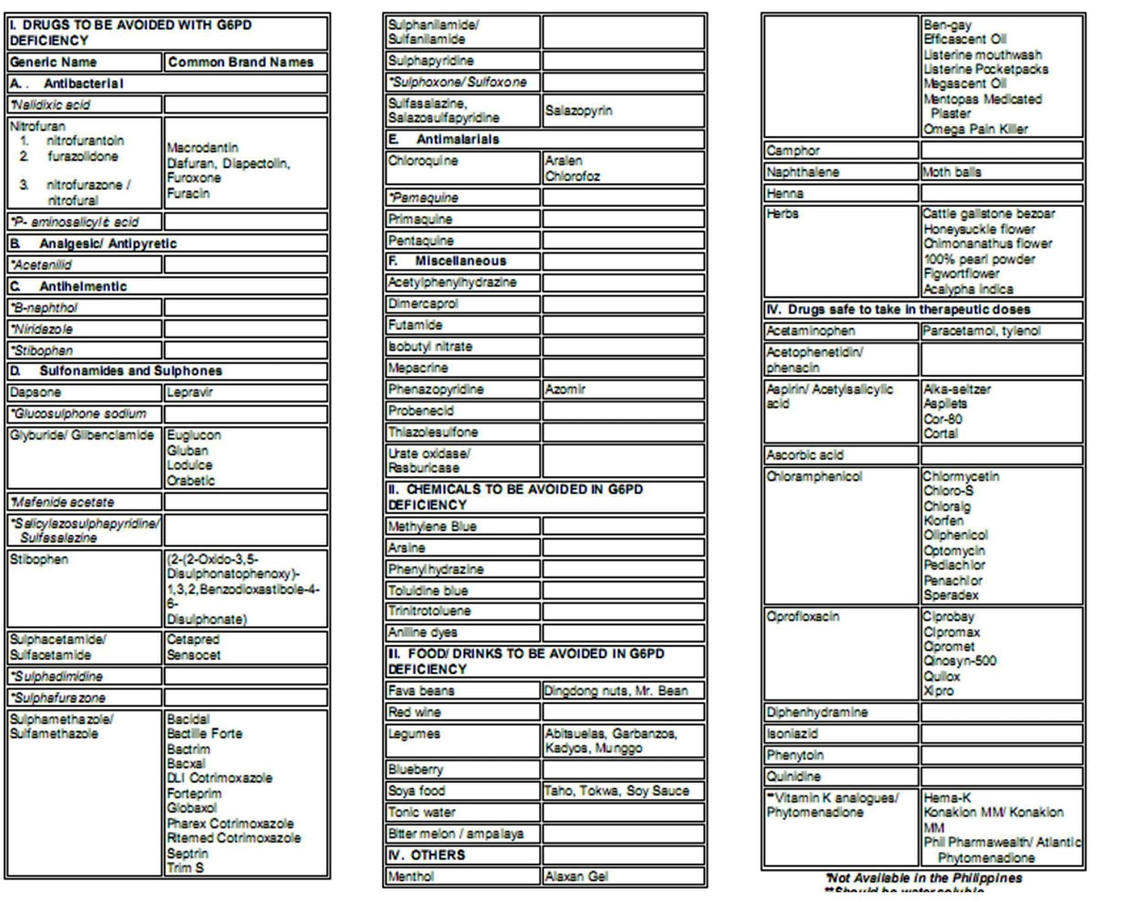


Slide 13
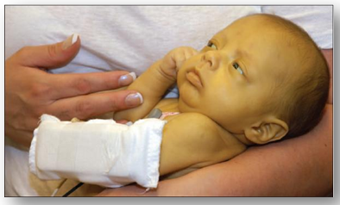
Acute bilirubin encephalopathy and its sequelae (kernicterus) are the most life threatening manifestations of neonatal G6PDD that should be preventable.

Slide 14
G6PDD TREATMENT
A. NEONATAL HYPERBILIRUBINEMIA
Neonates with early and prolonged indirect hyperbil | First line Plus | Observe Monitor bilirubin levels Phototherapy Should be managed by pediatricians or physicians familiar with appropriate guidelines
BMJ Best Practice 2016

Slide 15
G6PDD TREATMENT
A. NEONATAL HYPERBILIRUBINEMIA
If with ongoing hemolysis or markedly elevated bilirubin levels | plus | Exchange transfusion Should be managed by pediatricians familiar with appropriate guidelines To decrease the risk of neurological toxicities Double exchange transfusion 5% albumin before exchange transfusion
BMJ Best Practice 2016

Slide 16
G6PDD TREATMENT
B. ACUTE HEMOLYSIS
Acute hemolysis | First line Plus | Supportive care plus folic acid Increase fluid intake Folic acid to supply increased RBC production: 5 mg po once daily for 14-21 days Hematology consult once hemolysis is diagnosed

Slide 18
G6PDD TREATMENT:
ACUTE HEMOLYSIS
Severe anemia Hgb < 7g/dL with no renal impairement | plus | Blood transfusion Packed RBC for severe or symptomatic anemia Absolute Hgb threshold differs based on age and comorbidities Hematology consultation once hemolysis is diagnosed

Slide 19
G6PDD TREATMENT:
ACUTE HEMOLYSIS
Severe anemia Hgb < 7g/dL with renal impairement | plus | Blood transfusion and renal support EPO if with inadequate endogenous EPO levels Hemoglobinuria can cause acute renal damage Dialysis may be required to support patient until renal function recovers. SPECIALTY REFERRAL

Slide 20
G6PDD TREATMENT
C. Chronic nonspherocytic hemolytic anemia
CNHA | First line Plus | Supportive care plus folic acid Increase fluid intake an eat light diet as nausea is common Folic acid to supply increased RBC production; 5 mg po once daily for 14-21 days Hematology consult once hemolysis is diagnosed

Slide 21
G6PDD TREATMENT
C. Chronic nonspherocytic hemolytic anemia
Severe anemia Hgb < 7g/dL with no splenomegaly | plus | Blood transfusion Packed RBC for severe or symptomatic anemia Absolute Hgb threshold differs based on age and comorbidities Hematology consultation once hemolysis is diagnosed

Slide 22
G6PDD TREATMENT
C. Chronic nonspherocytic hemolytic anemia
Severe anemia Hgb < 7g/dL with splenomegaly | adjunct | Splenectomy If with significant extravascular hemolysis meaning marked splenomegaly or persistent anemia interfering with growth and normal activity May result in significant decrease in hemolysis

Slide 23
G6PDD TREATMENT
C. Chronic nonspherocytic hemolytic anemia
Severe anemia Hgb < 7g/dL with splenomegaly | adjunct | Splenectomy Should receive appropriate vaccines pre-op (HIB, pneumococcus, meningococcus) Post-splenectomy should start long term prophylaxis against infection by encapsulated bacterial organisms

Slide 24
SUMMARY:
MANAGEMENT OF G6PDD
Avoiding oxidative stressors
Parent and patient education
Recommend testing of other children
Treat hyperbilirubinemia with
  Phototherapy
  Exchange transfusion
Rarely anemia may be severe enough to warrant blood transfusion
Referral system

Slide 25

MARAMING SALAMAT PO!

