Slide 1
COMMUNITY- BASED- TREATMENT
And
REHABILITATION
for Drug Users and Recovering Drug Dependents
SONIA H. CARREON, RSW,MPA
HEAD, AFTERCARE AND MSWS

Slide 2
Community reinforcement and contingency management
These are behavioral approaches directed at modifying behaviours that are underpinned by conditioned learning.
• Clear definitions of the desirable behavior (e.g., abstinence from illicit drugs)
• Regular monitoring for the presence or absence of the desired behaviour (e.g., urine tests)
• Specified rewards for the desired behaviour (e.g., money, vouchers, takeaway doses of substitution medication, or lottery tickets); and
• Positive personal feedback from staff for the desired behavior
Contingency management can be administered by staff with relatively little training.

Slide 3
The Community Reinforcement Approach (CRA)
is more broadly based in using social, recreational, familial and
vocational reinforces to aid clients in the recovery process.
CRA integrates several treatment components, including building motivation to quit, helping cessation of drug use, analysing drug use pattern, increasing positive reinforcement, learning new coping behaviours, and involving significant others in the recovery process.

Slide 4
Relapse prevention
Relapse prevention involves avoiding a return to drug use and building a healthier self by becoming involved with
activities that do not include drug use.
Interventions comprise skills to recognise cues and risk factors for drug use, and the development of strategies to resist drug use. A range of counselling approaches are used with the aim of helping clients:
• Recognize the situations in which they are most likely to use drugs (‘triggers’ and craving)
• Avoid these situations when appropriate
• Cope more effectively with the range of problems and problematic behaviours associated with drug use

Slide 5
INTERVENTIONS
SCREENING
ASSESMENT AND TREATMENT PLANNING
CASE MANAGEMENT
COUNSELLING
SUSTAINED RECOVERY MANAGEMENT

Slide 6
Steps towards Building
Recovery Capital
Domain 1: Physical and Mental Health Supports
Physical and mental health supports are important elements of drug rehabilitation and social reintegration processes.
Beneficiaries are not only persons in the process of recovery, but also their families, their immediate environments, and the community at large.

Slide 7
Domain 2: Family, Social supports, and Leisure Activities
Family involvement, social supports, and leisure activities have been shown to contribute to better outcomes in the treatment and rehabilitation process.

Slide 8
Domain 3: Safe Housing and Environments Conducive to Health and Recovery
Providing safe housing is an important factor in the recovery process.
For example:
• Supported housing (half-way houses) provide a drug-free ambience that may help sustain abstinence and
support the recovery process
• Collective living promotes the development of positive peer interactions and building up support groups and
networks
• Stable housing provides an adequate setting for family contacts and visits and the re-establishment of trust among family members.

Slide 9
Domain 4: Peer-based Support
During this period clients may feel insecure, fearful, and anxious, and such feelings may increase the risk of relapse.
Support groups may act as positive mirrors, generate confidence, and offer support in times of crises.

Slide 10
Domain 5: (Self-)Employment and Resolution of Legal Issues
Employment counselling, including job seeking training and rapid job placement;
Development of vocational skills;

Slide 11
Domain 6: Vocational Skills and educational development
Some of the positive outcomes
experiencing higher levels of satisfaction and security,
reducing the risk of relapse.
Steps to make this possible include:
Making vocational assessment
counselling services as part of rehabilitation
social reintegration programmes aimed at the creation of sustainable livelihoods

Slide 12
Domain 7: Community integration and cultural renewal
Helpful Methods
• Training programs, weekend retreats, relapse prevention education;
• Additional counselling approaches that may help address severe psychological and emotional trauma;
• Used to facilitate cognitive-emotional integration, social bonding, and community affiliation; Promoting self-expression and conflict resolution
• Promote a sense of purpose

Slide 13
Domain 8: Meaning and Purpose in Life
- is central to leading a full and healthy life
Suggested Steps in assisting:
• Making an initial assessment, taking into account spiritual interests of clients, is useful in defining the content of the therapeutic counselling process;
• Suggest different types and practices of spiritual practice, depending on the cultural context, might have an added value (e.g., as a relaxation strategy to face fears, anxiety, anger, and create a mental sense of recovery and
well-being)

Slide 14
The Community-Based Aftercare Program for Recovering Drug Dependents:
A Multi-Sectoral Team Approach

Slide 15
DAVAO OPD AND AFTERCARE FACILITY

Slide 16
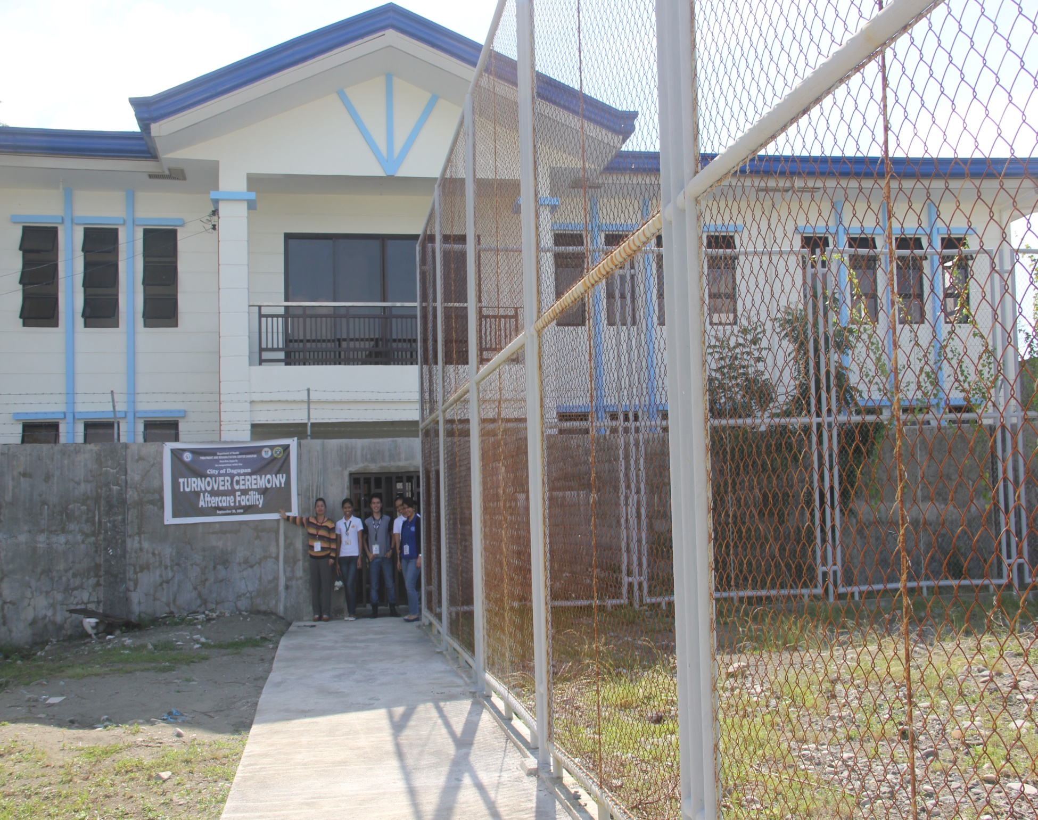
NEW DOH-TRC DAGUPAN OPD AND AFTERCARE FACILITY
Turn-over Ceremony: SEPT. 28,2016

Slide 17
AFTERCARE FLOW CHART
PRE-DISCHARGE CONFERENCE
PRE – ENTRY PHASE
ENTRY PHASE
INTENSIVE PHASE
CONTINUING PHASE
TERMINATION PHASE
Report to DOH/ LGU
Log-in by Clerk
Physical/Medical Examination by MEDICAL OFFICER
Psychological Interventions by PSYCHOLOGIST
Social intervention by
SOCIAL WORKER
Psychiatric Evaluation
Random Urine Drug Test
Spiritual and Moral Recovery by religious leader/or Ustadz
Legal Assistance with the Legal Officers
Supervise the services by PROGRAM DIRECTOR
Exit Evaluation

Slide 18
Legal Basis

Slide 19
Duration of Aftercare
SEC. 56 of R.A. 9165
“period not exceeding 18 months

Slide 20
Legal Basis
SEC. 56 of R.A. 9165
………. during the initial aftercare and follow up program of eighteen (18) months, the drug dependent requires further treatment and rehabilitation in the center, he/she shall be recommitted to the center for confinement. Thereafter, he/she may again be certified for temporary release and ordered released for another aftercare and follow up program pursuant to this Section

Slide 21
BOARD REGULATION No. 1
Series of 2006
SUBJECT: GUIDELINES IN THE IMPLEMENTATION OF THE AFTERCARE PROGRAM FOR RECOVERING DRUG DEPENDENTS
……. Department of Health (DOH), Department of Social Welfare and Development (DSWD) and other agencies in drug control, treatment and rehabilitation,………..
.

Slide 22
“Aftercare”
- is a broad range of community-based service supports designed to maintain benefit when the structured treatment has been completed. It may involve a continuation of individual or group counseling and other supports, but usually at a lower intensity and often by other agencies or organizations.

Slide 23
ARTICLE III
AFTERCARE PROGRAM
SECTION 3. What is an Aftercare Program?
An Aftercare Program (ACP) refers to services that help recovering drug-dependent persons to adapt to everyday community life, after completing earlier phases of treatment and rehabilitation. It provides an opportunity to address important issues and problems associated with abstinence and recovery.
Aftercare provides a safe environment for continued support till it is no longer needed. Aftercare and follow-up is an integral component of the treatment and rehabilitation process. It is continuation of the rehabilitation process within the community after discharge from a treatment facility.
The aftercare and follow-up program facilitates the client’s reintegration to the community and prevents relapse into drug dependency. The ACP is composed of medical, psycho-social, and economic programs which are focused on reviewing and consolidating the gains made during treatment.

Slide 24
SECTION 4. GOAL OF AFTERCARE PROGRAM
The focus is for the client to achieve a “holistic recovery” and provide support and guidance to prevent relapse into drug use.

Slide 25
SECTION 5. OBJECTIVES
General:
To provide a program for recovering drug dependents who have been discharged from rehabilitation centers for reintegration and independent functioning within their families and communities and to prevent the recurrence of drug abuse or relapse.

Slide 26
Specific Objectives:
1. To help recovering drug dependents cope and manage their cravings for prohibited drugs after discharge and to aid them in acquiring knowledge and skills to prevent or manage relapse;
2. To develop for the recovering drug dependents new social networks and peer-group programs using new approaches that will operate in a self-help orientation under professional supervision;

Slide 27
3. To provide services designed to increase the recovering drug dependent’s self-reliance and integration into society through educational, vocational, and social programs;
4. To help patients identify and alleviate high risk factors of addiction and develop coping skills to deal with them;

Slide 28
5. To assist recovering drug-dependent persons develop positive social support system; and
6. To develop community-based self-help support groups to assist drug-dependent persons in the recovery process, social reintegration, and maintenance of abstinence

Slide 29
SECTION 7. Who may Offer ACP?
ACP may be offered by the original TRC as an outpatient or by trained aftercare program givers, under the supervision of a DOH- accredited physician.

Slide 30
e. Upon completion of the treatment and rehabilitation program, the client shall undertake an aftercare program as determined by the accredited physician or the Center TEC.
f. The TRC shall refer the patient for aftercare to support groups, self- help groups and other agencies providing aftercare-related services determined to be suitable for the client’s needs;
(Example: Barangay ADAC, NA, Provincial Social Workers and others).

Slide 31
The Center shall also provide aftercare services (see Section 9 for the details) which may consist of any of the following services:
1. Social Services
Case Work and Individual Counseling
b) Group Work and Group Counseling
c) Recovery Training Session
d) Faith-Based Session;
e) Family Counseling
f) Referral Services
g) Conduct of Parent Recovering Dependent Dialogue

Slide 32
2. Psychological Services
Psychological assessment through administration of test and evaluation of client;
b) Provision of psychological counseling to improve client’s positive attitude;
c) Psychotherapeutic management;
d) Group therapy session with psychiatrists
e) Referral of client for further psychiatric treatment

Slide 33
3. Other Services
  Narco-Urine Test
b) Coordination with GO’s/NGO’s re: other support services
During this period, the patient shall be required to attend the services prescribed by the accredited physician or the Center TEC.

Slide 34
The Treatment and Rehabilitation Center and/or the accredited physician shall monitor the progress of the client and shall report any deviation from the prescribed aftercare plan.
i. A pre-discharge conference shall be conducted to determine if the client can already be issued a Certificate of Completion for the aftercare program.

Slide 35
Section 9. INTERVENTIONS AND SERVICES

Slide 36
1. Group Sessions
Ideally the group should not exceed twelve (12) participants.
The duration will depend on the degree of progress and full recovery of the client. The modules will also deal knowledge and skills in identifying personal high-risk factors, and develop specific coping strategies to prevent or manage relapse.

Slide 37
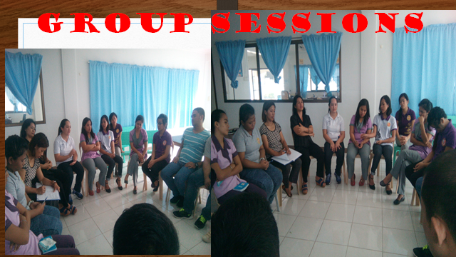
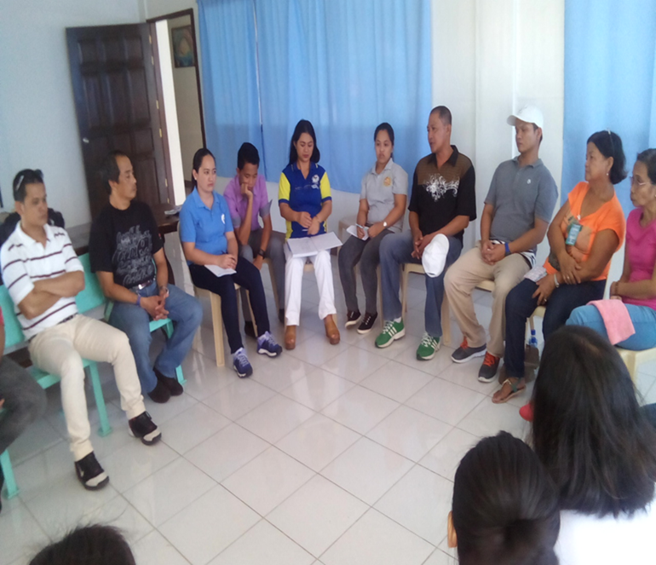
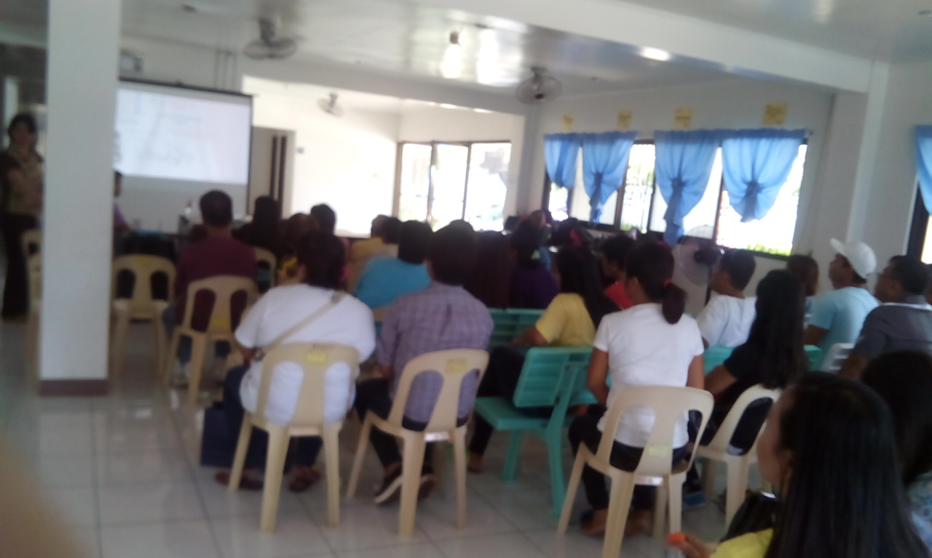
GROUP WORK AND GROUP SESSIONS
A group of recovering drug dependents shall meet together at least once a week , led by a professional facilitator to confront behavior problems, deal with social integration issues such as drug cravings, social pressure to use, family issues and etc., and acquire knowledge and new strategies on how to overcome drug cravings and present relapse incidents among the Recovering Drug Dependents.
GROUP WORK AND GROUP COUNSELLING FOR AFTERCARE RECOVERING DRUG DEPENDENTS

Slide 38
2. Individual Therapies and Counseling sessions maybe pursued as necessary.

Slide 39
3. Family Counseling
Primary purpose :
- to keep the solidarity and harmony in the RDD’s family.
aim to develop healthy interpersonal relationships within the family and to establish open positive communication;
- shall be done regularly to help family members gain deeper understanding of their role in the treatment process.
- Family members shall be oriented of their roles in the reintegration of drug dependents to the community.
Assessment of possible substance abuse by other members of the family or significant others shall be a component of this service.

Slide 40
4. Attendance to Support Groups
- attending self-help programs : Narcotics Anonymous (NA) / Alcoholic Anonymous (AA) meetings, regular follow-up at treatment center, individual and group counseling sponsor/sponsee meetings, alumni association meetings, etc.

Slide 41
5. Marital Enhancement Seminar
allow the RDDs and their respective spouses to learn techniques and strategies on the proper and effective ways of resolving marital conflicts.
it will strengthen husband-wife relationship and family
life.

Slide 42
6. Effective Parenting
- a week-long course on parenting skills enhancement and the promotion of family solidarity to support the client, and increase parenting skills of the parents and / or guardians of the recovering drug dependents.
aim to provide and / or enhance the knowledge and skills of the parents / parent substitutes on the care and management o f clients with particular focus on enhancing family unity, consciousness and well-being.

Slide 43
Section 10. Educational Assistance
Based on the assessment of the social worker on the educational needs, skills and qualifications, arrangement shall be facilitated for the client’s
re-entry to school or work.

Slide 44
Section 11. Employment Assistance/Skills Training / Livelihood Assistance
to augment the income of the client and his/her family either in the form of livelihood assistance or micro- credit entrepreneurship.
geared towards generating income from projects that are feasible with the resources available for the livelihood of families.
Referrals can be made to agencies which either generate or facilitate employment : DOLE, or link potential employees to specific programs such as those provided by government and the private sectors through job markets, etc.

