Slide 1
COMMUNITY- BASED- TREATMENT
And
REHABILITATION
for Drug Users and Recovering Drug Dependents
SONIA H. CARREON, RSW,MPA
HEAD, AFTERCARE AND MSWS

Slide 2
Section 12. Faith-Based Development
- views faith as an inspiration to change and well being of the individual.
pastoral counseling shall be facilitated if such is requested.

Slide 3
Section 13. Other Services
Narco-urine testing:
done during the period of aftercare,
done on a random basis, or when there are signs of relapse, or any “just cause”.
If found positive to dangerous drugs for two consecutive drug testing, assessment of risks, counseling, and follow-up of the client shall be undertaken immediately.
- recommitment to the center for further treatment and rehabilitation shall be prescribed if the results of assessment so indicate. Thereafter, the client may again be certified for temporary release and ordered released for another aftercare and follow-up program. A close working relationship shall be maintained by the rehabilitation team with the client and the family.
13.1 Additional services such as assessment and the provision of follow-up services to clients with co-occurring psychiatric problems shall be provided when necessary.

Slide 4
ARTICLE V
TERMINATION OF THE GENERAL AFTERCARE PROGRAM

Slide 5
SECTION 14.
-The client’s case shall be terminated only after strict adherence to the aftercare program plan and follow-up schedule and upon completion of the eighteen (18) months period of aftercare program as prescribed in R.A. 9165 and/or achievement of the following seven (7) indicators for a recovered drug dependent

Slide 6
a. Negative results of at least three (3) consecutive random drug testing;
b. Has improved in terms of adequate coping skill, regained self-esteem, and in over-all functioning;

Slide 7
c. Assumption of social responsibility,
e.g. reintegration to previous employment, or manifestation of a serious desire to learn skills and search for employment or self-employment, resumption of school activity either formal or non-formal, and the absence of any involvement in criminal activity;
d. No social deviancy, e.g. drug-related criminal or gang activity, social evil vices, etc., and maintaining good standing in the community;

Slide 8
e. Existence of positive social support system or meaningful drug-free social relationship; and
f. Endorsement of concerned and responsible person/agency attesting to the client’s successful social reintegration.
The accredited physician or the TRC shall issue a Certificate of Completion for the aftercare program for the patient for whatever purpose it may serve him/her.

Slide 9
ARTICLE VI
ROLES AND RESPONSIBILITIES OF GOVERNMENT AGENCIES
SECTION 15. The following agencies shall have the respective responsibilities as indicated:

Slide 10
A. Department of Health (DOH)
Conduct training of accredited physician on Aftercare Program;
2. Develop and implement a comprehensive aftercare and follow up program in coordination with DSWD and LGUs in order to complete the eighteen (18) months period;
3. Recommend, to the court the release of a drug dependent;
4. Inform the Provincial DOH Representative on the random drug testing results for monitoring purposes;

Slide 11
5. Develop data-banking system;
6. Provide technical assistance and conduct of monitoring on program implementation;
7. Develop standards and guidelines in the implementation of after care program;
8. Conduct on-going evaluation and improvement of Aftercare and Follow-up Program; and
9. Accredit NGOs providing aftercare services for drug dependents in coordination with DSWD.

Slide 12
B. Department of the Interior and Local Government (DILG)
(Through the Provincial/City/Municipal Social Welfare Development Office and the respective Provincial/City/Municipal/Barangay Anti-Drug Abuse Councils)
Conduct follow-up aftercare including direct provision of services based on DOH guidelines;
2. Conduct advocacy activities;
3. Document best practices on after care interventions; and
4. Submit report to DOH on status of clients served.

Slide 13
C. Department of Social Welfare and Development (DSWD)
1. Conduct capability building and/or provide technical assistance to LGUs in the provision of aftercare services and other relevant psycho-social services;
2. Conduct advocacy activities; and
3. Accredit NGOs providing aftercare services (RA 9165, Sec. 57);

Slide 14
D. Dangerous Drugs Board (DDB)
Direct the Parole and Probation Administration to recommend drug dependents to undergo community service as part of his/her aftercare and follow up program; and
2. Design and develop a national treatment and rehabilitation program for drug dependents including a standard aftercare and community service program for recovering drug dependents, in consultation and coordination with the DOH, DSWD and other agencies involved in drugs control, treatment and rehabilitation, both public and private .

Slide 15
E. Department of Justice (DOJ) [Through the Parole and Probation Administration (PPA)]
Take charge of provisions accordingly promulgated in consonance with Section 57 and Section 70 of RA 9165 and the applicable provisions of Pres. Dec. No. 968, (the Probation Law of 1976), as amended and RA No. 9344 (Juvenile Justice and Welfare Act of 2006);
2. Provide follow-up aftercare services based on DOH/DDB approved guidelines;
3. Conduct advocacy and training activities specific for the above-mentioned provisions and target population;
4. Document best practices on after care interventions; and
5. Submit report to DOH/DDB on status of clients served.

Slide 16
F. Department of Labor and Employment (DOLE)
Provide training on aftercare in the context of the training for the Assessment team of the Drug-Free Workplace training course.
2. Document success stories and best practices as well as failures in reintegration.
3. Provide referrals to employment programs, trainings for new skills, entrepreneurship and links to resources

Slide 17
G. Non-Governmental Organizations (NGOs)
1. Assist the Government Agencies in effectively implementing provisions of the aftercare guidelines;
2. Assist in providing support structures for aftercare clients;
3. Assist in monitoring aftercare services rendered;
4. Advocate aftercare activities at the community level;
5. Provide technical and logistical support to aftercare services; and
6. Acquire adequate skills for program implementation, when the NGO is directly involved in providing aftercare services.

Slide 18
DOH
AFTERCARE IMPLEMENTATION SCHEME

Slide 19
Phases of Aftercare
•Entry
•Intensive
•Continuing
•Termination

Slide 20
Entry Phase
•First month to second month
•Interphase between residential and community components of rehabilitation
Preparation of documentary requirement
•Contract signing and agreements

Slide 33
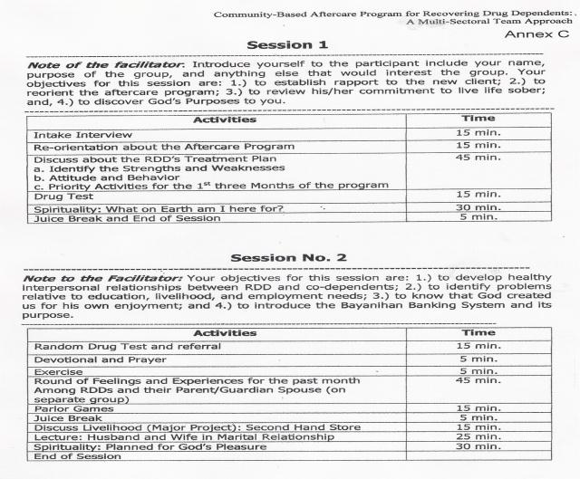

Slide 34
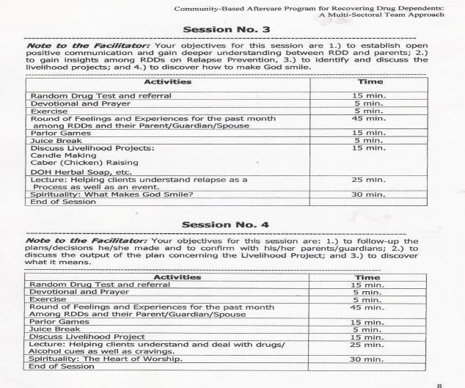

Slide 35
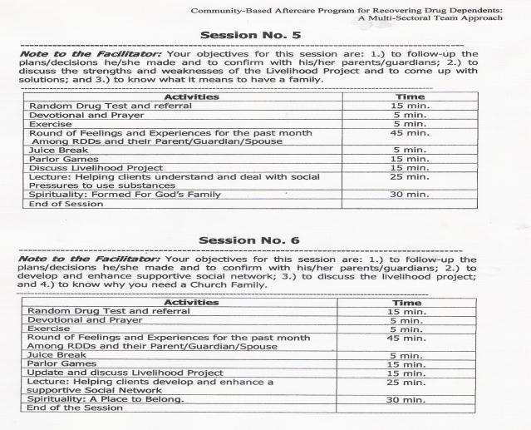

Slide 36
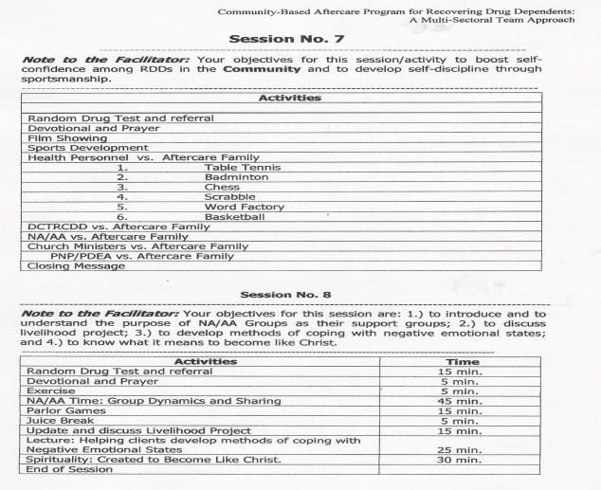

Slide 37
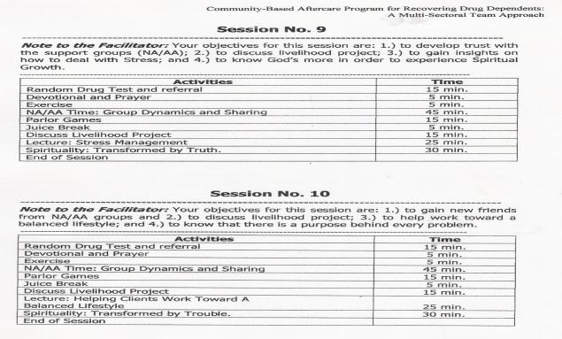

Slide 38
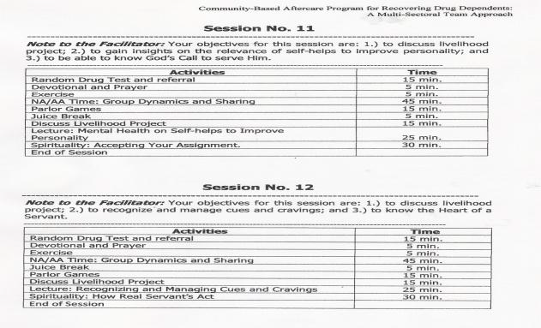

Slide 39
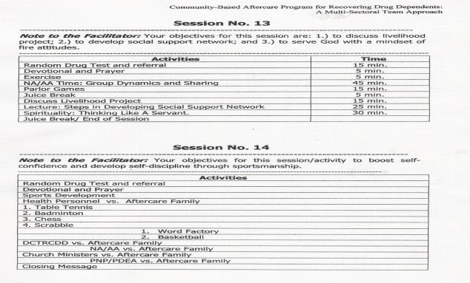

Slide 40
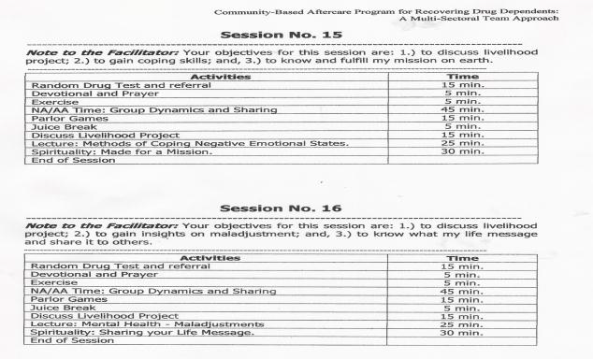

Slide 41
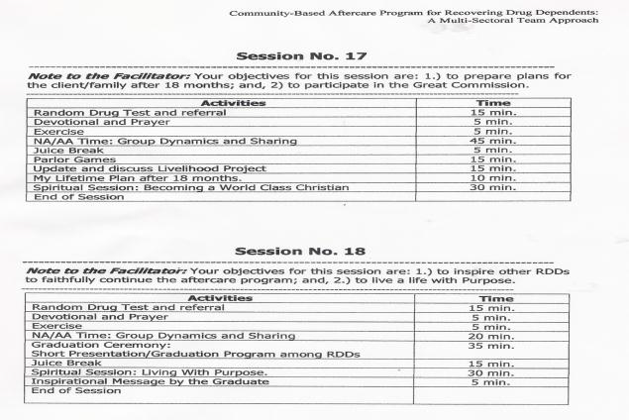

Slide 42
DAILY WORK SCHEDULE
TIME | ACTIVITIES
7:30 – 8:00 am | Morning Exercise
8:00-8:30am | Interview with the Recovering Drug Dependent and family member by the Social Worker.
8:30-9:30am | Physical Check-up by the Medical Officer and referral to Drug Testing Laboratory for Urine Drug Test.
9:30-10:00am | Psychological Intervention or Social Interventions
10:00-10:15am | Break Time
10:15-11:00am | Bible Sharing and Purpose Driven Life by Spiritual Mentor for Christian Recovering Drug Dependents. Islamic Intervention Session for Muslim.
11:00-12:00n | Reminders of the Aftercare Treatment Plan and Treatment Contract by the Social Worker before issuing Certificate of Attendance
12:00nn-1:00pm | Lunch Time
1:00pm-3:00pm | Progress/Final Case Conference with the Community Aftercare Team and Family Members.
3:00pm | Break Time
3:00-5:00pm | Administrative Function

Slide 43
Sample Schedule of Sessions
Time | Activities
7:30 to 8:30 am | Preparation and Morning Exercise
8:30am to 9:30 am | Morning Meeting
9:30 to 10:00 am | Opening Ceremony
10;00 to 10:15 am | Break
10:16 to 11:15 am | Developmental (Lectures)
11:16 to 12:00 NN | Spiritual enhancement
12:00 to 1:00 PM | Lunch Break
1:00 to 3:00 PM | Group psychotherapy/ individual Counseling
 | Group Dynamics/ Group Activities/ O.T.
Every Second Tuesday of the Month: Family Group Sessions
Every 4rth Friday of the Month: Recreational/Outreach/Socialization activities

Slide 50
THANK YOU AND GOD BLESS IN YOUR IMPLEMENTATION OF THE COMMUNITY-BASED TREATMENT AND CARE SERVICES TO OUR CLIENTS.

