Slide 1
Options for Writing Cause-of-Death Statements for Periprocedural Deaths

Slide 2
Option for Writing Causes of Death for Periprocedural Deaths
Periprocedural death refers to death that is known or suspected as having resulted in whole or in part from diagnostic, therapeutic, or anesthetic procedures.
The “procedure” may be as simple as the administration or ingestion of drug.
It is also referred to as “misadventure,” “iatrogenic,” or “errors and accidents in medical care.”

Slide 3
Option for Writing Causes of Death for Periprocedural Deaths
Such words as “misadventure” and “iatrogenic” may connote negligence.
Many procedural deaths, however, do not involve negligence, mistake, or culpability.
It is recognized that the approach to certifying such deaths varies and the certifier must have the liberty to write cause-of-death statements which best meet their needs in a particular case.

Slide 4
Major ICD categories of periprocedural deaths :
Accidental poisoning by and exposure to noxious substances. (X40 – X49).
Ex., accidental poisoning by and exposure to nonopiod analgesics, antipyretics antirheumatics.
Drugs, medicaments and biological substances causing adverse effects in therapeutic use (Y40 – Y59).
Ex., adverse effect of properly administered systemic antibiotics.

Slide 5
Major ICD categories of periprocedural deaths :
Misadventures to patients during surgical and medical care (Y60 – Y69).
Ex., unintentional cut, puncture, perforation or hemorrhage during surgical and medical care.
4. Medical devices associated with adverse incidents in diagnostic and therapeutic use (Y70 – Y82).
Ex., obstetric and gynecologic devices associated with adverse incidents.

Slide 6
Major ICD categories of periprocedural deaths :
Surgical and other medical procedures as the cause of abnormal reaction of the patient, or of later complication, without mention of misadventure at the time of procedure (Y83 – Y84). Ex., aspiration of fluid.

Slide 7
Categories of periprocedural death may be defined:
Peridiagnostic (related to a diagnostic agent, procedure or device)
Perianesthetic (related to an anesthetic agent, procedure, or device)
Peritherapeutic (related to a therapeutic agent, procedure, or device)
Perioperative (related to a surgical procedure or device; may be further subcategorized as intraoperative or postoperative
*The term periprocedural is a generic term that may be used to include any of the categories defined above.

Slide 8
Ensure that a periprocedural death is evident
Indicate in the cause-of-death statement the periprocedural nature of death to ensure proper coding by nosologist.
This is done by including in the wording of cause-of-death statement the appropriate category of periprocedural death (i.e., peridiagnostic, perianesthetic, peritherapeutic, perioperative [or intraoperative or postoperative], or periprocedural).

Slide 9
Sample cause-of-death statement for periprocedural death
Part I | Time Interval
a. Intraoperative myocardial infarction | hours
b. Atherosclerotic coronary artery disease | years
c.
Part II Resection of adenocarcinoma of colon

Slide 10
Classification of periprocedural death
Based on circumstances surrounding the death in question, periprocedural death may be classified as:
Malfunction of (or defective) medical device, tool, or diagnostic/therapeutic agent. (Ex., short circuit in cautery device causing electrocution.)
Incorrect use of a medical device, tool, or diagnostic/therapeutic agent. (Ex., administering the wrong dosage of a drug.)

Slide 11
Classification of periprocedural death
Rarely occurring complication with recognized untoward potential. (Ex., malignant hyperthermia from anesthesia.)
Unanticipated complication. (Ex., leaving a surgical towel in the abdomen.)
Reasonably anticipated outcome of an indicated medical therapy or procedure. (Ex., pneumothorax from PEEP required to ventilate patient with severe pneumonia.)

Slide 12
Classification of periprocedural death
Inherent and accepted risk of an invasive procedure or surgery. (Ex., rejection of a transplanted organ.)
Nonspecific stress of a procedure or therapy not falling in other classification. (Ex., death during hip surgery in elderly.)
Periprocedural death otherwise not classifiable. (Ex., death during surgery but cause cannot be determined.)

Slide 13
Dilemma of format for writing COD for periprocedural deaths
Which periprocedural events constitute an “injury?”
Where and how to report the injury in the cause-of-death statement?
How to relate and report an injury in relation to existing disease processes?
How to designate the manner of death?
How to completely and accurately certify death without inciting litigation or unduly raising issues of culpability when a periprocedural incident presents itself as an injury?

Slide 14
Approach to selecting format for writing cause-of-death statement
The structure or format of the cause-of-death statement that will be will be based on your answer to this question:
Would death have been imminent in the procedure’s absence?
(Would the patient have died without the procedure?)

Slide 15
Death Imminent
An elderly man with refractory congestive heart failure due to atherosclerotic coronary artery disease died of digoxin toxicity because of the high doses required.

Slide 16
Death Imminent: Use Combined Format
Part I | Time Interval
a. Digoxin toxicity | Hours
b. Peritherapeutic complication of digoxin therapy due to congestive heart failure | Hours; 5 weeks
c. Atherosclerotic coronary artery disease | 5 weeks
Part II

Slide 17
The combined format (i.e., everything is stated in Part I) may be used for such death and other similar deaths, such as:
Theophylline toxicity in a patient with refractory asthma;
Death of a patient with a neoplasm whose death results from a chemotherapeutic agent through some toxic effect; or
Ventilator-induced pneumothorax in an AIDS patient with respiratory insufficiency from pneumonia.

Slide 18
Death Not Imminent
An elderly man with a previous stroke (cerebral infarction) from carotid artery sclerosis died of scald burns sustained in an overheated whirlpool being used as part of the physical therapy regimen to treat lower extremity contractures that occurred following stroke. Prior to the scald burns he had been stable.

Slide 19
Death Not Imminent: Use Split Format
Part I | Time Interval
a. Immediate Cause
b. Antecedent Cause
c. Underlying Cause
Part II Carotid artery sclerosis with remote cerebral infarction

Slide 20
Death Not Imminent: Use Split Format
Part I | Time Interval
a. Pseudomonas burn wound sepsis | 2 days
b. Peritherapeutic cutaneous scald burns from whirlpool therapy | 4 days
c. | 4 days
Part II Carotid artery sclerosis with remote cerebral infarction

Slide 21
The split format is used for this case and for other types of periprocedural deaths in which death would likely not have been imminent in the procedure’s absence.
In general, deaths that are to be assigned a manner of death other than natural are best accommodated by the split format because an injury event is stated as the underlying cause of death.

Slide 22
General guidelines for classifying manner of death
Class of periprocedural death | Suggested manner | Format
1. Malfunction of a medical device, tool, diagnostic/therapeutic agent | Accident | S
2. Incorrect use of a medical device, tool, diagnostic/therapeutic agent | Accident | S
3. Rarely occurring complication with recognized untoward potential | Variable | S/C
4. Unanticipated complication | Variable | S/C

Slide 23
General guidelines for classifying manner of death
Class of periprocedural death | Suggested manner | Format
5. Reasonably anticipated outcome of necessary medical therapy | Natural | C
6. Inherent and accepted risk of invasive procedure or surgery | Natural | C
7. Nonspecific stresses of a procedure not in another class | Natural | C
8. Periprocedural death not otherwise classifiable | Undetermined | C

Slide 24
Sample cause-of-death statements
The following case samples are based on the eight classifications of periprocedural deaths.
The examples can serve as templates which may be used for other types of periprocedural death that fall into the same class as a given example.

Slide 25
Class 1: Malfunction of a medical device, tool, dx/rx agent
A 65-year old male patient had metastatic adenocarcinoma of the prostate and was on morphine drip with an infusion pump. The roller on the pump was defective and tore the tubing, pumping air into the patient and producing fatal air embolism.

Slide 26
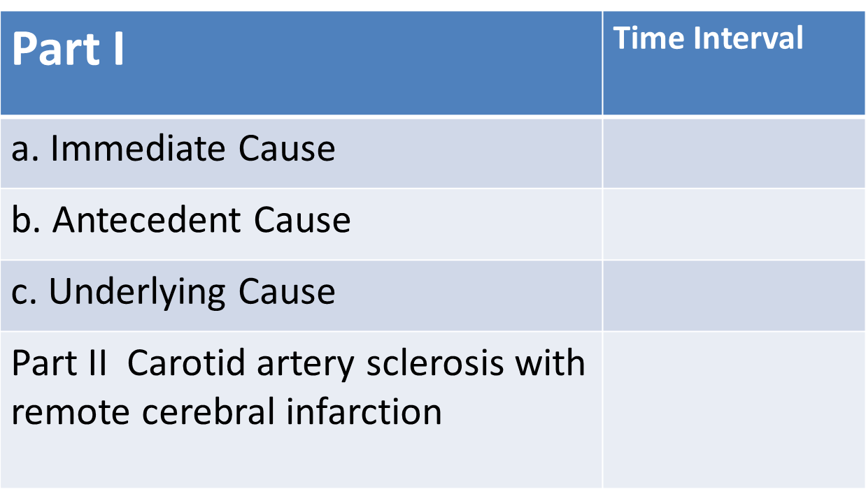
Class 1: Malfunction of a medical device, tool, dx/rx agent

Slide 27
Class 1: Malfunction of a medical device, tool, dx/rx agent
Part I | Time Interval
a. Intravenous air embolism | Minutes
b. Peritherapeutic injury by analgesia infusion pump | Minutes
c.
Part II Metastatic adenocarcinoma of the prostate

Slide 28
2. Incorrect use of a medical device, tool, diagnostic/therapeutic agent
A 50-year old man was undergoing retrograde pancreatic endoscopy for biliary tree problems when the physician inadvertently pushed the wrong button and instilled gas instead of water, causing dissection of gas into tissues and fatal gas embolism. Autopsy confirmed gas embolism and a common duct stone.

Slide 29
2. Incorrect use of a medical device, tool, diagnostic/therapeutic agent
Part I | Time Interval
a. Gas embolism | Minutes
b. Periprocedural injury during diagnostic endoscopy | Minutes
c.
Part II Choledocholithiasis with biliary obstruction

Slide 30
3. Rarely occurring complication with recognized untoward potential
Shortly following surgery for an inguinal hernia, the 50-year old patient developed malignant hyperthermia and died. Halothane was the primary anesthetic. The history and autopsy findings were consistent with a halothane-induced malignant hyperthermia.

Slide 31
3. Rarely occurring complication with recognized untoward potential
Part I | Time Interval
a. Immediate Cause
b. Antecedent Cause
c. Underlying Cause
Part II Carotid artery sclerosis with remote cerebral infarction

Slide 32
3. Rarely occurring complication with recognized untoward potential
Part I | Time Interval
a. Malignant hyperthermia | Hours
b. Perianesthetic complication of halothane anesthesia | Hours
c.
Part II Inguinal hernia and herniorraphy

Slide 33
4. Unanticipated complication
A 56-year old man underwent an “uneventful” cholecystectomy for gallstones and was discharged from the hospital few days after. Several days later, he developed peritonitis and died shortly after returning to the hospital, complaining of fever and abdominal pain, 5 days postoperatively. Autopsy showed a retained surgical towel in the abdomen with diffuse peritonitis.

Slide 34
4. Unanticipated complication
Part I | Time Interval
a. Peritonitis | Days
b. Retained surgical towel in abdomen | 5 days
c. Perioperative complication of cholecystectomy | 5 days
Part II Cholelithiasis

Slide 35
5. Reasonably anticipated outcome of necessary medical therapy
A 45-year old patient with a history of IV drug abuse and AIDS developed pneumocystis carinii pneumonia. She became progressively difficult to ventilate, ultimately requiring extreme positive pressure ventilatory support. Bilateral pneumothoraces were produced by the necessarily high ventilator pressures, and the patient died.

Slide 36
5. Reasonably anticipated outcome of necessary medical therapy
Part I | Time Interval
a. Immediate Cause
b. Antecedent Cause
c. Underlying Cause
Part II Carotid artery sclerosis with remote cerebral infarction

Slide 37
5. Reasonably anticipated outcome of necessary medical therapy
Part I | Time Interval
a. Bilateral pneumothoraces | Minutes
b. Peritherapeutic complication of ventilatory support due to Pneumocystis carinii pneumonia | Minutes; 5 weeks
c. AIDS | 3 years
Part II Intravenous drug abuse

Slide 38
6. Inherent and accepted risk of invasive procedure or surgery
A 48-year old female patient underwent laparotomy and removal of the gallbladder with placement of drains. The specimen showed that the patient had cholelithiasis and acute cholecystitis. No problems were encountered during surgery. Postoperatively the bile drainage did not diminish in the usual time and she developed bile peritonitis, shock, and died. Autopsy did not disclose any surgical failures.

Slide 39
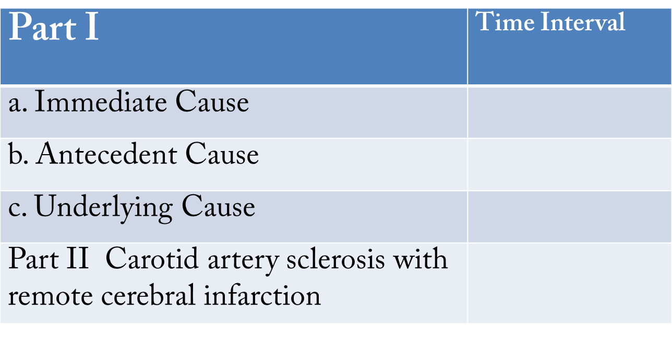
6. Inherent and accepted risk of invasive procedure or surgery

Slide 40
6. Inherent and accepted risk of invasive procedure or surgery
Part I | Time Interval
a. Bile peritonitis | 3 days
b. Postoperative complication of cholecystectomy | 5 days
c. Cholelithiasis | Months
Part II Cholecystitis

Slide 41
7. Nonspecific stresses of a procedure not in another class
A 63-year old man died on the operating table while undergoing triple bypass coronary artery surgery for atherosclerosis. He had a history of unstable angina and was rated as a high-risk patient preoperatively. The patient elected to have the procedure because angina severely restricted his lifestyle and quality of life. Autopsy did not show any surgical failures.

Slide 42
7. Nonspecific stresses of a procedure not in another class

Slide 43
7. Nonspecific stresses of a procedure not in another class
Part I | Time Interval
a. Intraoperative death during coronary bypass surgery | Hours
b. Atherosclerotic coronary artery disease | Years
c.
Part II

Slide 44
8. Periprocedural death not otherwise classifiable
A 45-year old man died on the operating table while undergoing inguinal herniorrhaphy. A thorough autopsy, medical records review, and death investigation failed to identify an immediate cause of death. This seemingly healthy man died during a relatively minor procedure for no determined reason.

Slide 45
8. Periprocedural death not otherwise classifiable

Slide 46
8. Periprocedural death not otherwise classifiable
Part I | Time Interval
a. Intraoperative death during inguinal herniorrhaphy | Hours
b. Undetermined cause | Unknown
c.
Part II

Slide 47
Medico-legal considerations
A death certificate is primarily a statistical document.
May constitute an important source of information for family members and other people or agencies who may then impart too much, or inappropriate significance to the death certificate especially if they are not aware of its general purpose, limitations, and opinion-based nature.

Slide 48
Medico-legal considerations
A major issue to those who certify periprocedural deaths is concern about whether cause-of-death wording and manner of death classification will foster litigation, unnecessarily implicate a treating physician or other person or agency, alienate professional colleagues, or unnecessarily alarm family members and survivors.

Slide 49
Medico-legal considerations
A problem may also result if the cause-of-death statement is oversimplified, or if the certifier omits known complications because some people may perceive an attempt to conceal facts or cover up a problem.

Slide 50
Medico-legal considerations
An objective approach that is based on documented or reasonably probable facts should minimize such problems through stating the truth to the best of one’s knowledge.

