Slide 1
PLANNING
Maria Teresa Vila-Calpito, RSW
Social Welfare Officer II

Slide 2
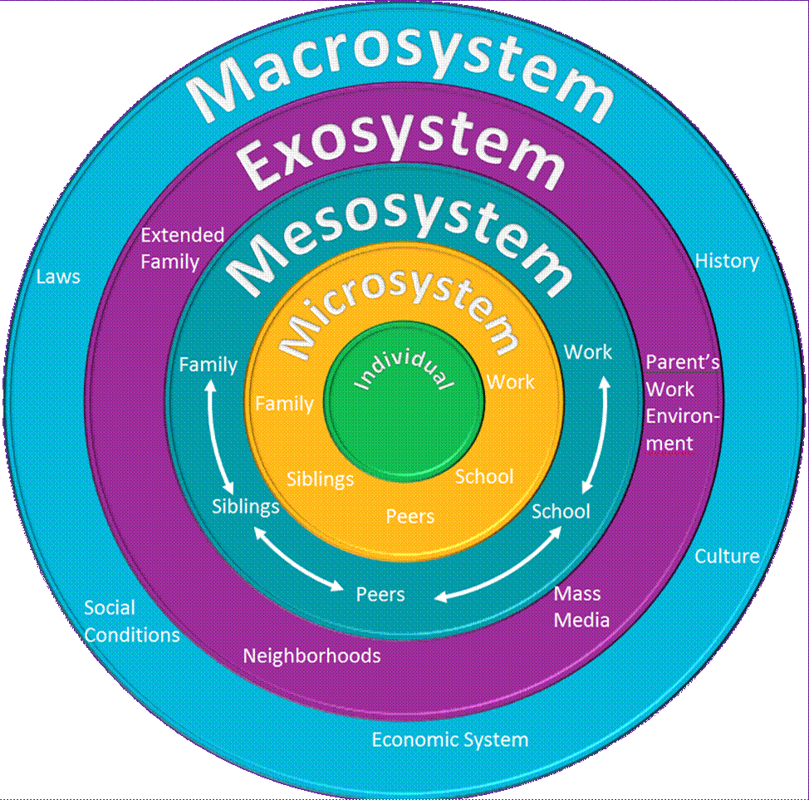
Ecological Framework
Micro level, where the focus is on the individual client’s personality, motivation, feelings and other personal characteristics
Meso level, where the focus is on the context immediately surrounding the client e.g. family, church/peer group
Macro level, where the focus is on the larger society’s characteristics & the way the client experiences these or the way these are brought to bear on the client’s situation e.g. political system, educational system, the economy, etc.

Slide 3
Strengths Perspective
An approach that focuses on client’s strengths, abilities & positive qualities instead of problems, defects, etc.
Major principles:
Every individual, family, community has strengths, assets and resources;
trauma & abuse, illness & struggles may be devastating but they also maybe opportunities for growth & source of challenge and opportunities;

Slide 4
Planning
Planning is the bridge between assessment and intervention or service delivery
develop plan with client that is comprehensive and addresses the issues/problems in the assessment
* Counselor & client to develop a contract which should be reviewed periodically; maybe modified or adjustments be made as necessary

Slide 5
Planning
Specify goals the service provider/client wish to achieve;
Identify what changes need to be made to achieve these goals;
Select from among alternative change strategies the interventions most likely to reach the goals;
Determine which actions will be taken by the client and the service provider; and
Establish timelines for completing these actions.

Slide 6
Contracting
Problems/concerns to be addressed;
Goals & objectives of the intervention;
Activities the client will undertake;
Tasks to be performed by the ;
Expected duration of the intervention;
Schedule of time & place for interviews or follow-ups; and
Identification of other people, agencies expected to participate and contribution to the change process.

Slide 7
Arranging Services: Service Coordination
If client needs services that the agency cannot provide, the Counselor should:
Locate such resources in the community;
Arrange for the client to make use of them;
Support the client in using them.

Slide 8
Monitoring
Monitoring is keeping track of what is happening & continuously evaluate the progress of the service provision or intervention.

Slide 9
Monitoring Services
Review of services received by client from the agency and other agencies;
Review of changes in client’s condition & circumstances such as income, family relationships, etc.;
Check progress toward the goals or objectives set forth in the plan of services; may entail adjustments to improve effectiveness

Slide 10
Documentation
Document all services delivered to your client
Document activities conducted
Documentation provides a written account of activities /services as they happen

Slide 11
Evaluation & Termination
Evaluation – measures the degree of changes in the client and the effectiveness of the interventions
Termination – Counselor guides concluding activities of the process of ending the helping relationship; resumption of service may occur in the future if need arises

