Slide 1




BASIC TRAINING FOR BARANGAY HEALTH WORKERS
Calasiao, Pangasinan
BREASTFEEDING

Slide 2

All mothers can breastfeed regardless
of the sizes of their breasts. Even
mothers with flat or invented nipples
can breastfeed. Taking good care of
the breasts is very important for the
health of both mother and her baby.
Feeding the infant breastmilk exclusively for the first 6 months is the best nutrition a mother can provide. This will also minimize the chance of the baby getting infected with sickness.
The BHW should help promote exclusive breastfeeding among mothers.

Slide 3
A. The three E’s of Breastfeeding
1. Exclusive
2. Early start
3. Extended
B. Importance of Breastfeeding
C. Composition of Breastmilk
D. Advantages of Exclusive Breastfeeding
E. Proper Breastfeeding Procedures
1. Care of the Breast
2. Anatomy of the Breast
3. Proper Positioning
4. Duration of Feeds
F. Help that mothers need to Breastfeed successfully
1. Psychological preparation
2. Practical advice
G. Problems and their solution during Breastfeeding
1. Early problems
2. Later problems

Slide 4
A. The Three E’s of Breastfeeding
1. Exclusive breastfeeding
Exclusive Breastfeeding means that the baby should receive only breastmilk for the first 6 months of life.
Breastmilk already contains almost everything the baby needs.

Slide 5
2. Early Start
Breastfeeding should be started immediately after delivery. This is a good time for the baby to learn to suck. In most cases, the real milk of the mother comes in on the second or third day.
You must encourage the mother to let the baby suck even if the milk has “not come out” yet.

Slide 6


As the baby sucks
  He gets the “colostrum”
  The milk will be stimulated to flow earlier
  The uterus will contract and return to shape

Slide 7
3. Extended breastfeeding
Breastfeeding can continue for as long as the mother feels comfortable doing it. However, the baby will need other foods in addition to breastmilk upon reaching the age of 6 months.
Breastfeeding should continue for another 12-18 months while the child gets more and more solid foods.

Slide 8
B. Importance of Breastfeeding
Advantages of BREASTFEEDING
Breastmilk | Breastfeeding
Perfect nutrients | Helps bonding and development
Easily digested Efficiently used | Helps delay a new pregnancy
Protects against infection | Protects mothers’ health
Costs less than artificial feeding

Slide 9
C. Composition of Breastmilk
The yellowish or clear in colour is called COLOSTRUM. It is the breastmilk that women produce in the first few days after delivery.
Colostrum contains antibodies and more white blood cells than white milk. It protects the body from infection.
Colostrum is also rich in a substance which stimulates the development of the baby’s intestines. It actually prepares the baby to absorb and digest milk. Although colostrum is secreted in small amounts, it is enough for a normal baby.
Besides colostrum, milk also contains an element which helps make special bacteria grow in the baby’s intestines. These bacteria prevent diarrhea.

Slide 10
Colostrum
Property | Importance
Antibody Rich | Protects against infection and allergy
Many white cells | Protect against infection
Purgative | Clears meconium Helps to prevent jaundice
Growth factors | Help intestine to mature Prevents allergy, intolerance
Vitamin A Rich | Reduces severity of infection Prevents eye disease

Slide 11
Breastmilk is good for the baby because in contains all the nutrients that a baby needs for the first 6 months of life.
  The right amount of protein, iron , fat, lactose (milk sugar) and iron
  Enough vitamins for the baby (vitamin supplement or fruit juice not an absolute necessity)
  Enough water for a baby even in a hot climate
  The correct amount of salt, calcium and phosphate

Slide 12
D. Advantages of Exclusive Breastfeeding
Breastmilk is easily digested.
It is always ready for the baby and needs no preparation.
It never grows sour nor spoiled.
It helps stop bleeding after delivery.
Breastfeeding on demand helps protects the mother against another pregnancy.
Breastfeeding is good psychologically for both mother and child. It helps them to bond together, become attached to each other and love one another better.
It is cheap and available anytime.
Breastmilk prevents illnesses.

Slide 13
Summary of differences between milks
 | Human Milk | Animal Milk | Formula
Bacterial contaminants | none | Likely | Likely when mixed
Anti-infective factors | Present | Not present | Not present
Growth factors | Present | Not present | Not present
Protein | Correct amount easy to digest | Too much difficult to digest | Partly corrected
Fat | Enough essential fatty acids lipase to digest | lacks essential fatty acids lipase to digest | lacks essential fatty acids No lipase
Iron | Small amount well absorbed | Small amount not well absorbed | Extra needed not well absorbed
Vitamins | Enough | Not enough A and C | Vitamins added
Water | enough | Extra needed | May need extra

Slide 14
E. Proper BreastfeedingProcedures
1. Care of the Breast
Before breastfeeding the baby, the mother should clean her breast with a wet piece of cloth or cotton. She should not use soap or alcohol on her breast as this can cause irritation.
In case the mother takes a bath daily, there is no need to clean her breast before every breasfeeding.

Slide 15
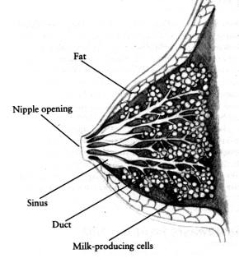
2. Anatomy of the Breast

Slide 16

The breast is made up of some milk-producing glands and some other tissues and fat. This milk goes through tubes or ducts toward the nipple.
Before the ducts reach the nipple they become wider and form lactiferous sinuses. Milk collects in them. About 10 fine ducts lead from the sinuses to the nipple.
The nipple is very sensitive. Around the nipple is a circle of dark skin called areola. On the areola are very small swellings. These are glands that produce oils. This oil helps keep the nipple skin soft and in good condition.

Slide 17
When a baby takes the nipple into his/her mouth, he/she must also take in much of the areola. The mother should position the baby so that he/she can take in as much milk as possible.
The baby’s sucking stimulates the mother’s breast to produce milk. The more the baby sucks, the more milk is produced.

Slide 18
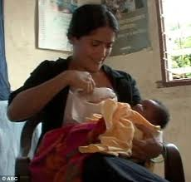

3. Proper positioning
The correct steps to follow in positioning the baby for breastfeeding.
Let the mother sit or lie somewhere comfortable so that she is relaxed. A low seat is usually best.
Show her how to hold the baby in her arms. The baby faces the breast while the baby’s stomach is against the mother’s stomach.
Let the back of the baby’s shoulders rest on the mother’s arm. The baby’s head should be free to bend back a little.

Slide 19
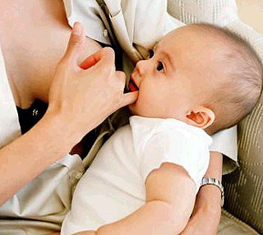

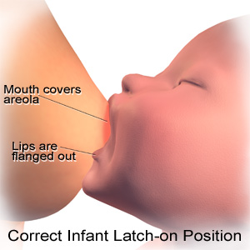
She should touch the baby’s cheek or the side of the baby’s mouth. This will stimulate the rooting reflex.
She should wait until the baby’s mouth is open and ready to start sucking.
The mother should hold and offer the whole breast. She should not pinch the nipple or areola.
She should aim the baby’s lower lip towards the base of the areola.

Slide 20
Four key points in breasfeeding
The baby is:
  With his head and body straight;
  With his face facing the breast; and his nose opposite her nipple;
  With his body close to her body;
  Supporting his bottom (if newborn);

Slide 21
How to support her breast:
With her fingers against her chest wall below her breast;
With her four finger supporting the breast;
With her thumb above;
Her fingers should not be too near the nipple.

Slide 22
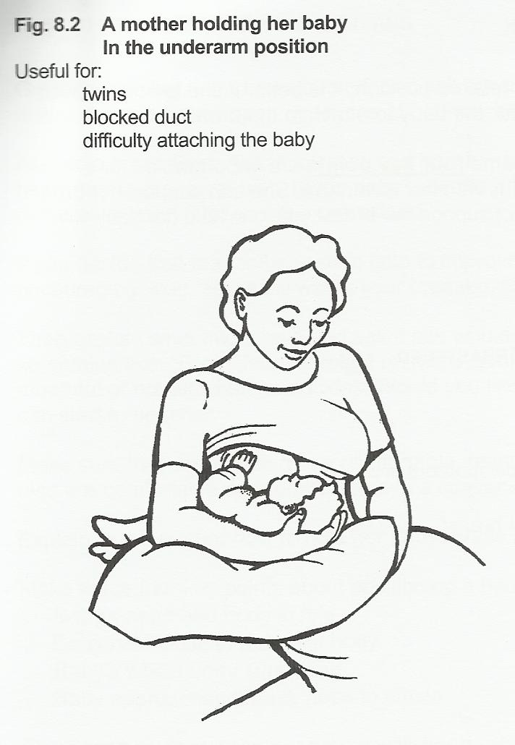
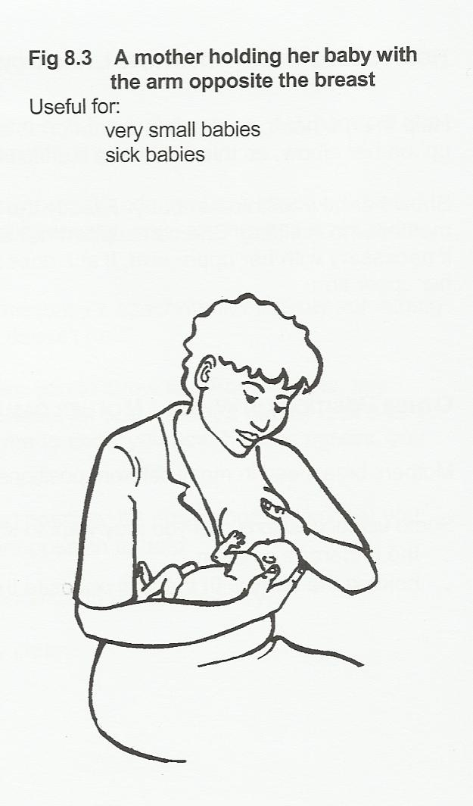
Other Position while breastfeeding

Slide 23
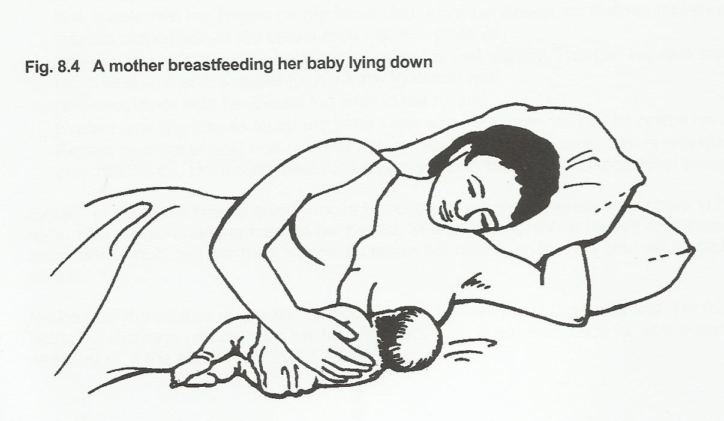
Other Position while breastfeeding

Slide 24
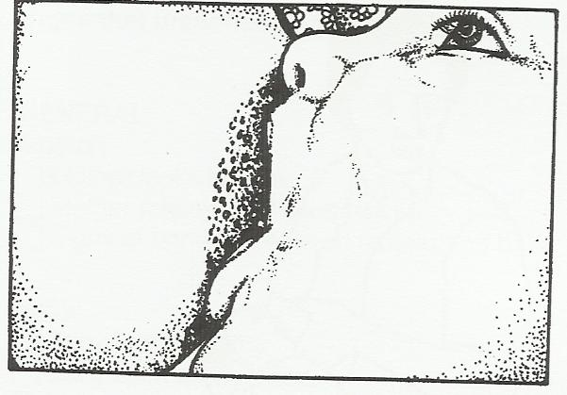
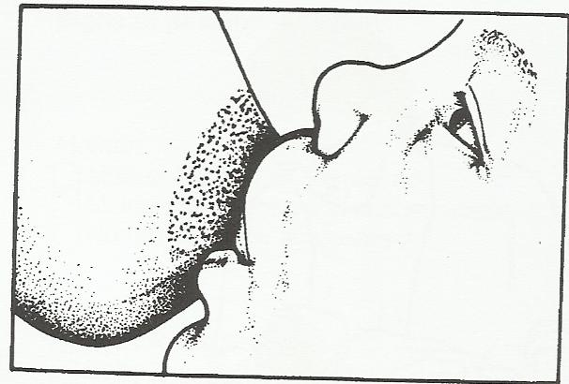
Which of this two picture has a good attachment
Right Left

Slide 25
Show how to support her breast
(demonstrate )
If she has small and high breast – no need to support
C- position of the hand
Not hold her breast too near to the nipple
Scissors’ hold – block milk flow

Slide 26
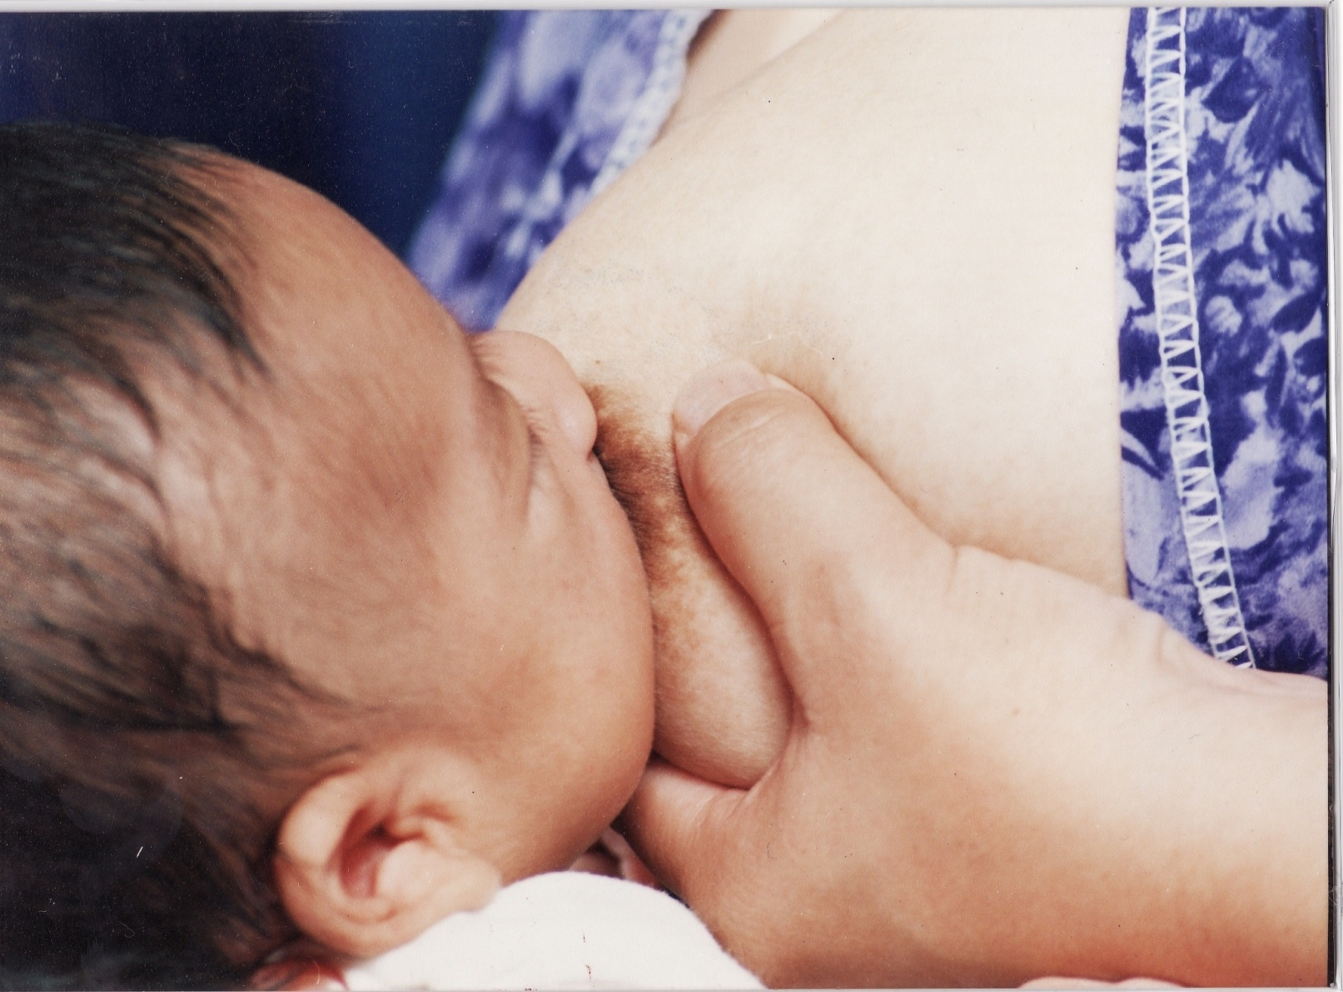
C- position of the hand

Slide 27
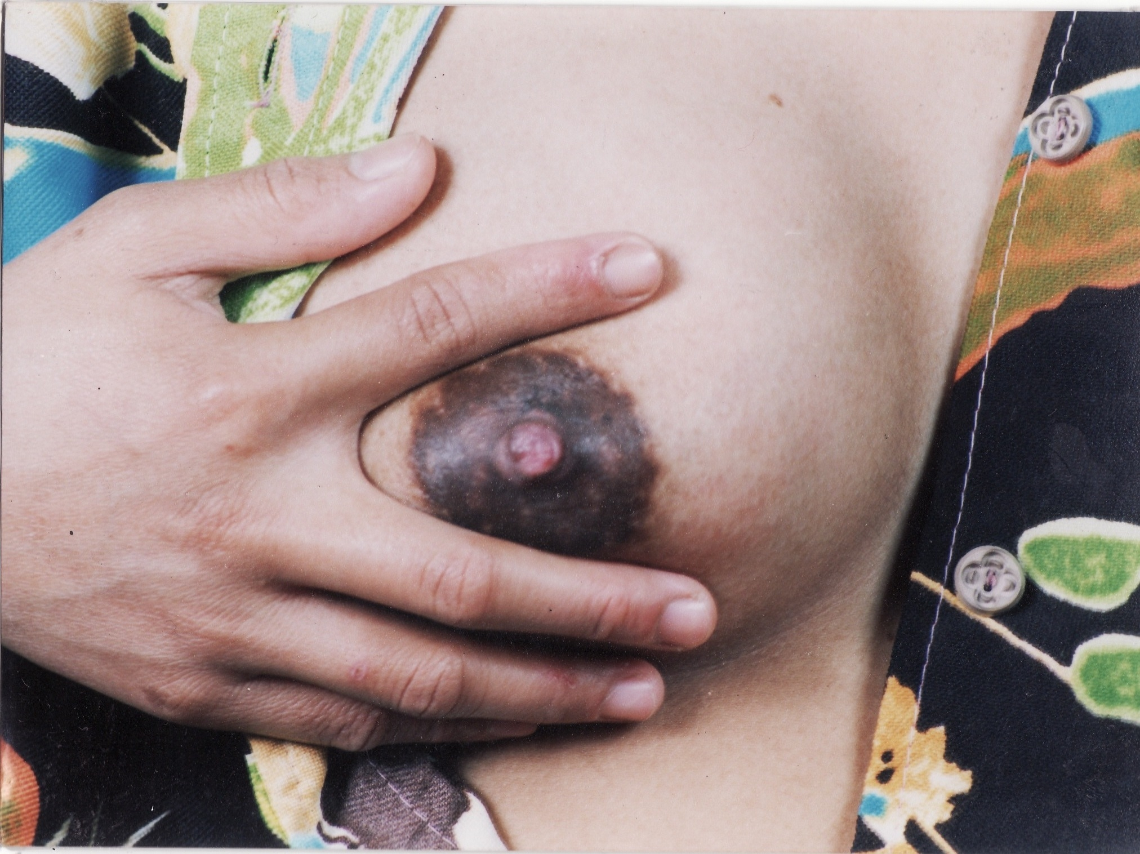
Scissors’ hold – block milk flow

Slide 28
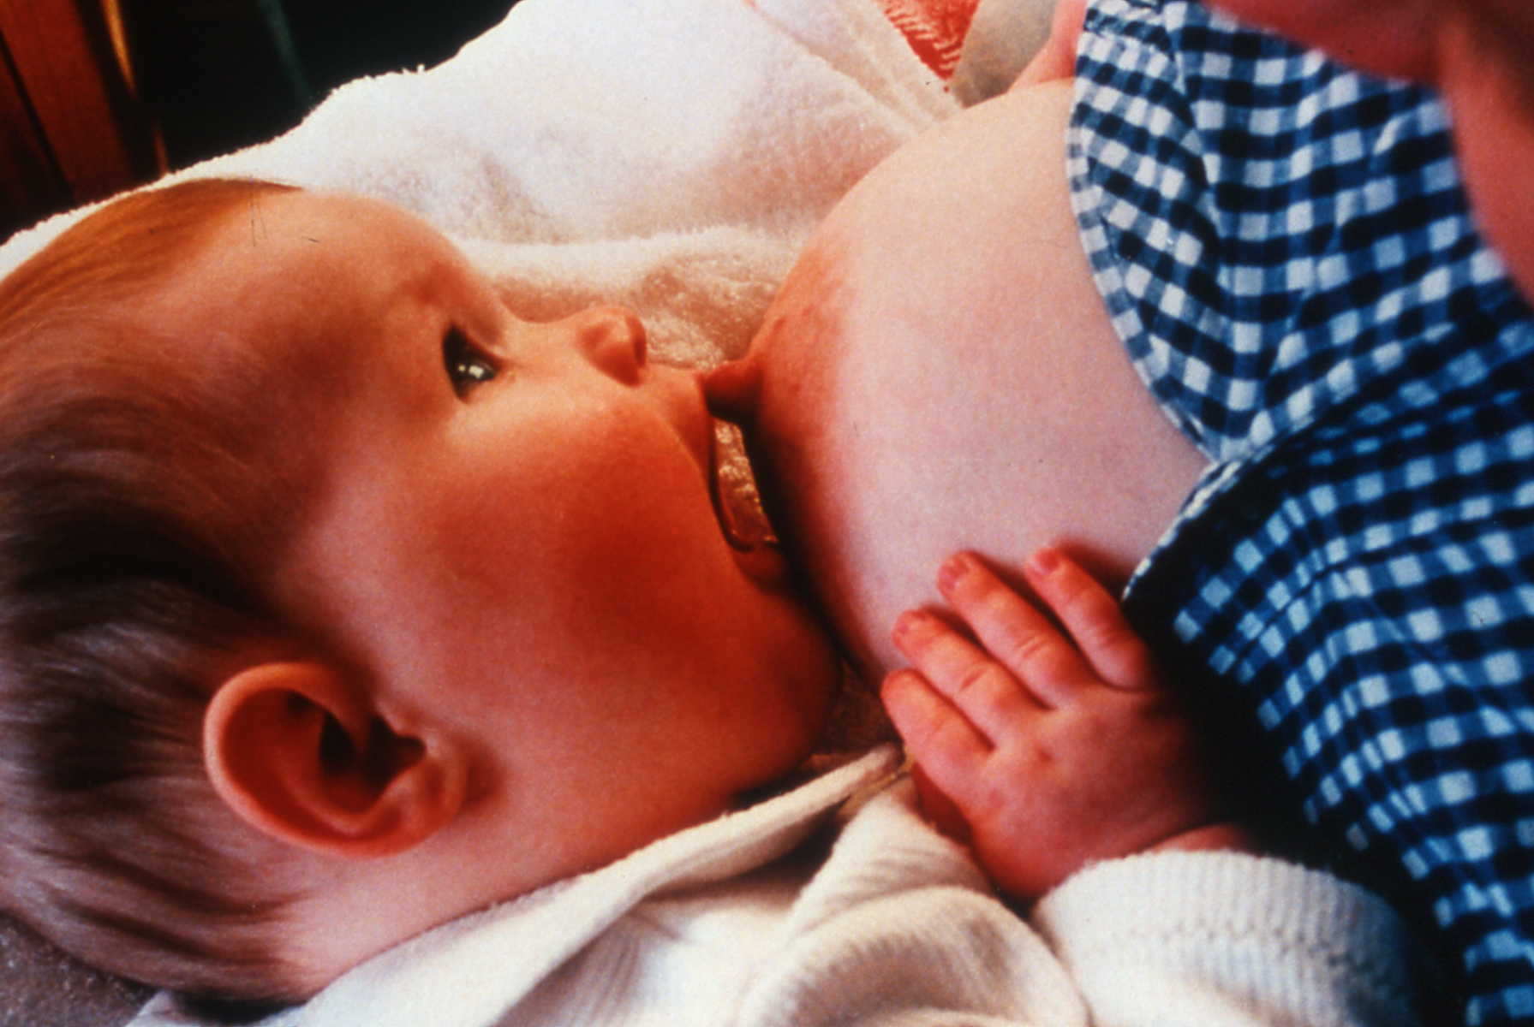
Attachment
For teaching purposes only and not for publication.

Slide 29
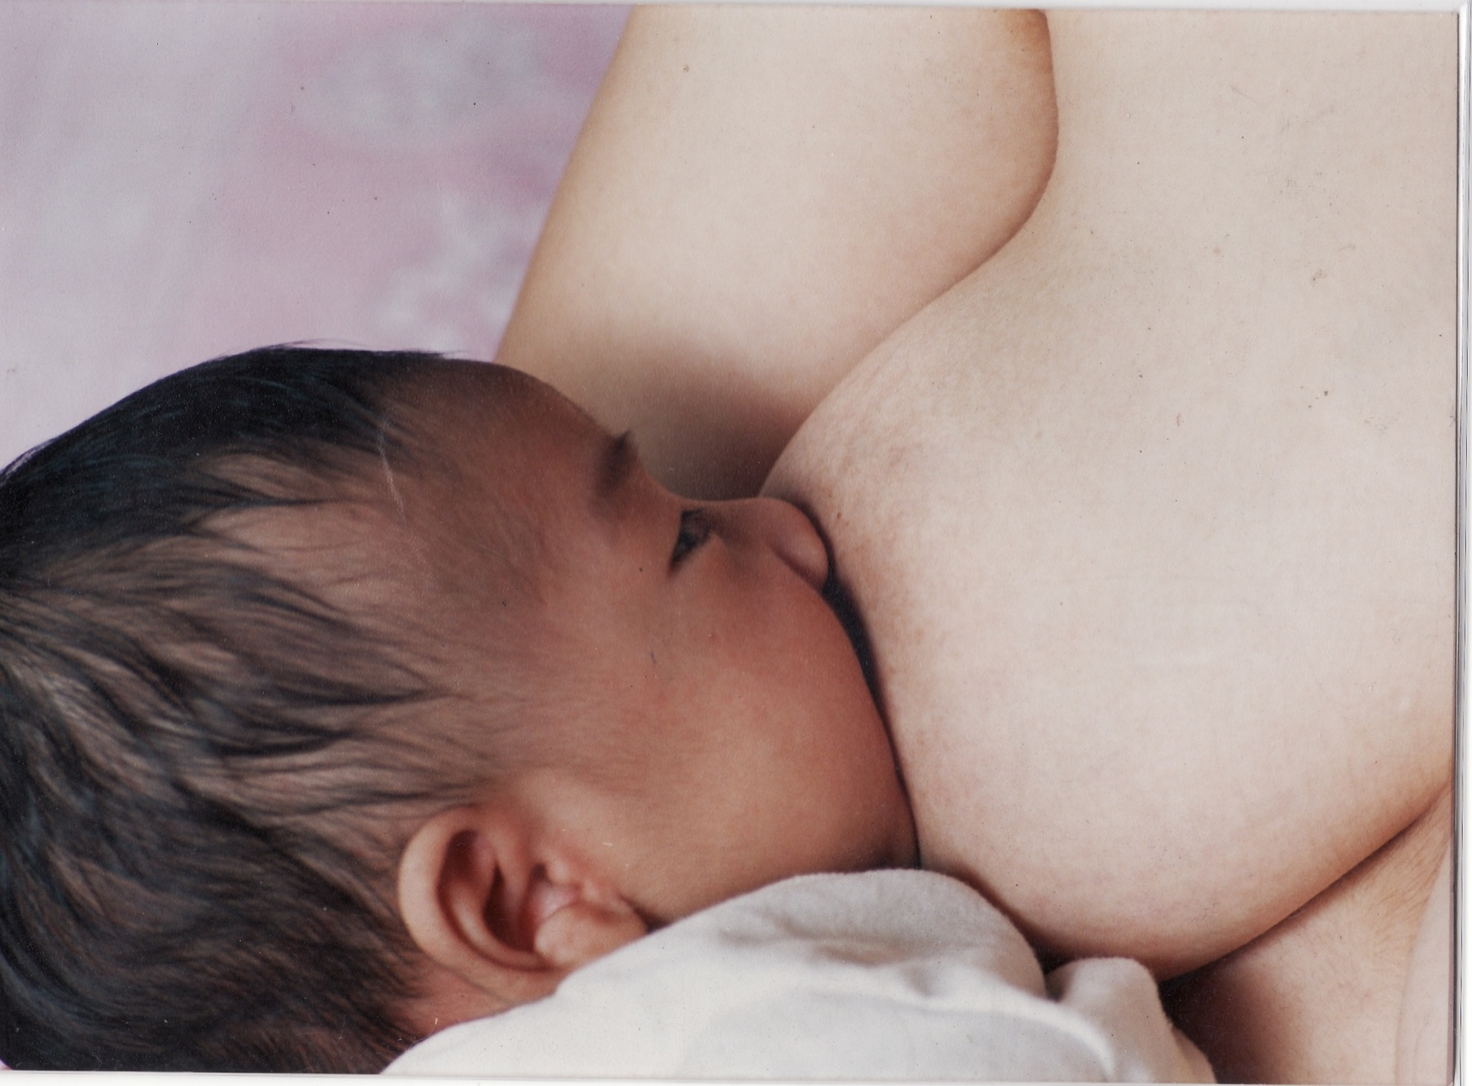
For teaching purposes only and not for publication.

Slide 30
Signs of good attachment
Mouth wide open
More areola in the upper lip
Lower lip is turned outward
Chin touches the breast

Slide 31
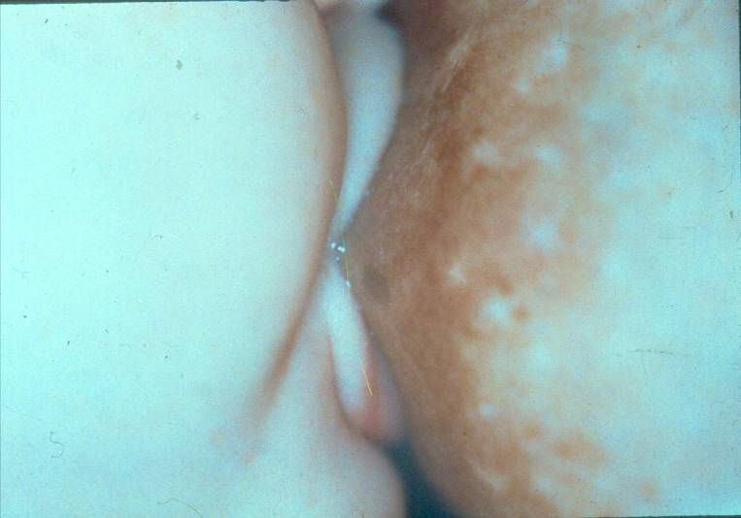
Wide Open Mouth
7/4
©UNICEF C107-7

Slide 32
Signs of good attachment
Mouth wide open
More areola in the upper lip
Lower lip is turned outward
Chin touches the breast

Slide 33
Wide Open Mouth
7/4
©UNICEF C107-7

Slide 34
Signs of good attachment
Mouth wide open
More areola in the upper lip
Lower lip is turned outward
Chin touches the breast

Slide 35
Wide Open Mouth
7/4
©UNICEF C107-7

Slide 36
Signs of good attachment
Mouth wide open
More areola in the upper lip
Lower lip is turned outward
Chin touches the breast

Slide 37
Wide Open Mouth
7/4
©UNICEF C107-7

Slide 38
Signs of good attachment
Mouth wide open
More areola in the upper lip
Lower lip is turned outward
Chin touches the breast

Slide 39
Which of this two picture has a good attachment
Right or Left

Slide 40
These are the signs that the baby is in good position for breastfeeding.
The baby’s whole body is close to the mother; the baby is facing the mother; and the stomach of the baby is touching the mother’s stomach.
The baby mouth and chin are close to the breast.
The baby’s mouth is wide open.
More part of the areola is seen above the baby’s upper lip and less of it can be seen below his/her lower lip.
The baby takes slow deed sucks.
The baby is relaxed and happy.
The mother does not feel pain on her nipple.

Slide 41
These are signs that the baby is in bad position while sucking:
The baby’s stomach is not touching the mother’s stomach.
The baby’s mouth and chin are separated from the breast.
There is too much areola seen below the lower lip of the baby.
The baby takes many quick and small sucks.
The baby fusses or refuses to suck because he/she does not get the milk.
The mother may feel pain on her nipple

Slide 42
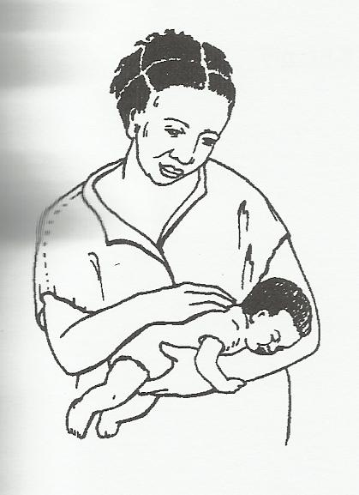
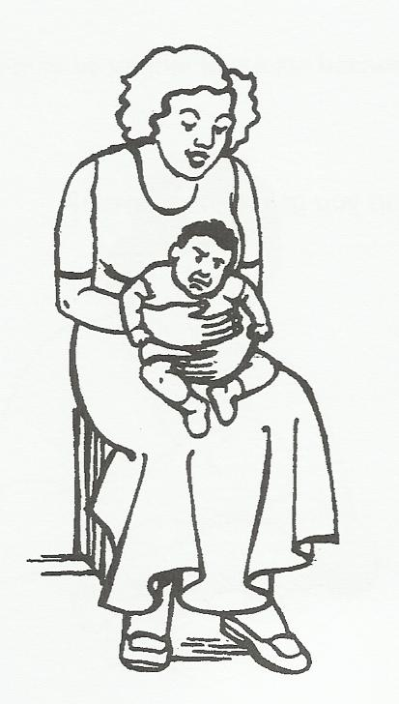
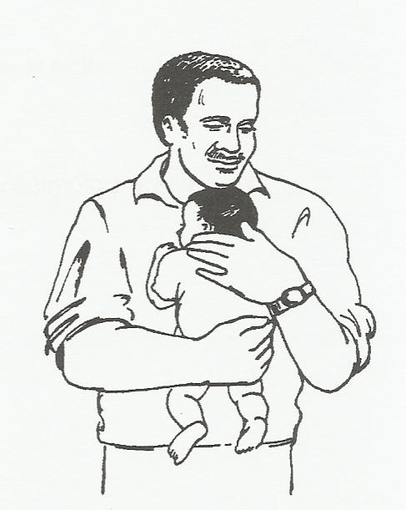
Ways on how to hold a colicky baby

Slide 43
3. Duration of feeds
When breastfeeding, the most important point to remember is that both breast are offered at one feeding time and for as long as the baby still wants to suck.
Let the baby finish the first breast, to make sure that he/she gets the hindmilk. Let him/her take the second breast if he/she wants to, but do not force him/her.
If the baby falls asleep after sucking only from the left breast, the right breast should be offered next feeding time.

Slide 44
F. Help that mothers need to
Breastfeed Successfully
1. Psychological preparation
Try to let the mothers feel that the best choice is breastmilk. However, don’t blame her if she does something else.
You must be kind, gentle and sympathetic. Give each woman a chance to ask questions. Show interest and sincerity in helping her. Encourage her to tell you about any doubts and fears that she might have.

Slide 45
2. Practical Advice
Advise Pregnant Mothers
a. Your milk is the best food for your baby. The quality of the milk will always be good regardless of your diet.
b. The size and shape of the breast do not matter. Small breast and large breast both produce perfect milk in sufficient quantity.
c. Breastfeeding need not spoil your figure. It should help you to lose weight after the is born. If you wear a good bra or other support while you breastfeed, your breast will return to a good shape after you wean the baby.

Slide 46
d. Bottle feeding is dangerous because it causes much illness.
e. let the baby suck soon after delivery- it will help your milk to flow freely.
f. make one or two of your dresses open at the front so that your baby can breastfeed easily.
g. All mothers feel more emotional and sensitive than usual for a few weeks after delivery.

Slide 47
E. Problems and Solution During
Breastfeeding
There are so many problems that a mother experiences when she breastfeeds. It is important that we anticipate these problems so that we will be able to help them when they occur.
1. Early Problems
A. The breast are too full and they hurt (engorged breasts)

Slide 48
SOLUTION: Get the milk from the breast. If possible, let the baby suck through his/her mouth in a good position. If the baby cannot suck well, the mother can express by hands, try putting a warm compress on the breast, or simply take a warm bath or shower.
B. Painful Swelling in the Breast (Mastitis)
SOLUTION : Let the baby continue to feed frequently from the breast. If the baby cannot, then express the milk. Gently massage the lump towards the nipple.

Slide 49
C. Sore nipples (due to bad positioning when the baby is sucking)
SOLUTION: Help the baby by positioning him towards the breast in the correct way. Advise mothers not to wash their nipples with soap every time they feed. Instead, just wash them once a day during regular bathing. She should take the baby off the breast at the end of a feed by inserting her little finger between her breast and the baby’s mouth. This will make the baby release the breast.

Slide 50
D. Cracked Nipples
SOLUTION: Correct the feeding position. Advise the mother to wash the nipples without soap only once a day. Expose the nipples to air and sun as much as possible. Leave a drop of hindmilk on the nipple after feeding because it helps the skin to heal.

Slide 51
E. Nipples are too short (flat but protract easily)
SOLUTION: During pregnancy, exercise to improve nipples protractibility. After delivery, let the baby suck strongly as soon as he/she can and make sure that he/she fixes onto the breast in a good position.
F. Nipples are too long
SOLUTION: Help the mother to put the areola as well as the long nipple into the baby’s mouth.

Slide 52
2. Later problems
A. Not enough milk
SOLUTION: Conduct the weight check by weighing the baby and checking his weight gain on a growth chart. A healthy baby should gain between half and 1kg/month. If the baby is gaining weight, then there is enough milk. Reassure the mother.

Slide 53
B. Mother has to go back to work
SOLUTION: Continue to breastfeed at night, in the early morning and at any other time that you are at home. Express milk before you go to work and leave it for the helper to give the baby. Express your milk at work to keep up your supply. If you decide to use a formula, do not use a bottle. Instead, feed the baby using a cup or spoon. It is better to use than a bottle because it does not satisfy the baby’s need to suck. This will make the baby continue to breastfeed.

Slide 54

THANK YOU!

