Slide 1
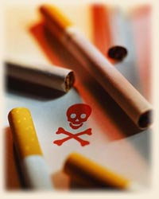
A Killer Drug
Tobacco is a kind of drug
Everyday eight thousand people die just because of using its derivatives.
SMOKING: Its Origin
The tobacco plant, scientifically known as Nicotiana tabacum, is a plant grown for its leaves, which are smoked, chewed, or sniffed for a variety of effects. Tobacco is considered addicting because it contains the chemical nicotine. Sniffing and chewing tobacco originated in North America and Europe. It was Christopher Columbus who introduced tobacco into Europe. It then became very popular with the Portuguese, Spanish, French, British, and Scandinavians.

Slide 2
Global Trends in Tobacco Use
1.1 billion or 1 in 3 adults smoke
    about 80% live in low- and middle-income countries
total number of smokers is expected to reach about 1.6 billion by 2025
World Bank, 1999
1.2 billion smokers over the age of 15 years
    300 million are in China
WHO, 2001
Smoking already kills one in 10 adults worldwide
By 2030, the proportion will be one in six, or 10 million
deaths per year
By 2020, seven of every 10 people killed by smoking will be in low-
and middle-income nations

Slide 3
Tobacco Production and Consumption
Manufactured Cigarettes
  Philippines has manufactured 73 billion cigarettes in 1994, occupying the 15th leading producer of cigarettes
Imported Cigarettes
  Philippines has imported some 13.98billion cigarettes, occupying the 12th place among world’s leading importers
Tobacco Consumption
  Among 25 leading countries in 1994, Philippines ranked 15th on apparent tobacco consumption with some 85.36 billion cigarettes or about 1.6% of the world’s total (WHO 1997)

Slide 4
Economic Issues
The Philippine government earns about 21 billion pesos from the sale and manufacture of tobacco and tobacco products each year.
But it loses about 46 billion pesos to tobacco-related healthcare and lost of productivity.
WHY IS TOBACCO SO BAD?
Tobacco is toxic to your body.
Tobacco is addictive. Once you start using it your body starts needing it.
Tobacco can kill you!
Each time you smoke a cigarette you are taking away 5 to 20
minutes of your life.

Slide 5
Health Consequences of Smoking are Two-Fold
Addiction
    The addictive properties of nicotine are well documented but often underestimated by the consumer
Fatal and disabling diseases
    The diseases associated with smoking are well documented & include:
      Cancers of the lungs and other organs
      Ischemic heart disease
      Strokes
      Respiratory diseases such as emphysema, frequent asthma attacks

Slide 6
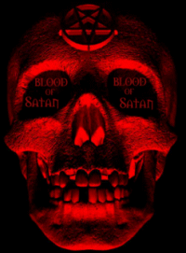
Smoking
single most preventable health crisis of all
kills nearly 5 million people each year
20,000 Filipinos die every year due to tobacco-related disease
- that's 2 to 3 every hour!
Smoking
KILLS !

Slide 7
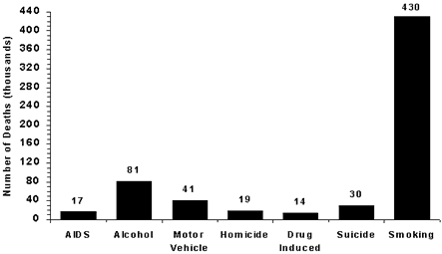
Killing potential of smoking

Slide 8
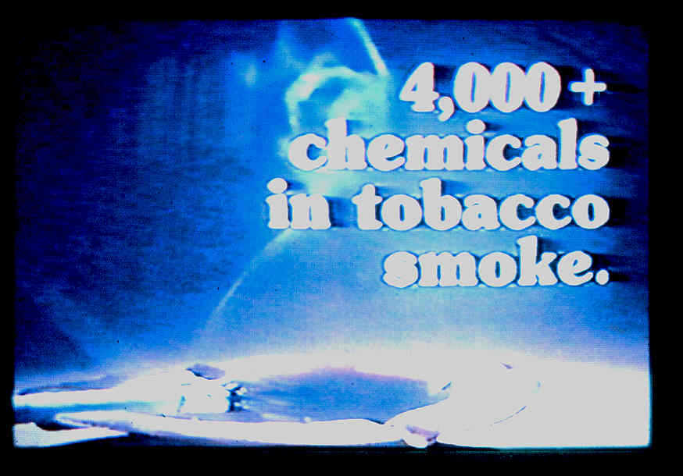
What Are You Smoking?
There are 4,000 chemicals in cigarette smoke
60 of which are cancer-inducing substances

Slide 9
Lots of toxic chemicals!
Here are some of the chemicals:
Carbon Monoxide- auto exhaust, gas chambers
Carbon Dioxide
Carbonyl Sulfide
Benzene
Toluene- Industrial solvent, in explosives
Formaldehyde - body tissue preserver
Acrolein- aquatic herbicide- burned glycerol
Acetone- poisonous solvent, nail polish remover
Pyridine- poisonous solvent
Methylpyridine- Insecticide solvent
Vinylpyridine
Hyrogen Cyanide- rat poison, gas chambers
Hydrazine- rocket fuel chemical
Anatabine
Ammonia- poisonous, cleaning agent
Methylamine- tanning agent
Dimethylamine- tanning accelerator
Nitrogen Oxides
Nitrosodimethylamine
Nitrosodiethylamine
Nitrosopyrrolidine
Formic Acid- caustic solvent
Acetic Acid- caustic solvent
Methyl Chloride- poisonous refrigerant
Butadiene
Particulate Matter- animal carcinogen
Nicotine- Isecticide
Phenol- toilet bowl disinfectant

Slide 10
Lots of toxic chemicals!
and some more:
Catechol-tanning, dyeing agent
Hydroquinone-photographic developing agent
Aniline-industrial solvent
Toluidine-agent in dye manufacture
Napthalamine-mothballs
Aminobiphenyl
Benz(a)anthracene
Benzo(a)pyrene
Cholesterol
Butyrolactone
Quinoline-specimen preservative
Harman
Nitrosonornicotine
NNH
Nitrodiethanolamine
Cadmium
Nickel
Zinc-anti-corrosion coating for metals
Aluminum-metal
Titanium-metal
Copper-metal
Mercury-metal Silicon-metal
Silver-metal
Gold-metal
Polonium-210-radioactive element
Benzoic Acid-tobacco curing agent
Lactic Acid-caustic solvent
Glycolic Acid-metal cleaning agent
Succinic Acid-agent in Lacquer manufacture
PCDDs and PCDFs –dioxins, dibenzofurans Hexamine-barbecue lighter
Stearic Acid-candle wax
Cadmium-rechargeable batteries
Arsenic-poison
Butane-cigarette lighter fluid
Propylene Glycol-antifreeze

Slide 11
Lots of toxic chemicals!
The more serious ones…
  Nicotine – an intake off 60 mg can kill; each stick has
  15-20 mg
  Tar – an irritating & cancer-causing substance
  Ammonia – makes smokers addicted
  Carbon monoxide – also found in car smoke
  Cadmium – highly toxic, found in car batteries that
  causes liver, kidney & brain damage
  Lead – stunts growth & causes brain damage
  Arsenic – well-known poison

Slide 12
What are the effects of nicotine on the body?
Nicotine gives the so-called “positive effects” which include:
  Enhancement of memory and alertness
  Improvement of skills and work performance
  Alteration of mood, reduced stress, improvement in “sociability” and even euphoria
However, these effects are fleeting and are far out weighted by negative effects. These include:
  Shortness of breath
  Chronic cough
  Increased heart rate and blood pressure
  “Ulcer-like” stomach pains (hunger pains), nausea and diarrhea
  Reduction of fertility
  Early onset of menopause in women
  Tremors, especially in the inexperienced user
  Sweating with the smell of nicotine

Slide 13
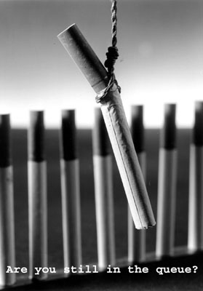
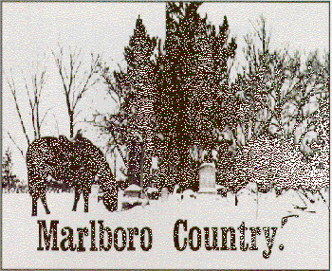
WHY DO YOUNG PEOPLE SMOKE?
Advertisements make it look attractive
Peer pressure
Some people think it helps with weight control
Some people think it helps reduce stress
Their parents do it
Rebellion

Slide 14
I’m YOUNG, THIS WON’T HAPPEN TO ME…
You may think that you are young and these problems only occur when you get old, but it all starts when you start smoking. You are probably already feeling the effects.
Teen smokers have a harder time competing in sports because of shortness of breath, decreased circulation, and rapid heart rate.
Smokers are more likely to miss a “big game” because they get sick more often with colds, flu, bronchitis, and pneumonia.

Slide 15
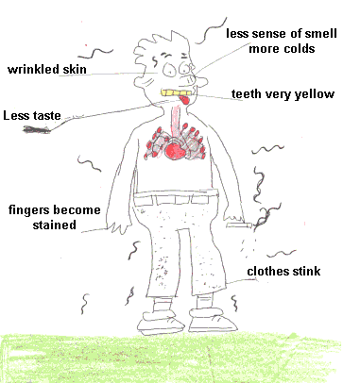
I’m YOUNG, THIS WON’T HAPPEN TO ME…
Think about the more immediate effects:
    Bad breath
    Yellow teeth
    Stinky clothes
Sniff a dirty ashtray to see what a smoker really smells like to non-smokers
Hair loss, wrinkling, discolored fingers and bad breath are just some of the side effects of smoking
Smoking makes bones brittle, making you prone to injuries
Smoking for more than 20 years will reduce your lifespan by 20 to 25 years
IS THIS COOL?
NAH!!!

Slide 16
WHAT YOU SHOULD KNOW…
SECOND HAND SMOKE
Mainstream smoke is smoke that is inhaled through a smoker’s mouth
Sidestream smoke is smoke that drifts off at the end of cigarettes
A secondhand smoker or passive smoker is one who inhales mainstream or sidestream smoke. Non-smokers who are exposed to second-hand smoke are more at risk because the particles in the exhaled smoke are smaller. They reach deeper into the lungs of the passive smokers.
Non-smokers who live with smokers are:
  at 20-30% increased risk of developing cancer, particularly lung cancer
  At 20-30% increased risk of developing heart disease
Second-hand smoke kills 35,000 to 65,000 adult non-smokers
from heart disease and 3,000 non-smokers from lung
cancer every year in USA alone

Slide 17

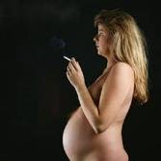
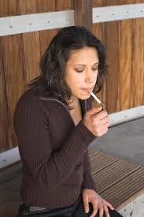

WHAT YOU SHOULD KNOW…
In children, passive smoking is known to cause fetal growth impairment, cot death (SIDS), asthma, bronchitis, pneumonia and middle ear disease
Children’s exposure to tobacco smoke is responsible for up to 13% of asthma cases, 13% of ear infections and 20% of all lung infections in children under 5.
Smoking can cause the following problems in women:
  Reproductive disturbances (such as, infertility)
  Problems during pregnancy include:
        a. Fetal abnormalities and even death
        b. Low-birth weight infants
  Increase risk of Ischemic heart disease
  Increase risk of Lung CA
  Increase risk of CA’s of the Pancreas, Bladder and Larynx
  Increase. risk of chronic bronchitis and emphysema

Slide 18
long-term effects of cigarette smoking
Coronary artery disease – at least 20% of deaths are smoking-related
Heart disease - Smokers in their 30s and 40s have a heart attack rate that is five times their non-smoking peers
Hardening of the arteries and complication of blocked arteries, hypertension, blood clots
Stroke – People who smoke a pack a day have almost two and a half times the risk of getting a stroke
Peptic ulcer disease
Lung diseases – chronic obstructive pulmonary diseases such as chronic bronchitis and emphysema; smoking caused nearly 85,000 deaths in 1990 due to these diseases.
Cancers – oral, especially of the respiratory tract and the oral cavity, nose, pharynx, larynx, lung, cervical, urinary bladder, kidney, and pancreas; smoking accounts for 85% of all lung cancers
Disease of the oral cavity, e.g., irritation and infection of the gums and teeth
Delayed wound healing

Slide 19
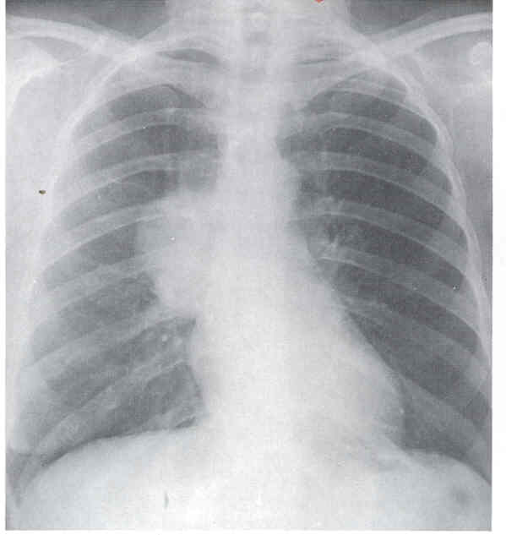
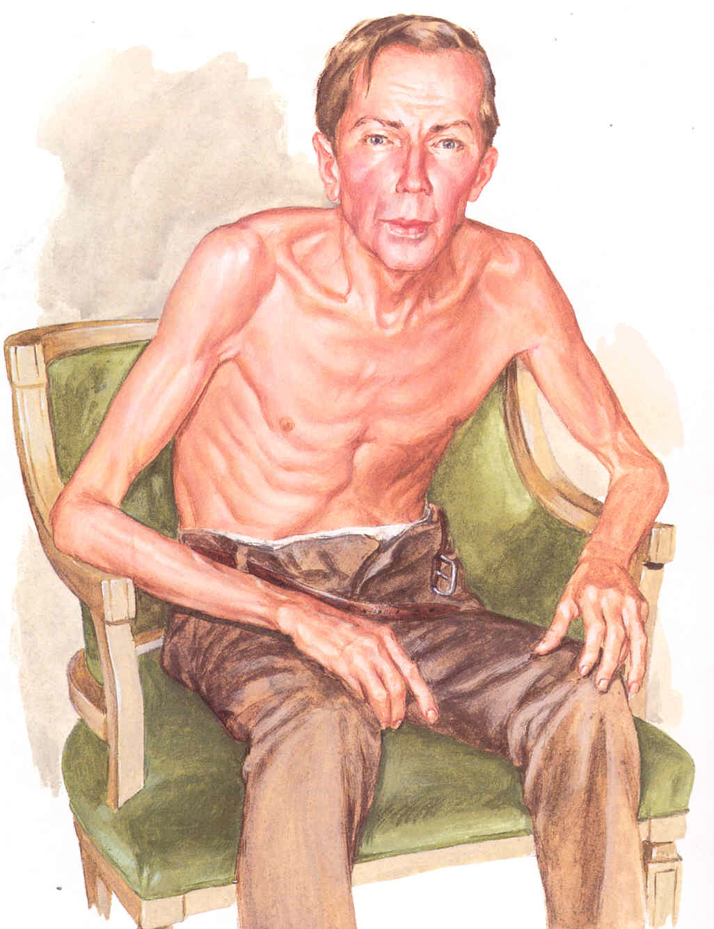
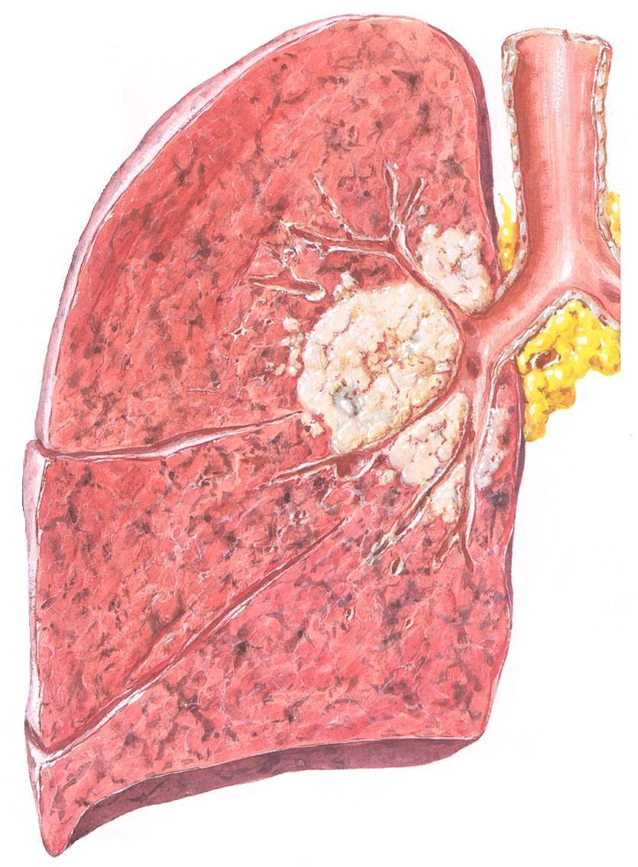
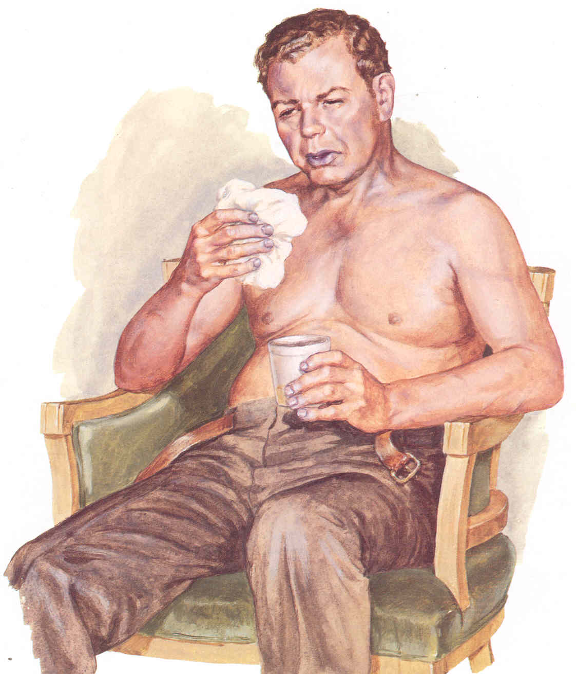
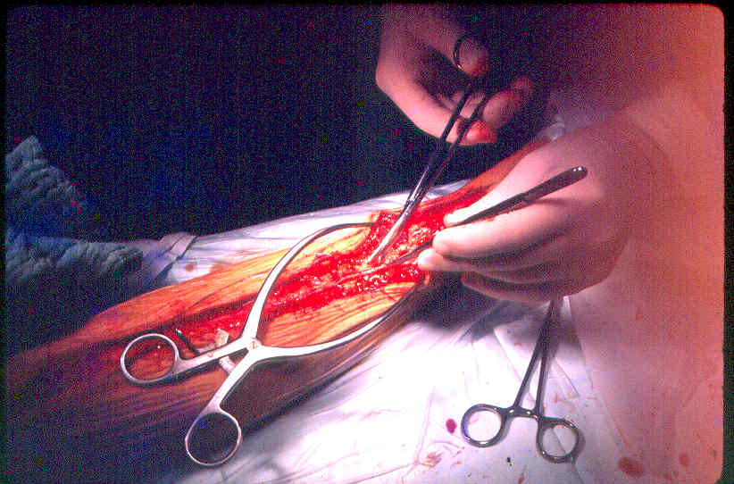
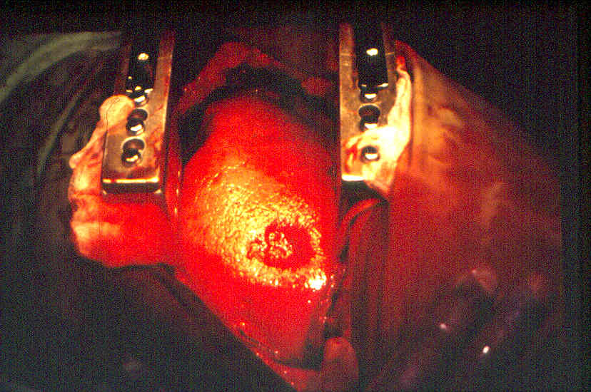
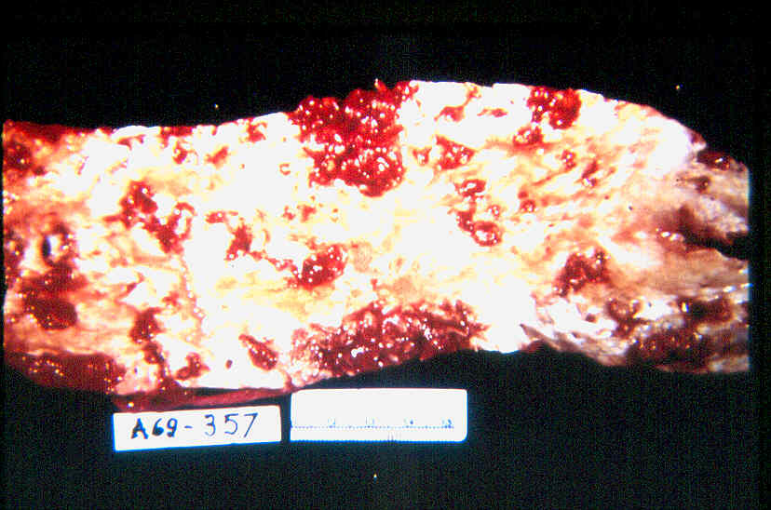
long-term effects of cigarette smoking

Slide 20
Youth Tobacco Survey in the Philippines
Global Youth Tobacco Survey Phase I, 2000
Objectives:
To monitor tobacco use among school-based adolescents
To assess students’ tobacco-related knowledge, attitudes and behaviors
Youth are particularly vulnerable to become “tobacco addicts.”
Courtesy of:
Marina Miguel-Baquilod, MD, MSc Epi
GYTS Coordinator

Slide 21
Youth Tobacco Survey in the Philippines
Global Youth Tobacco Survey Phase I, 2000
Major Indicators:
  Prevalence of tobacco use (cigarettes and other products)
  Access to tobacco products
  Exposure to Environmental Tobacco Smoke (ETS)
  Exposure to media messages and school lessons
  Beliefs and attitudes regarding tobacco use
Survey Methods:
  School-based
  Target population:
      2nd to 4th year high school students
  Self-administered multiple choice questionnaire

Slide 22
Youth Tobacco Survey in the Philippines
Global Youth Tobacco Survey Phase I, 2000
Sampling Design:
Two-stage cluster survey
Stage 1: 150 schools selected (PPS)
    Luzon 50
    Visayas 50
    Mindanao 50
Stage 2: at least 40 students selected per school (random selection of classes)
Minimum total sample size: 6,000 students

Slide 23
Youth Tobacco Survey in the Philippines
Global Youth Tobacco Survey Phase I, 2000
RESULTS
  Demographics
    Number of respondents: 11,630
    Age: 12 - 18 years, median 14
    Gender:
      Female 57%
      Male 43%
    Year Level:
      Sophomore 38%
      Junior 32%
      Senior 30%

Slide 24
Youth Tobacco Survey in the Philippines
Global Youth Tobacco Survey Phase I, 2000
Proportion of Respondents who Ever Smoked

Slide 25
Youth Tobacco Survey in the Philippines
Global Youth Tobacco Survey Phase I, 2000
Proportion of Respondents who Currently Smoke

Slide 26
Youth Tobacco Survey in the Philippines
Global Youth Tobacco Survey Phase I, 2000
Proportion of Respondents who Ever Smoked

Slide 27
Youth Tobacco Survey in the Philippines
Global Youth Tobacco Survey Phase I, 2000
Proportion of Respondents who Currently Smoke

Slide 28
Youth Tobacco Survey in the Philippines
Global Youth Tobacco Survey Phase I, 2000
Sources of Cigarettes of Current Youth Smokers

Slide 29
Youth Tobacco Survey in the Philippines
Global Youth Tobacco Survey Phase I, 2000
Places where Current Youth Smokers Smoked

Slide 30
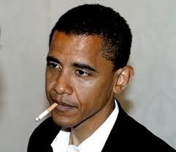
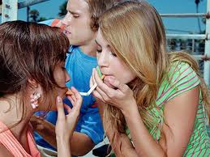
Youth Tobacco Survey in the Philippines
Global Youth Tobacco Survey Phase I, 2000
Exposure to Environmental Tobacco Smoke
At home
60% exposed to smokers
          59% have parents who smoke
Outside home
75% exposed to smokers
        11% have friends who smoke

Slide 31
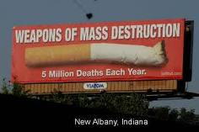
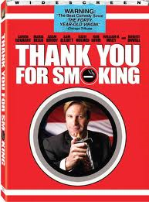
Youth Tobacco Survey in the Philippines
Global Youth Tobacco Survey Phase I, 2000
Exposure to Tobacco-related Messages
Pro-Smoking Influence
  85% exposed to pro-smoking messages
  18% had tobacco promotional materials
  18% offered free cigarettes by tobacco sales reps
Anti-Smoking Influence
  83% exposed to anti-smoking messages
  65% taught ill effects of smoking

Slide 32
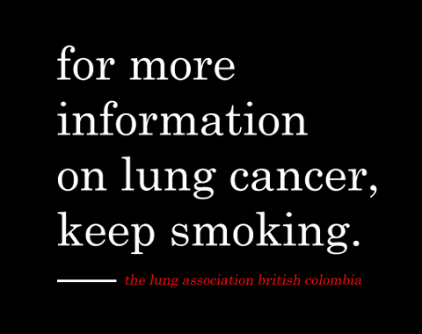
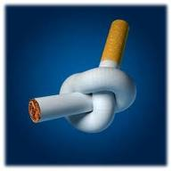
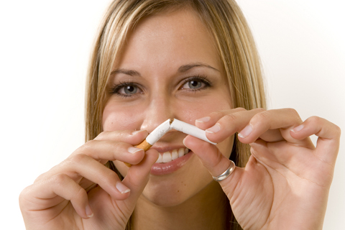
Youth Tobacco Survey in the Philippines
Global Youth Tobacco Survey Phase I, 2000
Positive Indicators for Anti-Smoking Campaign
72% think cigarette smoking is harmful
72% think cigarette smoking makes one less attractive
85% of current smokers want to stop smoking

Slide 33
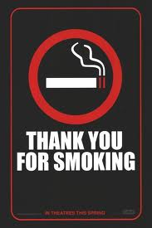
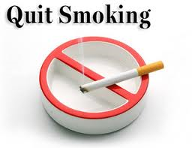
Youth Tobacco Survey in the Philippines
Global Youth Tobacco Survey Phase I, 2000
Challenges for Anti-Smoking Campaign
27% of non-smokers are likely to initiate smoking
Only 39% agree that smoking should be banned from public places
Only 6% of those who wish to quit smoking had access to professional help

Slide 34
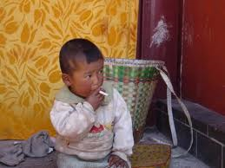
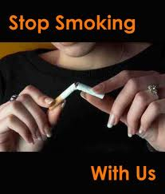
Youth Tobacco Survey in the Philippines
Global Youth Tobacco Survey Phase I, 2000
Conclusions
High prevalence of tobacco use among the youth
Frequent exposure to Environmental Tobacco Smoke
Youth have easy access to tobacco products
Lack of access to smoking cessation programs

Slide 35
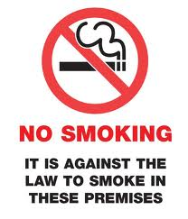
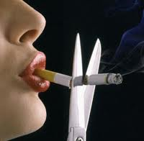
Youth Tobacco Survey in the Philippines
Global Youth Tobacco Survey Phase I, 2000
Recommendations
Stronger anti-smoking legislation
  Increase tobacco taxes
  Ban sale of tobacco products to and by minors
  Advertising ban
Implement Clean Air Act
  Prohibit smoking in public places

Slide 36
Maraming salamat…

