Slide 1
Control of Diarrheal Diseases (CDD)
BASIC TRAINING FOR BARANGAY HEALTH WORKERS
Calasiao, Pangasinan

Slide 2
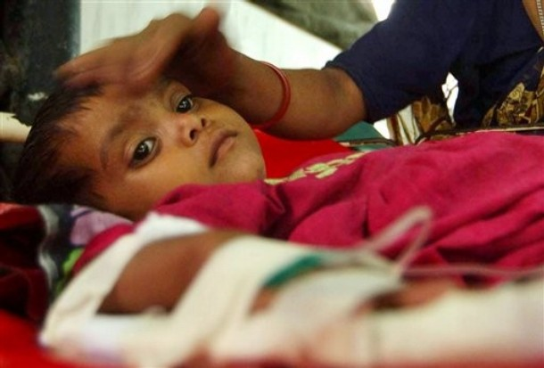
Children under 5 years old continue to die from dehydration due to diarrhea. Most diarrhea cases are not properly managed at home.
You can teach mothers how to properly manage diarrhea at home. As BHWs, you can help reduce the number of children dying due to dehydration.

Slide 3
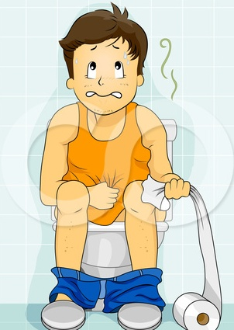
A. Definition of Diarrhea
Diarrhea is the passing out of loose or watery stool 3 or more times a day. It is mainly caused by germs that enter the body through the mouth. Seven out of 10 cases are caused by a virus, therefore, no drugs and antibiotics are necessary.

Slide 4
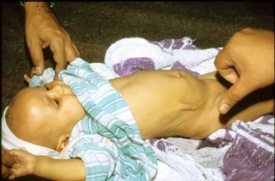
B. Signs and Symptoms of Dehydration
A child has signs of dehydration if he has any 2 of the following:
Loose stool 4 or more times a day
Very thirsty
No tears when crying
Fever
Sleepy and irritable
The skin fold remains raised for
a few seconds when pinched.

Slide 5
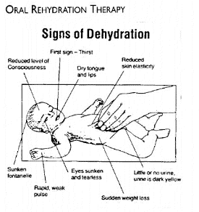

Slide 6
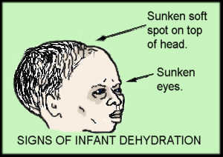
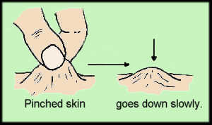

Slide 7
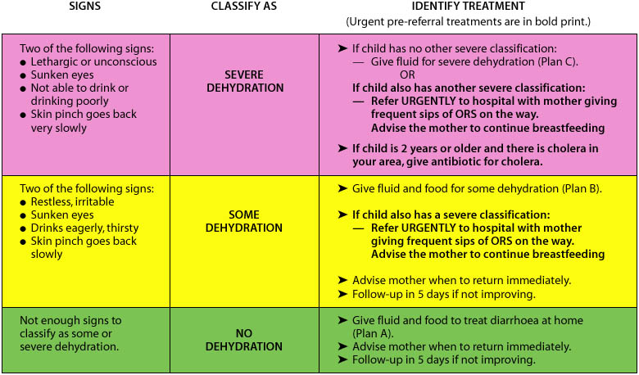
Classifications of Dehydration

Slide 8
For a child who has diarrhea
Ask if the child has diarrhea?
Is the stool loose ?, watery stool “matubig ba?”
Is it 3 or more times in a 24-hour day?
For how long or how many days?
Is there blood in the stool?

Slide 9
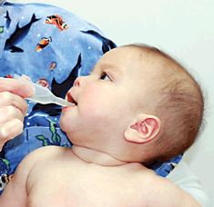
C. Prevention of Dehydration
1.Fluids
.
The first “F” is fluids.
As soon as diarrhea starts, a child should be given fluids immediately. Fluids should be given after every loose bowel movement.

Slide 10
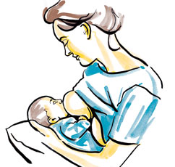
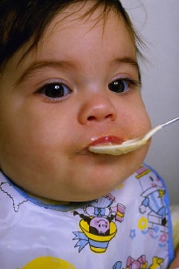
2. Feeding
The second “F” is feeding
Continue breastfeeding. If the child is no longer being breastfed, give small frequent feedings, 6 or more times a day. This will prevent malnutrition.

Slide 11
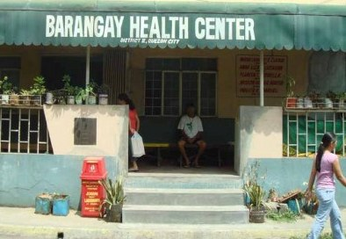
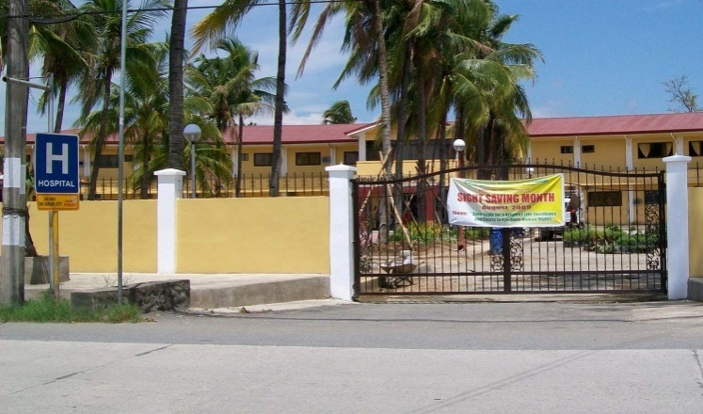
3. Fast referrals
The last “F” is fast referral.
Refer the child to the nearest health facility immediately if he/she:
Passes out stools 3 or more times a day
Is very thirsty
Has sunken eyes
Has a fever
Does not eat nor drink normally
Seems not to be getting better
Has blood in stool

Slide 12
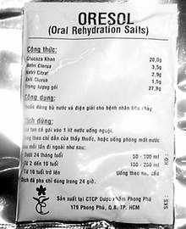
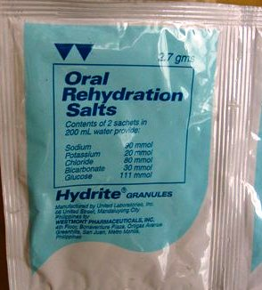
D. Referring a Diarrheal Case
A child suffering from dehydration should be referred immediately to the nearest health facility.
If the distance to the nearest health facility will take more than 15 minutes, give an Oral Rehydration Solution (Oresol) packet to the mother. Teach her to prepare the solution and let her child drink this before going to the health facility. This will ensure that dehydration does worsen.

Slide 13
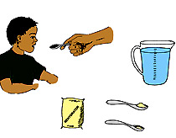
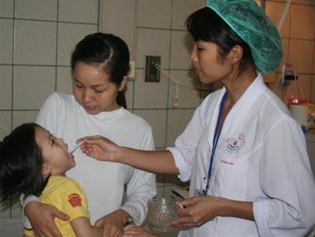
For children under 2 years old, give ¼ to ½ cup Oresol. For those above 2 years old, give ½ to 1 cup.
You can give a child more if he/she wants more.

Slide 14
1. Exclusive Breastfeeding
E. Prevention of Diarrhea
Exclusive breastfeeding for the first 6 months of the baby and partially up to 2 years can prevent the occurrence of diarrhea.
Breastfeeding avoids use of contaminated bottles, teats and formula. The content of breast milk also builds the baby’s body resistance to diseases.

Slide 15
2. Improved Weaning Practice
Introducing new food to the infant is critical.
This is the reason why you need to teach mothers on when to introduce new food, what food should be given, and how it should be prepared.

Slide 16
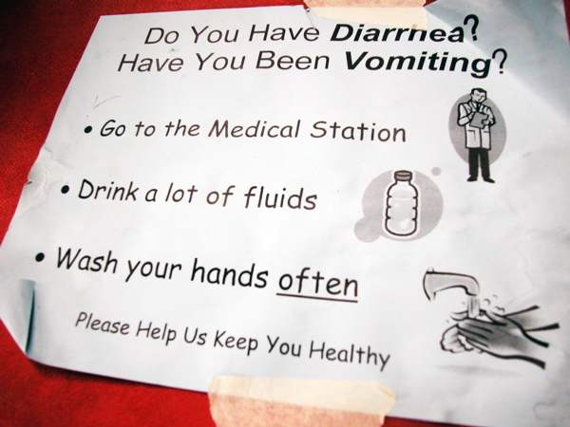
3. Proper Handwashing
Proper handwashing refers to the washing of hands with soap and water:
After defecation
After cleaning a child who has defecated and after disposing of a child’s stool
Before preparing food
Before eating
Before feeding

Slide 17
3. Proper Handwashing

Slide 18
4. Other measures
There are 7 effective measures to prevent diarrhea:
Breastfeeding
Improved weaning practice
Access to safe water
Proper hand washing
Use of sanitary toilets
Proper disposal of baby’s stools
Measles immunization

