Slide 1
BASIC TRAINING FOR BARANGAY HEALTH WORKERS
Calasiao, Pangasinan
Expanded Program on Immunization

Slide 2
Ang Expanded Program on Immunization (EPI) ay proyekto ng Department of Health (DOH) katulong ng World Health Organization at UNICEF na inilunsad noong 1976. Naglalayon itong bawasan ang bilang ng mga sanggol at batang nagkakasakit at namamatay sanhi ng child- hood preventable diseases na kinabibilangan ng diphtheria, hepatitis B, measles, pertussis, polio, tetanus at tuberculosis. .

Slide 3
At noong 1986, ang ating bansa ay nak-isa sa Universal Child Immunization goal. Ang apat na estratehiya para dito ay: - Tuloy-tuloy na mataas na antas ng routine Full Immunized Child (FIC) coverage na di bababa sa 90% in sa mga probinsya. munisipyo at siyudad;, - Mapanatiling polio-free and Pilipinas para sa global certification - Mapuksa ang tigdas (measles) sa taong 2008, - Mapuksa ang neonatal tetanus sa taong 2008.

Slide 4
3. Oral Polio Vaccine (OPV1, 2 at 3) - ang OPV1 ay ibabakuna sa ikaanim na linggo ng sanggol. Apat na linggo ang pagitan ng OPV1, OPV2 at OPV3. 4. Hepatitis B Vaccine (HPV1, 2 at 3) - ang HPV1 ay ibabakuna pagkapanganak. Anim na linggo ang pagitan ng OPV1 at OPV2 at walong linggo ang pagitan ng OPV2 at OPV3. 5. Measles Vaccine - ibabakuna sa pang-siyam na buwan ng sanggo
“ A child is said to be Fully Immunized Child when he/she receives 1 dose of BCG, 3 doses of Hepa B, 3 doses of DPT,
3 doses of OPV, and 1 dose of Measles before his/her 1st Birthday.,.”

Slide 5
MGA BAKUNA PARA SA MGA SANGGOL Nararapat makumpleto ng sanggol ang labing-isang bakuna bago siya mag-isang taon upang maging ligtas siya sa sakit. Ang mga ito ay kinabibilangan ng mga sumusunod: 1. Bacillus Calmette-Guérin (BCG) - ibabakuna pagkapanganak 2. Diphtheria-Pertussis-Tetanus Vaccine (DPT1, 2 at 3) - ang DPT1 ay ibabakuna sa ikaanim na linggo ng sanggol. Apat na linggo ang pagitan ng DPT1, DPT2 at DPT3.

Slide 6
Routine Immunization Schedule for Infants
Vaccine | Minimum Age at 1st Dose | Dose | Minimun Interval Between Doses | Route | Reason
1.BCG | Birth or anytime after Birth | 1 |  | injection | BCG given at the earliest possible age protects against the possibility of infection from other family members
2.DPT | 6 weeks | 3 | 4 weeks | injection | An early start with DPT reduces the chance of severe pertussis
3.OPV(polio) | 6 weeks | 3 or more | 4 weeks | oral | The extent of protection against polio is increased the earlier the OPV is given
4.Hepatitis B | 6 weeks | 3 | 4 weeks | injection | An early start of Hepatitis B reduces the chance of being infected and becoming a carrier.
5.Measles | 9 months | 1 |  | injection | At least 80% of measles can be prevented by immunization at this age
6. MMR | 12-15 months | 1 |  | Injection

Slide 7
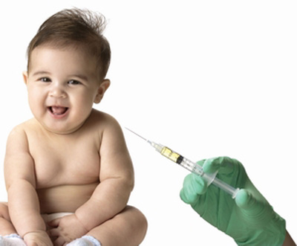
ROUTINE SCHEDULE NG BAKUNA: Kada araw ng ikatlong Miyerkules (3rd Wednesday) ng buwan ang nakatakdang araw ng bakuna sa lahat ng mga Barangay Health Stations (BHS) sa buong Pilipinas. May mga BHS na iba ang araw kung ang Rural Health Midwife ay nakatalaga sa higit sa isang BHS.

Slide 8
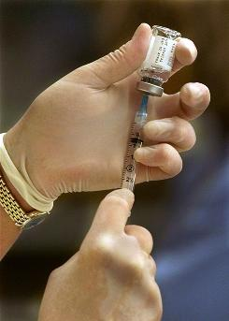
KAHALAGAHAN NG PAGBABAKUNA SA MGA SANGGOL Ang pagbabakuna ay nagbibigay ng proteksyon sa mga sanggol laban sa mga sumusunod na nakakahawang sakit:
Diphtheria
Pertussis
Measles
Hepatitis B
Tetanus
Tuberculosis
Polio
Mumps
Rubella

Slide 9
TETANUS TOXOID IMMUNIZATION
Ang babaeng buntis ay babakunahan ng Tetanus Toxoid Immunization upang hindi siya magkaroon ng tetanus at ang sanggol niya, ng neonatal tetanus.
TT1 - ibabakuna sa pinakamaagang stage ng pagbubuntis
TT2 - ibabakuna apat na linggo pagkatapos ng TT1; nagbibigay ng 80% proteksyon; ang sanggol ay protektado at ang ina ay may tatlong taong proteksyon

Slide 10
TETANUS TOXOID IMMUNIZATION
TT3 - ibabakuna anim na buwan pagkatapos ng TT2; nagbibigay ng 85% proteksyon; ang sanggol ay protektado at ang ina ay may limang taong proteksyon
TT4 - ibabakuna isang taon pagkatapos ng TT3; nagbibigay ng 99% proteksyon; ang sanggol ay protektado at ang ina ay may sampung taong proteksyon
TT5 - ibabakuna isang taon pagkatapos ng TT4; nagbibigay ng 99% proteksyon; ang ina ay may habambuhay na proteksyon at ang lahat ng sanggol na manggagaling sa kanya ay protektado

Slide 11
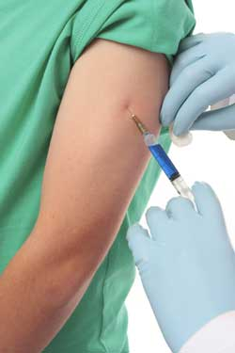
Sa unang pagbubuntis, dapat na magpabakuna ng unang tetanus dose sa ika-lima hanggang
ika-anim na buwan ng
pagbubuntis.
Ang susunod na bakuna ay
makalipas ang isang buwan.

Slide 12
TETANUS TOXOID IMMUNIZATION SCHEDULE FOR WOMEN
Vaccine | Minimun Age/Interval | Duration of Protection
TT1 | At 5th or 6th month of pregnancy | No protection will be given as yet to both mother and infant
TT2 | At least 4 weeks after TT1 | Infants born to the mother will be protected from neonatal tetanus Gives 3 years protection for the mother
TT3 | At the 5th to 6th month of succeeding pregnancy regardless of interval from previous pregnancy | Infants born to the mother will be protected from neonatal tetanus Gives 5 years protection for the mother
TT4 | At the 5th to 6th month of succeeding pregnancy regardless of interval | Infants born to the mother will be protected from neonatal tetanus Gives 10 years protection for the mother
TT5 | At the 5th 0r 6th month of succeeding pregnancy regardless of interval | Gives lifetime protection for the mother All infants born to that mother will be protected

Slide 13
POINTERS ON IMMUNIZATION: 1.Every child deserves to be given the benefits of immunization protection based on PD 996 immunization law. September 16, 1976 . 2.No vaccine gives 100% protection. They go hand in hand with good hygiene and other measures for disease prevention. 3.Recommended series of immunization must be completed for adequate protection. 4.Interruption of schedule does not interfere with final immunity nor does it necessitate contraindication to vaccination. 5.Malnutrition, minor respiratory infections, moderate fever, cough and diarrhea do not constitute contraindications to vaccinations. 6.Measles and OPV vaccines are most sensitive to heat. They must be strictly maintained at 5 – 20 C.

Slide 14
7.The absolute contraindications to immunization are : a.DPT2 or DPT3 to a child who has had convulsion or shock with in 3 days the previous dose. b.Live weakened vaccine like BCG must not be given to individual who are immunocompromised due to malignant disease. 8.Vaccines are safe and effective with mild side effects after vaccination. 9. No extra doses must be given to child/mother who missed a dose. 10.Giving doses of a vaccine at less than 4 weeks interval may lessen the anti body response. Lengthening the interval leads to higher antibody levels. 11`.Practice FEFO first expiry first out rule, and 1 syringe one needle one child policy must strictly implemented.

Slide 15
ROLE OF THE BHWS IN IMPROVING IMMUNIZATION COVERAGE
The BHWs has a big participation and involvement in improving the immunization coverage. They are the Their role as community organizer, health educator and provider can help inform more people of the importance of the immunization program.
1. They are the front liners who convince and encourage parents to have their children vaccinated and disseminate to their community information regarding immunization schedules, special programs on immunization like GP and Ligtas Tigdas.

Slide 16
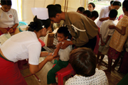
ROLE OF THE BHWS IN IMPROVING IMMUNIZATION COVERAGE
2. During the immunization day itself, they are always on hand to assist in getting the infants’ height and weight, checking records, master listing, and guide the clients on what to expect and what to do before and after the immunization, respectively.

Slide 17
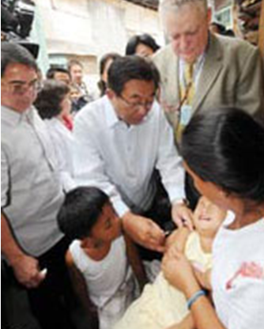
Our country is committed to eradicating polio, reducing cases of measles and eventually of deaths, as well as eliminating tetanus among newborns.
Our country is committed to eradicating polio, reducing cases of measles and eventually of deaths, as well as eliminating tetanus among newborns.

Slide 18
Special campaigns have been undertaken to improve further program implementation, notably the National Immunization Days (NID), Knock Out Polio (KOP) and Garantisadong Pambata (GP) since 1993 to 2000. The latest of these being the Measles Rubella Supplemental Immunization Activity held last April to May of this year. This is being supported by increasing/ sustaining the routine immunization and improved surveillance system.

Slide 19
TANDAAN PO NATING LAHAT-
ANG BAKUNA AY KARAPATAN NG BAWAT BATANG PILIPINO!
Maraming Salamat!

