Slide 1
BASIC TRAINING FOR BARANGAY HEALTH WORKERS
Calasiao, Pangasinan
FAMILY PLANNING

Slide 2
It is common knowledge that Family Planning (FP) has challenging issues regarding the wide gap between:
the knowledge and practice of FP and
knowledge about the method and services offered

Slide 3
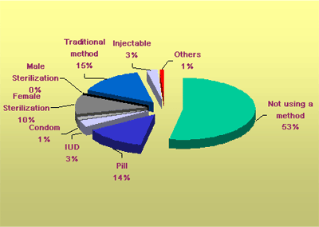
To meet the FP needs of married couples of reproductive ages (MCRAs), the BHWs should actively participate in the dissemination of information. It is necessary to develop the skills of the BHWs to provide appropriate information regarding FP.

Slide 4
Family planning is:
Having the number of children based on the couple’s belief, health and economic situation.
Spacing births properly.
Making sure pregnancies occur only during the right time in a mother’s life.
Helping childless couples have children

Slide 5
BENEFITS OF FAMILY PLANNING (FP)
1. For the Mothers
It delays pregnancy until the mother is ready to have another baby.
It provides a mother who may be suffering from some chronic illness (e.g. TB, diabetes, anemia, etc.) enough time for treatment and recovery.
It prevents young mothers (below 18 years old) and old mothers (above 35 years old) from getting pregnant because it is dangerous at their age.

Slide 6
It gives her enough time and opportunity to love and provide proper care and attention both to her husband and children.
It gives more time for herself, her family and her community.

Slide 7
2. For the Children
It can result to a healthy mother
who can in turn produce healthy children
It can provide a happy home filled with love and attention
It will give time and opportunity for parents to attend to the growth and development of the children.
It will allow more opportunities
for adequate food, clothing
good education and other needs.

Slide 8
3. For the Fathers:
It enables him to give his children a good education and a better home
It gives time for his own advancement
It enables him to give his family a happy and contented life.
It frees a jobless
father from worry
of having an
additional child
to support.

Slide 9
4. For the Family:
It gives the family members more opportunities to enjoy each other’s company with love and affection.
It enables the family to have a home savings for the improvement of their standard of living and for emergencies.

Slide 10
METHODS OF FAMILY PLANNING
There are two basic methods in family planning. first is the natural method and the second is the artificial method.
A. Natural Family Planning (NFP) refers to a variety of methods used to plan or prevent pregnancy, based on identifying the woman's fertile days. For all natural methods, avoiding unprotected intercourse during the fertile days is what prevents pregnancy. Natural methods are also known as fertility awareness-based methods.

Slide 13
Basal Body Temperature (BBT)
Women using the Basal Body Temperature (BBT) Method identify their fertility by observing their body temperature each morning before beginning any activity. The body temperature is lower before ovulation and rises slightly to about .2 degrees Celsius after ovulation.
Couples who wish to avoid a pregnancy abstain from intercourse from the onset of menses until three days after the woman's basal body temperature has risen, to about .2 degrees Celsius or .4 degrees Fahrenheit, signifying the end of the fertile phase

Slide 14
Cervical Mucus Method
The Cervical Mucus Method, also call the Ovulation Method, is based on understanding and interpreting changing cervical secretions that are produced at the neck of the uterus (cervix). At the time of greatest fertility, these secretions become clear, stretchy, slippery and wet.
Couples who wish to avoid pregnancy abstain from intercourse from the onset of cervical mucus symptom until three days after the last day of fertile-type secretions

Slide 15
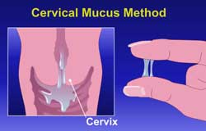

Slide 16
Symptothermal Method
The Symptothermal Method involves observing changes in the cervical secretions, along with changes in the basal body temperature, and the position and feel of the opening of the cervix. Other fertility signs such as mid-cycle pain or bleeding may accompany ovulation.
Couples who wish to avoid pregnancy abstain from intercourse during the fertile period identified by all of the fertility indicators

Slide 18
Lactational Amenorrhea Method (LAM)
The LAM is based on scientific evidence that a woman is not fertile and unlikely to become pregnant during full lactation or exclusive breastfeeding. Full lactation describes breastfeeding when no regular supplemental feeding of any type is given (not even water) and the infant is feeding both day and night with little separation from the mother.
LAM provides maximum protection as long as:
Menstruation has not resumed and
Bottle feeds or regular food supplements are not introduced and
Baby is less than 6 months of age.

Slide 19
The Standard Days Method
The Standard Days Method (SDM) is a simple fertility awareness-based method. It relies on a "standard rule" or a fixed "window" of fertility that makes it easy for women to know when they are likely to become pregnant.
The fact that it involves no calculation or observation makes the SDM easy for service providers to teach and for women to learn and use. To avoid pregnancy, a woman with cycles between 26 and 32 days long should not have unprotected intercourse on cycle days 8 through 19.

Slide 20
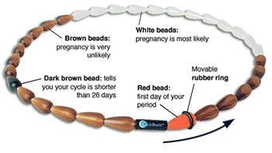
The Standard Days Method
A color-coded string of beads, called Cycle Beads™, are used to help women keep track of the days of their menstrual cycle.

Slide 21
Misconceptions on Natural Family Planning:
1. Rumor: Only women with regular cycle may use Natural Family Planning.
Fact: Where NFP is concerned, there is no such thing as a “regular” or “irregular” menstrual cycle. Every woman is different and every cycle is different. What is important is that signs and symptoms indicating fertility or infertility are observed, recorded and interpreted daily.

Slide 22
2. Rumor: A woman will get pregnant only if she has intercourse on the 14th day (or any other definite day) of her menstrual cycle.
Fact: Menstrual cycles vary from one woman to another and from one cycle to another. The time of fertility (or days when a woman can get pregnant) cannot be accurately predicted from one cycle to the next. A couple using NFP can determine whether the woman is fertile or not by observing, recording and interpreting signs and symptoms of fertility daily.

Slide 23
3. Rumor: I can no longer get pregnant because I am already a grandmother.
Fact: A physically healthy woman who is ovulating and menstruating and has not yet reached menopause can still get pregnant.

Slide 25
METHODS OF FAMILY PLANNING
B. Artificial Family Planning Methods refers to a variety of methods used also to plan or prevent pregnancy but are not dependent on a woman's fertile days categorized as:
1. Barrier methods of birth control physically stop the sperm from getting to the egg.
Condoms, the sponge,
diaphragms and
spermicides are all
barrier methods.

Slide 26
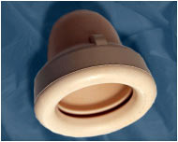
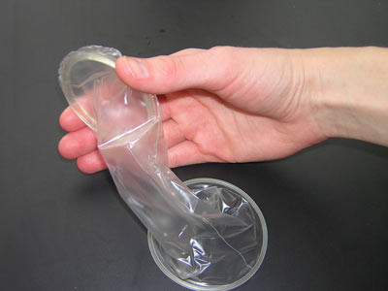
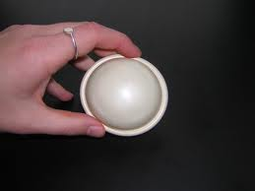
The Different Barrier Methods
Cervical Cap
Male Condom
Spermicide
Female Condom
Diaphragm

Slide 28
B. Artificial Family Planning Methods
2. Hormonal Methods work by altering the woman's hormones to make pregnancy unlikely or impossible. The birth control pill, the birth control shot (Depo-Provera), the birth control patch, the vaginal ring and some IUDs are examples of hormonal family planning options. Hormonal birth control is very effective when used correctly, but some women cannot use them for health reasons

Slide 29
ORAL PILLS

Slide 30
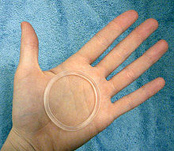
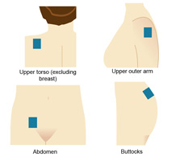
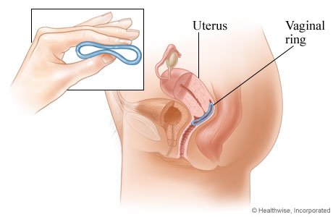
Birth Control Patch Vaginal Ring

Slide 31
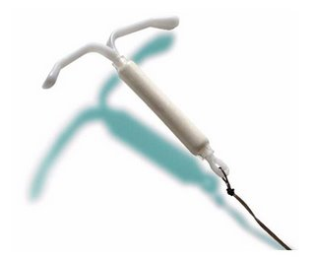
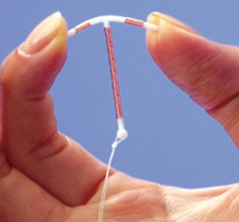
The Different Intrauterine Devices
IUS
Hormonal Levonorgestrel-Releasing IUD
Tcu 380A

Slide 32
B. Artificial Family Planning Methods
3. Permanent Methods -Surgical birth control or Sterilization is considered permanent, and is only for people who do not want any or any more children. Men can have a vasectomy, which is a procedure that is done on an outpatient basis in a doctor's office. Women can have a tubal ligation, which is done under general anesthesia in a hospital.

Slide 35
THANK YOU!

