Slide 1
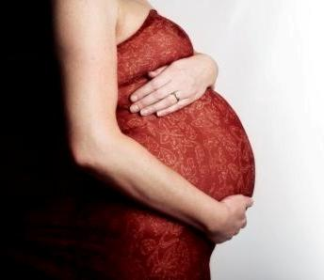
BASIC TRAINING FOR BARANGAY HEALTH WORKERS
Calasiao, Pangasinan
CARE DURING PREGNANCY

Slide 2
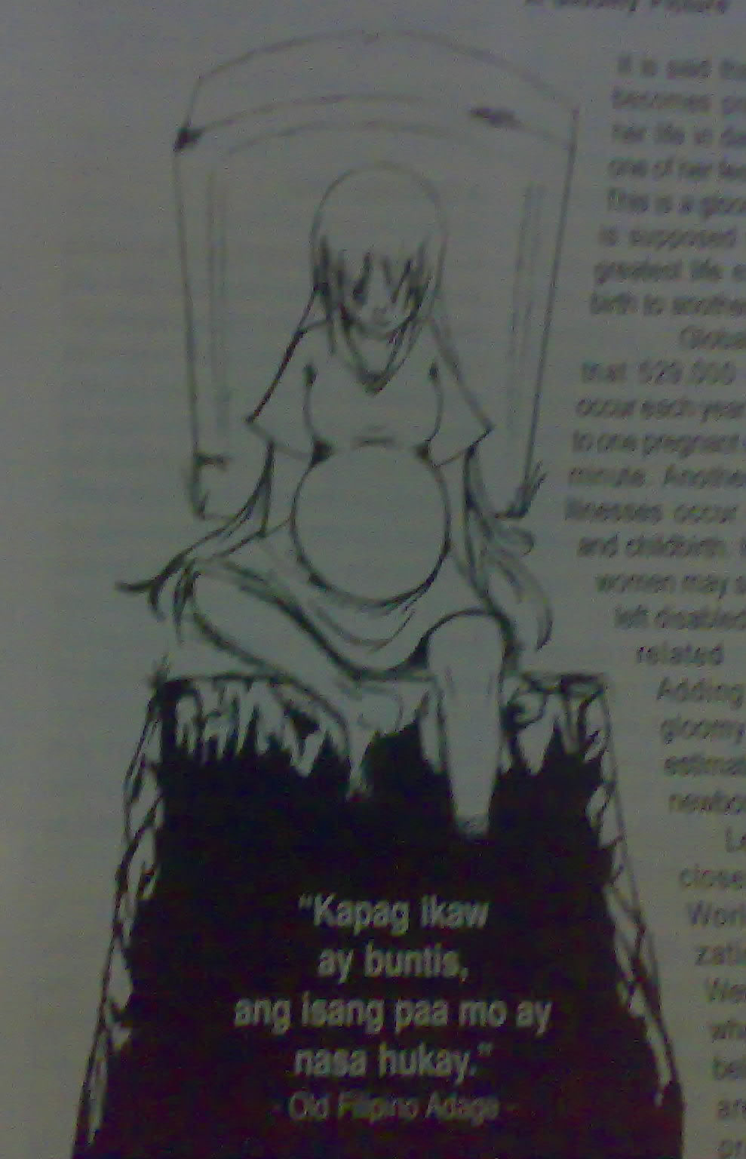
-
Notes:
Kapag

Slide 3
Program Goal:
Improve the health status of women especially the poor and contribute to the achievement of the Millennium Development Goal which is the reduction of the Maternal Mortality Rate by 75% by 2015.

Slide 4
A gloomy picture . . . . .
It is said that when a woman becomes pregnant, she puts her life in danger – like putting one of her feet to the grave…

Slide 5
In most cases, the first health-oriented person to get in contact with a pregnant woman in the community is the BHW. When a woman is pregnant, she needs to keep herself healthy in order to have a healthy baby.
Good prenatal care will result in the proper monitoring of the progress of the pregnancy. It checks the health condition of the mother and baby as they undergo changes that take place from conception to the time the mother goes into labor.
Another purpose of prenatal care is to detect early problems that may arise so that these can be acted upon on time.

Slide 6
The BHW should know the ff:
A. Early Signs of Pregnancy
B. Making a List of Pregnant Women
C. Health Tips for Pregnant Women
D. High Risk Pregnancy
E. Follow-up Visits
F. Preparations for Labor and
Delivery

Slide 7
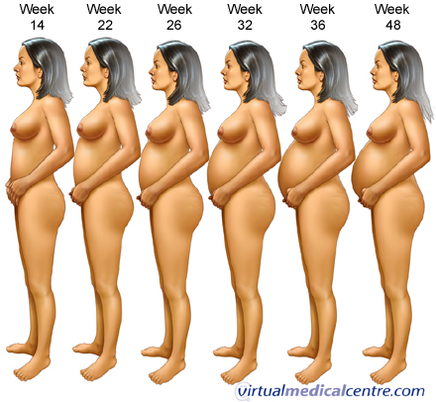
A. Early Signs of Pregnancy
Menstruation stops
Nausea and vomiting
Frequent urination
Feeling lazy and sleepy
Feeling dizzy
Enlargement of the breasts

Slide 8
B. Making a List of Pregnant Women
A good list should have the ff. items:
Name
Address
Age
Number of pregnancies
Date of last delivery
Date of last menstrual period

Slide 9
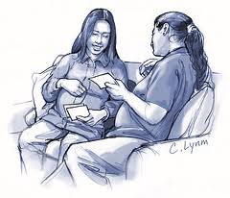
Once you have a list of pregnant women in your community, where do you put or keep the list?
The ideal thing is to get a big notebook where you can record the names of all the people in your
community (number of households), their ages (date to birth), and other information about them. For pregnant women, you should have those information cited above.

Slide 10
1. Proper Nutrition
C. Health Tips for Pregnant Women
We have said that one of the early signs of pregnancy is nausea and vomiting.
What do you think happens to the nutritional status of a woman if she is vomiting? What should be done to counteract this?

Slide 11
We have to advise these women to eat crackers as soon as they wake up and take it in small amounts. Hard candies and biscuits are also advisable and should be taken as frequently as possible. This way, nutritional losses are replaced and the feeling of nausea and vomiting will disappear. They may also take sips of lukewarm soup.

Slide 12
How long does this period last?
During the second half of the pregnancy she will no longer be vomiting and her appetite will soon come back.
What foods should you advise her to take?
They should be taking a lot of vegetables, fruits, milk and food rich in iron such as fish, malunggay, kangkong or other green, leafy vegetables

Slide 13
2. Personal Cleanliness
A pregnant woman should practice personal cleanliness.
What do you think are the reasons for her to wash her genitals?
The most important reason is that it will help prevent infection not only for the mother but also for the baby in her womb.

Slide 14
3. Tetanus Toxoid immunization
What are the most common causes of death among newborn infants?
Tetanus in the newborn. Tetanus can start from unclean instruments used during cord cutting and improper cord treatment.

Slide 15
Tetanus in the newborn can be prevented by giving Tetanus Toxoid (TT) injections to the mother. However, one injection is not enough. At least 2 injections given one month apart will protect the baby.
When a mother has received a total of 5 injections, all the babies that she will deliver should have been protected. The TT injections also protect the mother from tetanus.

Slide 16
4. Preparation for breastfeeding
There are many things to remember about breastfeeding. BHWs should focus and always remember the benefits of breastfeeding to the mother.
Benefits of Breastfeeding to Mothers:
When the baby is immediately allowed to suck on the breast right after delivery, the mother’s chances of bleeding after delivery are considerably reduced. This is because sucking the breast will stimulate contraction of the uterus.

Slide 17
Exclusive breastfeeding during the first 6 months will delay the next pregnancy.
It is convenient in terms of not having to prepare a bottle. All she has to do is to give her breast and the baby is fed. The mother can also sleep while feeding.

Slide 18
5. Schedule of prenatal check-ups
A pregnant woman needs to start prenatal visits during the first 3 month of pregnancy because:
It is during this time that the different parts of the baby’s body is forming, and the mother needs the appropriate health information and guidance.

Slide 19
Information gathered during this time will be the basis for her follow-up visits particularly for high risk cases.
These are the direct obstetrical complications:
- Hemorrhage
- Prolonged / obstructed labor
- PP sepsis
- Complications of abortion
- Pre-eclampsia/eclampsia
- Ectopic pregnancy
- Ruptured Uterus

Slide 20
6. Danger signs of Pregnancy
There are signs during pregnancy that will help indicate whether a pregnant woman should immediately consult a midwife or other high level of health workers for proper care.

Slide 21
The danger signs of pregnancy are:
Vaginal bleeding – no matter how little, if it occurs anytime during pregnancy
Puffiness of the face and hands
Headache, dizziness, blurring of vision
Hypertension – when the bloods pressure rises to 140/90 and above
Signs of labor before the 9th month of pregnancy
Breaking of bag of water
Abdominal pains/ contractions

Slide 22
EMERGENCY SIGNS
Unconcious/Convulsing
Vaginal Bleeding
Severe abdominal pain
Looks very ill
Severe headache with visual disturbance
Severe difficulty of breathing
Fever
Severe vomiting

Slide 23
7. Spacing the next pregnancy
It is good to start advising pregnant women to space their next pregnancy. Ideally, there should be at least a 2 year gap between pregnancies.

Slide 24
D. High Risk Pregnancy
Certain conditions predispose a woman to be a risk during pregnancy. These are:
Age less than 18 or greater than 35
First or 4th and more pregnancy
Pregnant within 15 months from the previous delivery
Pale or with severe anemia

Slide 25
OR, simply…
- too young (below 20 yrs. old)
- too old (above 35 yrs. old)
- too many children (more than 4)
- too soon (birth-spacing of less than 3 yrs
- too sickly (with chronic illness as HPN, Diabetes,TB etc)

Slide 26
If the pregnant woman has any of these conditions listed in the
Home-Based Mother’s Record,
she should be closely monitored and referred. She will probably need to deliver her baby in the hospital.

Slide 27
Why do women die ?
- complications related to pregnancy occurring during :
* labor
* delivery &
* puerperium
- HPN complicating pregnancy, child-birth and cesarean section, pre-eclampsia /eclampsia, hemorrhage, miscarriages or stillbirths.

Slide 28
Post Partum (PP) Hemorrhage cases are mostly due to uterine atony & placental separation
Other hemorrhages are due to pregnancy with abortive outcomes and Hemorrhage related to pregnancy (i.e. ectopic pregnancy and placenta previa, etc)

Slide 29
Now, with a shift in a new standard, all pregnancies are considered at risk. There will be no such thing as low-risk pregnancy because most obstetrical complications are not predictable but can be treated if detected early.
There is a shift of focus now in pregnancy to delivery and postpartum. Therefore, readiness is the “key word” accompanied by quality obstetrical care.

Slide 30
E. Follow-up Visits
On the first prenatal check-up, the pregnant woman is given a Home-Based Mother’s Record by the midwife. The BHW should help the midwife and mother in filling-up and interpreting the content of the HBMR and remind them of the date of the next visit.

Slide 31
It is very important for a pregnant woman to have a complete prenatal check-up. For those who fail to show up for her clinic appointment, the BHW should find out why.
Visit her and check the actual condition of the home and environment. Then motivate her to go for her regular check-up at the BHS or health center.

Slide 32
F. Preparations for Labor and Delivery
The mother prepares for the ff:
1. Things needed by the mother
duster with opening in front
sterile or ironed soft cloth/sanitary napkins

Slide 33
2. Things needed for the newborn
Clean ironed baby’s clothes
Clean ironed baby’s blanket
Clean ironed diapers
2 big safety pins
Clean ironed soft cloth

Slide 34
It is the best for the family to know and be prepared for the expected expenses. They should also be prepared for the possibility of transporting the mother to the hospital when needed.
Members of the family should also prepare for the coming of a new member. This new member of the family needs love and nurturing.

Slide 35
Reasons why there are mothers die giving birth what experts classified as the THREE DELAYS:
Delay in deciding to seek medical care
Delay in reaching appropriate care, and
Delay in receiving care at health facilities

Slide 36
1. Delay in deciding to seek medical care
Failure to recognize danger signs
Absence of skilled attendants
Lack of money to pay for medical expenses and cost of transportation
Pregnancy is unplanned or unwanted
Poor quality of obstetrical care

Slide 37
1. Delay in deciding to seek medical care
Fear of being ill-treated in the health facility
Lack of encouragement from relatives and community members to seek care
No available person to take care of the children, the home and livestock
Lack of companion in going to the health facility
Reluctance from the mother or the family due to cultural constraints
Notes:
The delay in deciding to seek care usually stems from failure to recognize the danger signs by both the midwife and mother.

Slide 38
2. Delay in identifying and reaching the appropriate facility
Distance from a woman’s home to a facility or provider
Lack of roads or poor condition of roads
Lack of emergency transportation whether by land or water
Lack of awareness of existing services

Slide 39
2. Delay in identifying and reaching the appropriate facility
Lack of referral system
Lack of communication with referral facility
Lack of moral, financial and logistical support from neighbors, the barangay captain and barangay officials or the mayor
Notes:
This delay relates to the issue of access of care

Slide 40
3. Delay in receiving appropriate and adequate care at the facility
Lack of healthcare personnel
Unprofessional attitudes of health care providers
Shortages of supplies
Lack of basic equipment
Poor skills of health care providers
Health is not prioritized by the barangay and municipal officials
Lack of budget from the LGU
Notes:
This delay relates to the issue of access of care

Slide 41
Safe Motherhood

Slide 42
What a Pregnant woman must have:
A Birth Plan with the readiness to respond to any complications
PHILHEALTH membership and is able to avail of the benefits accordingly
Saved/ allotted money to prepare for her childbirth and services that the newborn will be availing
Plans for desired Family Planning (FP) services (spacing or limiting methods)

Slide 43
Birth Plan Form
(Lifted from the Mother and Child Book)
I know that any complication can develop during delivery. I know that I should deliver my baby in a health facility.
I will be attended at delivery by _______________________________________
Name of doctor/nurse/midwife or others, specify.
I plan to deliver at __________________________________________________
Name of hospital/health center/clinic
This is a Philhealth accredited facility ___________Yes ___________ No
The estimated cost of the maternity package in this facility is P ______________. (Inclusive of newborn care)
The mode of payment is ____________________________________________.
The available transport is ___________________________________________.
I have contacted _____________________ to bring me to the hospital/maternity
Name
clinic/health center.
I will be accompanied by ____________________________________________.
Name
_______________________________will take care of my children/home while I
Name
am in the health facility.
In case of a need for blood transfusion, my possible donors are:
________________________________________________________________
Name Address
________________________________________________________________
Name Address
________________________________________________________________
Name Address
In case of complications, I will be referred right away to:
Contact person: ___________________________________________________
Address: _________________________________________________________

Slide 44
THANK YOU!!!

