Slide 1
BASIC TRAINING FOR BARANGAY HEALTH WORKERS
Calasiao, Pangasinan
NUTRITION FOR CHILDREN

Slide 2
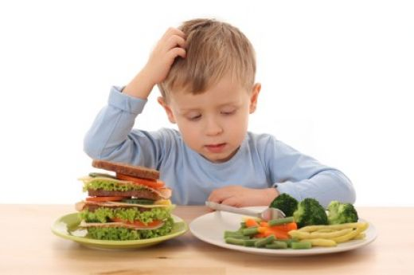
Proper nutrition is necessary for health attainment and maintenance, optimal growth and development of individuals particularly among the vulnerable groups: children (infants, pre-schoolers) and women.
Nutrition for pregnant and lactating women should always be emphasized to ensure good nutrition during these periods.

Slide 3
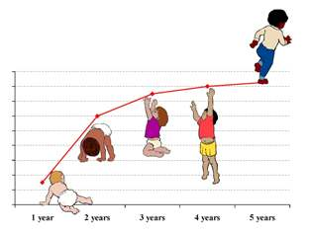
A. IMPORTANCE OF NUTRITION FOR CHILDREN
A child grows and develops more rapidly during the first year of life than at any other time. On the average, a baby should double his weight by the fifth to sixth month and triple it by the end of his first year. This rapid growth of bones, muscles and tissues can take place only if
the baby is getting enough
of the right kinds of food.

Slide 4
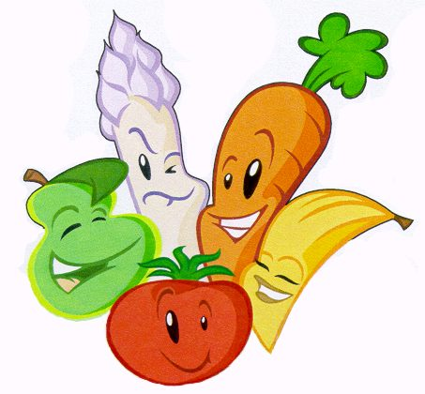
To be more specific, nutrition is important because:
It helps in the development of the brain, especially during the first year of the
child’s life;
It speeds up the growth and
development of the body
including the formation of
teeth and bones;
It helps fights infections and diseases;
It speeds up the recovery of a sick child; and
It provides the child more energy.

Slide 5
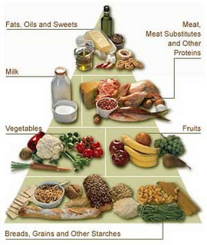
B. BASIC FOOD GROUPS
Classification
Functions
Nutrients
Food Sources

Slide 6
B. BASIC FOOD GROUPS
Classification:
The 3 basic food groups are:
1. Energy foods (energy-giving) :
Carbohydrates : wheat, rice, corn, etc. Fats or lipids
2. Body-building foods:
Proteins : soy, meat, poultry, seafood.
3. Protective (regulating) foods :-
Vitamins & Minerals : All fruits and vegetables as well as dairy products

Slide 7
Classification | Functions | Nutrients | Food Sources
Body-building or GROW foods | Help build & repair body tissues Develop body resistance to infections Supply additional energy | Protein | Fish, pork, chicken, beef, milk, cheese, butter, kidney, beans, mongo, peanuts, bean, curd, shrimp, clams
Body- Regulating or GLOW foods | Normal development of the eyes, skin, hair, bones and teeth Increase protection against diseases | Vitamins A & C Minerals: Iodine Iron | Tiesa, ripe papaya, mongo, guava, yellow corn, banana, orange, squash, carrot
Energy- giving or GO foods | Provides enough energy to make the body strong | Carbohydrates fats | Rice, corn, bread, cassava, sweet potato, banana, sugar cane, honey, lard, cooking oil, coconut milk, margarine, butter

Slide 8
The Basic Food Group is a food pattern to help you select the right kind of food everyday. It is also a guide in planning, selecting and preparing meals for the family. It is also called the GROW, GLOW and GO foods.

Slide 9
Guide in meal planning
Rice with sinigang na karne is a one-dish-meal. Look at the ingredients and let us see which food groups they belong:
meat
Sitaw
Kangkong
Gabi
Rice
One-dish-meals are nutritious and are cheaper than buying or preparing separated meals and vegetable dishes, especially with a limited food budget.
body-building food
body-regulating food
body-regulating food
energy-giving food
energy-giving food

Slide 10
1. What is complementary feeding?
C. COMPLEMENTARY FOODS FOR INFANTS
Complementary feedings means giving other foods in addition to breast milk.
These other foods are called complementary foods.
Additional foods and liquids are called complementary foods, as they are additional or complementary to breastfeeding, rather than adequate on their own as the diet.
It must be nutritious foods and in adequate amounts so the child can continue to grow.

Slide 11
Complementary foods are given:
by age 6 months;
in addition to breast milk; and
for the increased nutritional demand of a growing child.
Breastfeeding, however, should continue for as long as two years.
Starting other foods in addition to breast milk at
SIX COMPLETED MONTHS
helps a child to grow well.

Slide 12
At six completed months of age, it becomes easier to feed thick porridge, puree and mashed food because babies:
Show interest in other people eating and reach for food
Like to put things in their mouth
Can control their tongue better to move food around their mouth
Start to make up and down “munching” movements with their jaws.
In addition, at this age, babies’ digestive system are mature enough to begin to digest a range of foods.

Slide 13
Risks to Starting Complementary Foods TOO EARLY
Adding complementary foods too soon (before six months)
Take the place of breast milk, making it difficult to meet the child’s nutritional needs
Result in a diet that is low in nutrients if thin, watery soups and porridge are used because these are easy for babies to eat.
Increase the risk of illness because less of the protective factors in breast milk are consumed

Slide 14
Risks to Starting Complementary Foods TOO EARLY
Increase the diarrhea because the complementary foods may not be as clean or easy to digest as breast milk
Increase the wheezing and other allergic conditions because the baby cannot yet digest and absorb non-human protein well
Increase the mother’s risk of another pregnancy if breastfeeding is less frequent

Slide 15
Risks to starting Complementary Food TOO LATE
Starting complementary foods TOO LATE is also risk because:
The child does not receive the extra food nutrient required to meet his/her growing needs
The child grows and develop slower
Might not receive the nutrients to avoid malnutrition and deficiencies such as anemia from lack of iron.
Most babies do not need complementary foods before sic completed months of age

Slide 16
MILK CODE AO 51 IRR of 198
No advertising of breastmilk substitute and other products to the public
No free samples to mothers
No promotion in the health service
No company personnel to advise mothers
No gifts or personal samples to health workers.

Slide 17
2. Tips on introducing Complementary Foods for Infants
Introduce the new food before breastfeeding.
Test readiness of the baby by placing a teaspoon with food bet. His/her lips. If he/she closes his/her lips or pushes the teaspoon away, he/she is not ready yet. Do not force him/her to eat.
Start any new food in small amounts and gradually increase the amounts offered within 2 weeks.
Always give one new food at a time.

Slide 18
2. Tips on introducing Complementary Foods for Infants
Give clean water between feedings.
Use cup and teaspoon to feed the baby.
Give mashed, pureed or finely chopped foods
Offer bland foods, not too sweet or salty.
Handle the infants foods properly. Wash your hands with soap and water. Be sure to clean utensils and boil water for drinking. Cook food thoroughly .feed the baby with freshly cooked food. Always peel off all skins from any of the fruits and vegetables you use or cook.

Slide 19
2. Tips on introducing Complementary Foods for Infants
DO NOT OMIT BREASTMILK FROM HIS/HER DAILY MEAL
Divide the recommended amount of foods into 3-4 times a day.
Always be pleasant when feeding the baby.

Slide 20
D. COMMON NUTRITIONAL DEFICIENCIES AFFECTED CHILDREN
Babies and children should eat a variety of foods everyday to get all the nutrients they need. This will prevent the occurrence of nutritional deficiencies particular among infants children.

Slide 21
For Protein-Energy Malnutrition (PEM)
Breastfeed your infant
Bring child to health center for
- weighing (monthly growth monitoring)
-immunization
-vitamin A capsule supplementation
Give complementary foods to infants
Increase the variety of foods to infants
Increase the variety of foods served; add
green leafy and yellow vegetables
gradually
Practice family planning

Slide 22
For Vitamin A Deficiency (VAD)
Continue exclusive breastfeeding
Feed child at least ½ cup of green leafy and yellow vegetables cooked with a little fat or oil everyday.
Grow green leafy and yellow vegetables and fruits in the backyard
Bring child to health center for:
-immunization and
-vitamin A capsule
-immunization

Slide 23
For Iron Deficiency Anemia (IDA)
eat iron-rich food such as green leafy vegetables, liver and other internal organs
bring child to health center for:
-further clinical evaluation and
-iron supplementation
observe personal hygiene and maintain a sanitary environment to prevent parasitic infection

Slide 24
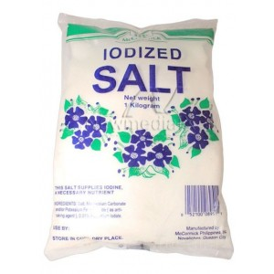
For Iodine Deficiency Disorders (IDD)
Eat food rich in iodine everyday
Use iodized salt everyday

Slide 25
Regular weighing of a child below 5 years of age is important as it:
Accurately measures the weight gain of the child;
Alerts parents and health workers if there is growth faltering;
Allows parents to take immediate action to prevent illness and malnutrition; and
Facilitates providing
comprehensive health care
for the child.

Slide 26
New GP Communication Package:

Slide 28
Remember all children below 5 years of age should have a growth chart and should be weighed regularly. This way, mothers can monitor if their children are gaining weight properly.
THANK YOU!

